Slide 1
Sheepdog Defense Group (SDG)
Senior Design Project
2018 - 2019
Notes:
Hello everyone. We are team Sheepdog and this year our client for senior design was Sheepdog Defense Group

Slide 2
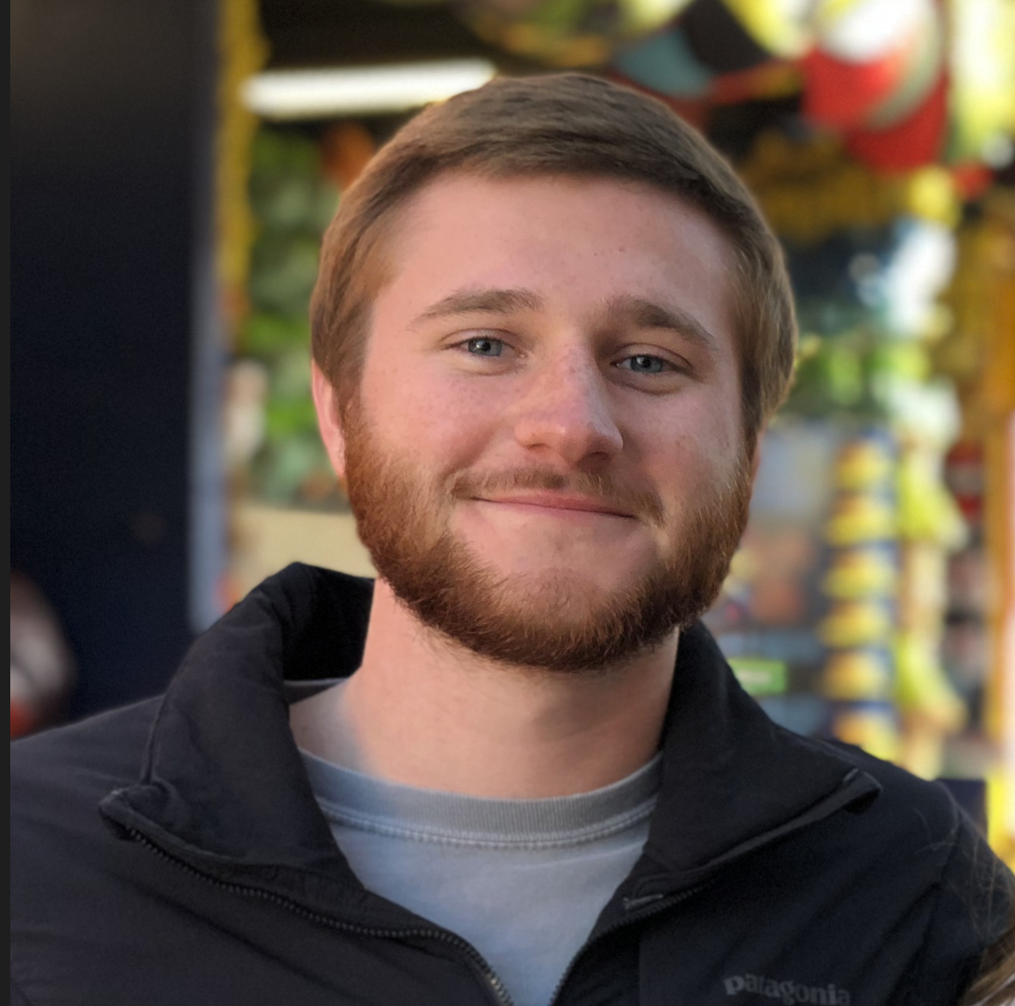
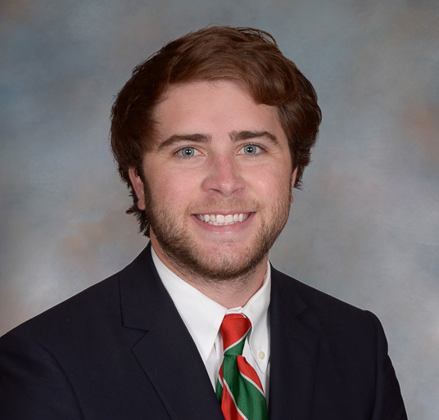
Our Team
Hayden Southworth
Tek Ghimire
John
Hodnett
Muoi Pham
Phong Nguyen
CITE
COSC

Slide 3
Overview
What is a Sheepdog?
Problems and Solutions
Development Plan
Demo’s
Technology Overview
Challenges
Future Plan
Acknowledgements
Notes:
Just a quick overview of what we’re going to be talking about today
First we’re going to talk about what it means to be a sheep dog and what Sheepdog Defense Group is about
Then we’re going to talk about the problems our clinet experienced with his old site and the goals and solutions we came up with for the new one
Then we’ll talk about how we broke up those goals into different iterations
Followed by some demos of the main features of the site
Then we’ll go over the technology we used, some challenges that we faced, our future plan, and lastly some asknowledgements

Slide 4
Philosophy
Sheep
Sheepdogs
Wolves
Notes:
So, what does it mean to be a sheepdog?
Sheepdog Defense Group operates under the philosophy that there are 3 types of people in the world
First, there are the sheep. And these are everyday people like us who just want to go through life and live in peace
Then there are the wolves. These are the people in the world who wish to cause harm to others
And third, there are the sheepdogs. These are the people who will stand up to the wolves and protect the sheep from any harm that may come

Slide 5
Rise in Religious Attacks
2 Fatal Church Shootings in 2017 First Baptist Sutherland Springs Texas is Tied for Worst Security is Still Not a Priority
Notes:
Why is there a need for sheepdogs?
In 2017, there were two fatal church shootings in the state of Texas
One of them was at First Baptist Southerland Springs church, where 26 people lost their lives and is the worst church shooting in the history of the US
Texas is tied with Georgia for having the most church shootings since 1999
Despite this rise in violence, Churches across the US still do not take the necessary steps to help protect their community

Slide 6
Our Client
David Riggall — Owner, Manager, and Trainer
Police officer for 14+ years
Shooting and hand-to-hand combat trained
Created SDG to help train people how to protect themselves and their communities
Notes:
This is something that David Riggall and Sheepdog Defense Group hope they can change.
David has been a police officer for over 14+
And during that time has received extensive firearms and hand to hand combat training
He and his team at sheepdog use their training to teach others how to better protect themselves

Slide 7
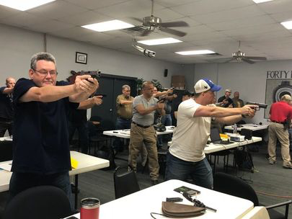
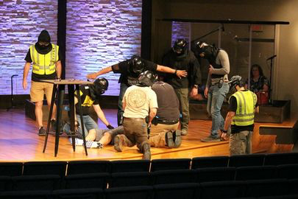
The Business
2 Types of Services
Civilian Classes Consulting
Notes:
Sheepdog Defense Group offers two types of services
The first are the civilian classes. These are for anyone who is looking to learn more or personal protection and includes courses for basic and intermediate firearms, License to Carry, Self-defense and tactical medical training.
For the consulting side, this is where churches contact him to develop safety and evacuation plans as well as to train members of a church to get them certified as level 3 and level 4 security officers under the texas department of public safety standards.

Slide 8
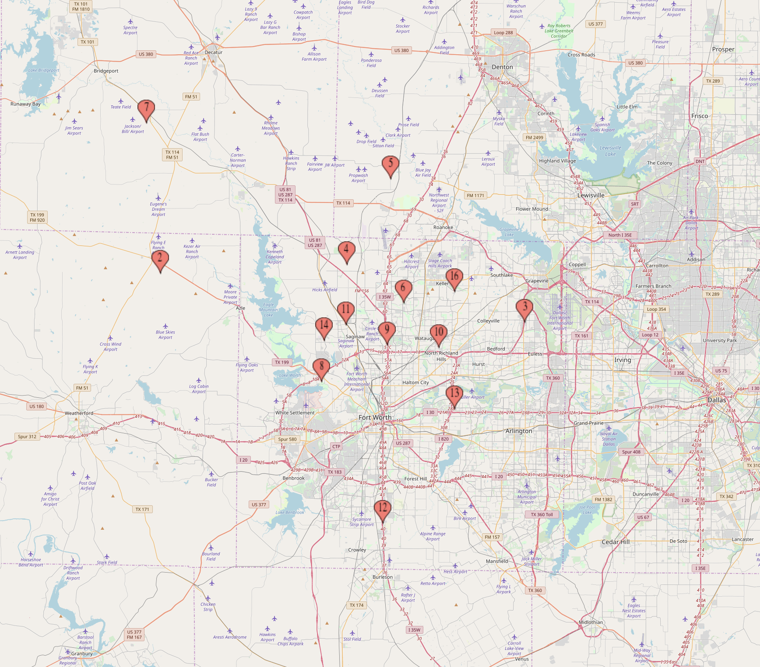
The Business
Fort Worth
Notes:
Currently, Sheepdog Defense group is working with 17 different churches across the state of texas.
Most of which are located in and around Fort Worth, but also has location in Houston and Midland

Slide 9
User Types
Customer
Guard
Administrator
Notes:
Before we get into the problems and solutions I think it’d be a good idea to tell yall a little bit about the different types of users that interact with our site. We have the customers, the ones who will be signing up for classes, requesting consultations, or purchashing merchandise from the shop. And we have the guards, who are church members that are trained and certified. And we have the administrators (such as David) who are the the ones who manage all of the data coming in and out of our site.

Slide 10
Problems & Solutions

Slide 11
Customer
Old Site
New Site
Heavy Use of Email
Classes
Consultations
Merchandise
Website Handles All of That
Notes:
The customers of our old site had to rely heavily on email use for classes, consultations, and merchandise. But now, all of that can be handled from within our new site (This speeds up the whole process and keeps our customers happy).

Slide 12
Guard
Old Site
New Site
No Profile Page
No Access To
Company Info
Church Info
User Profiles
Company Portal
Church Page
Notes:
The guards on the old site had no profile page or access to company and church information. But on our new site we gave them a user profile, a full company portal, as well as a church page (filled with all of the information they would ever need).

Slide 13
Admin
Old Site
New Site
Admin Page?
Heavy Use of Email
Class Sign-Up
Paper Documents
Guards
Customers
Admin Page
Website Manages
User Info
Classes
Consults
Merchandise
Notes:
Administrators on the old site actually had NO admin page and because of that they had to rely heavily on the email (just as the customers did) and stacks of paper documents with important information were being stored by David. But our new site incorporates an admin page and all of the data coming in and out (user info, classes, consults, and merchandise) is handled by our website.

Slide 14
Customer, Guard, and Admin
Old Site
New Site
Substandard UI
Improved UI
Notes:
All across the board, the old site had poor UI/UX work and was designed pretty poorly. But now our site has a completely new and improved look and feel. Take a look at the homepage of Sheepdog Defense Group’s website before we came on board —

Slide 15
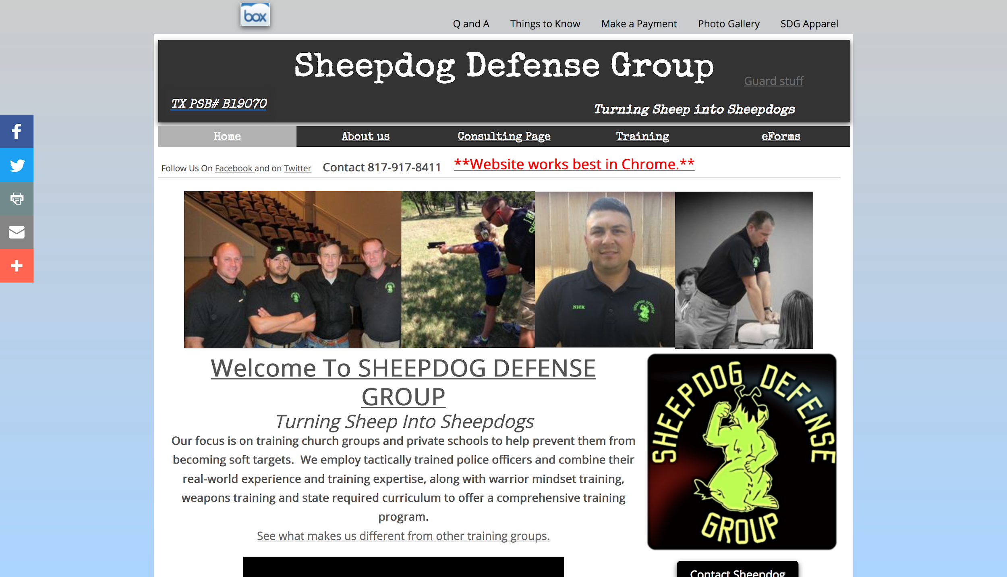
Notes:
It was cluttered, had poor sizing/spacing, lacked features, you couldn’t use it on mobile, and it had browser compatibility issues. You know it’s bad when you have to put in the header, bolded in red, underlined, with a double asterisk — “Website works best in Chrome”. We scrapped it all. Now take a look at our new website —

Slide 16
Notes:
It’s up and running on sheepdogdefensegroup.com. Y’all can go check it out! (After our presentation of course.)
We used an inviting minimalist design. We wanted it to be easy to use. It works with all browsers on desktop or mobile and it’s very responsive.
I think it’s going to do great job engaging more customers which should, in turn, bring in more business.

Slide 17
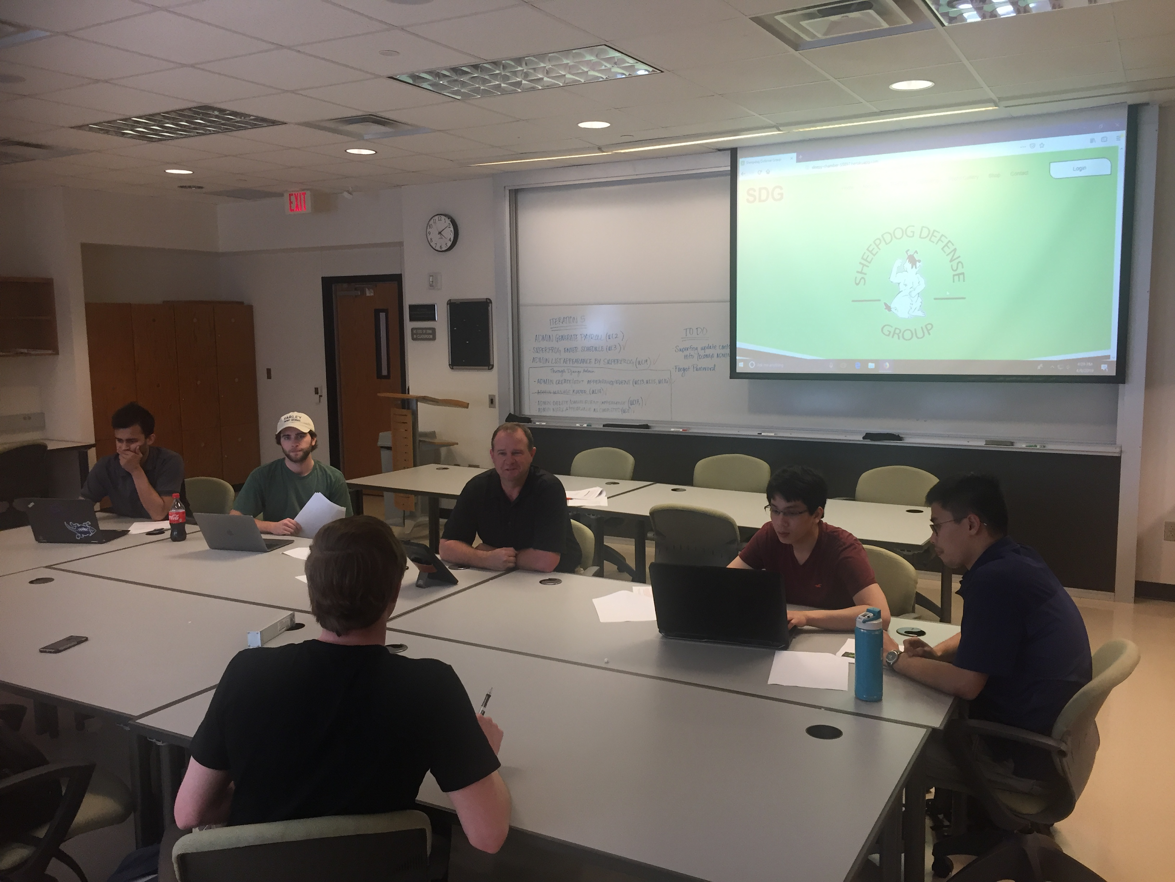
Our Plan
4 Iterations
4 Weeks Each
Client Meetings
Notes:
We planned 4 iterations for this project. Each iteration is 4 week long. We met with our client at the end of each iteration to collect feedback.
Our development is use case driven. A use case is a sequence of interactions between user and the system to complete a certain objective. We worked on different use cases for each iteration.
https://online.officetimeline.com/app/#/file/d1503529-69ea-4e0b-aaa5-bd11f2234984

Slide 18
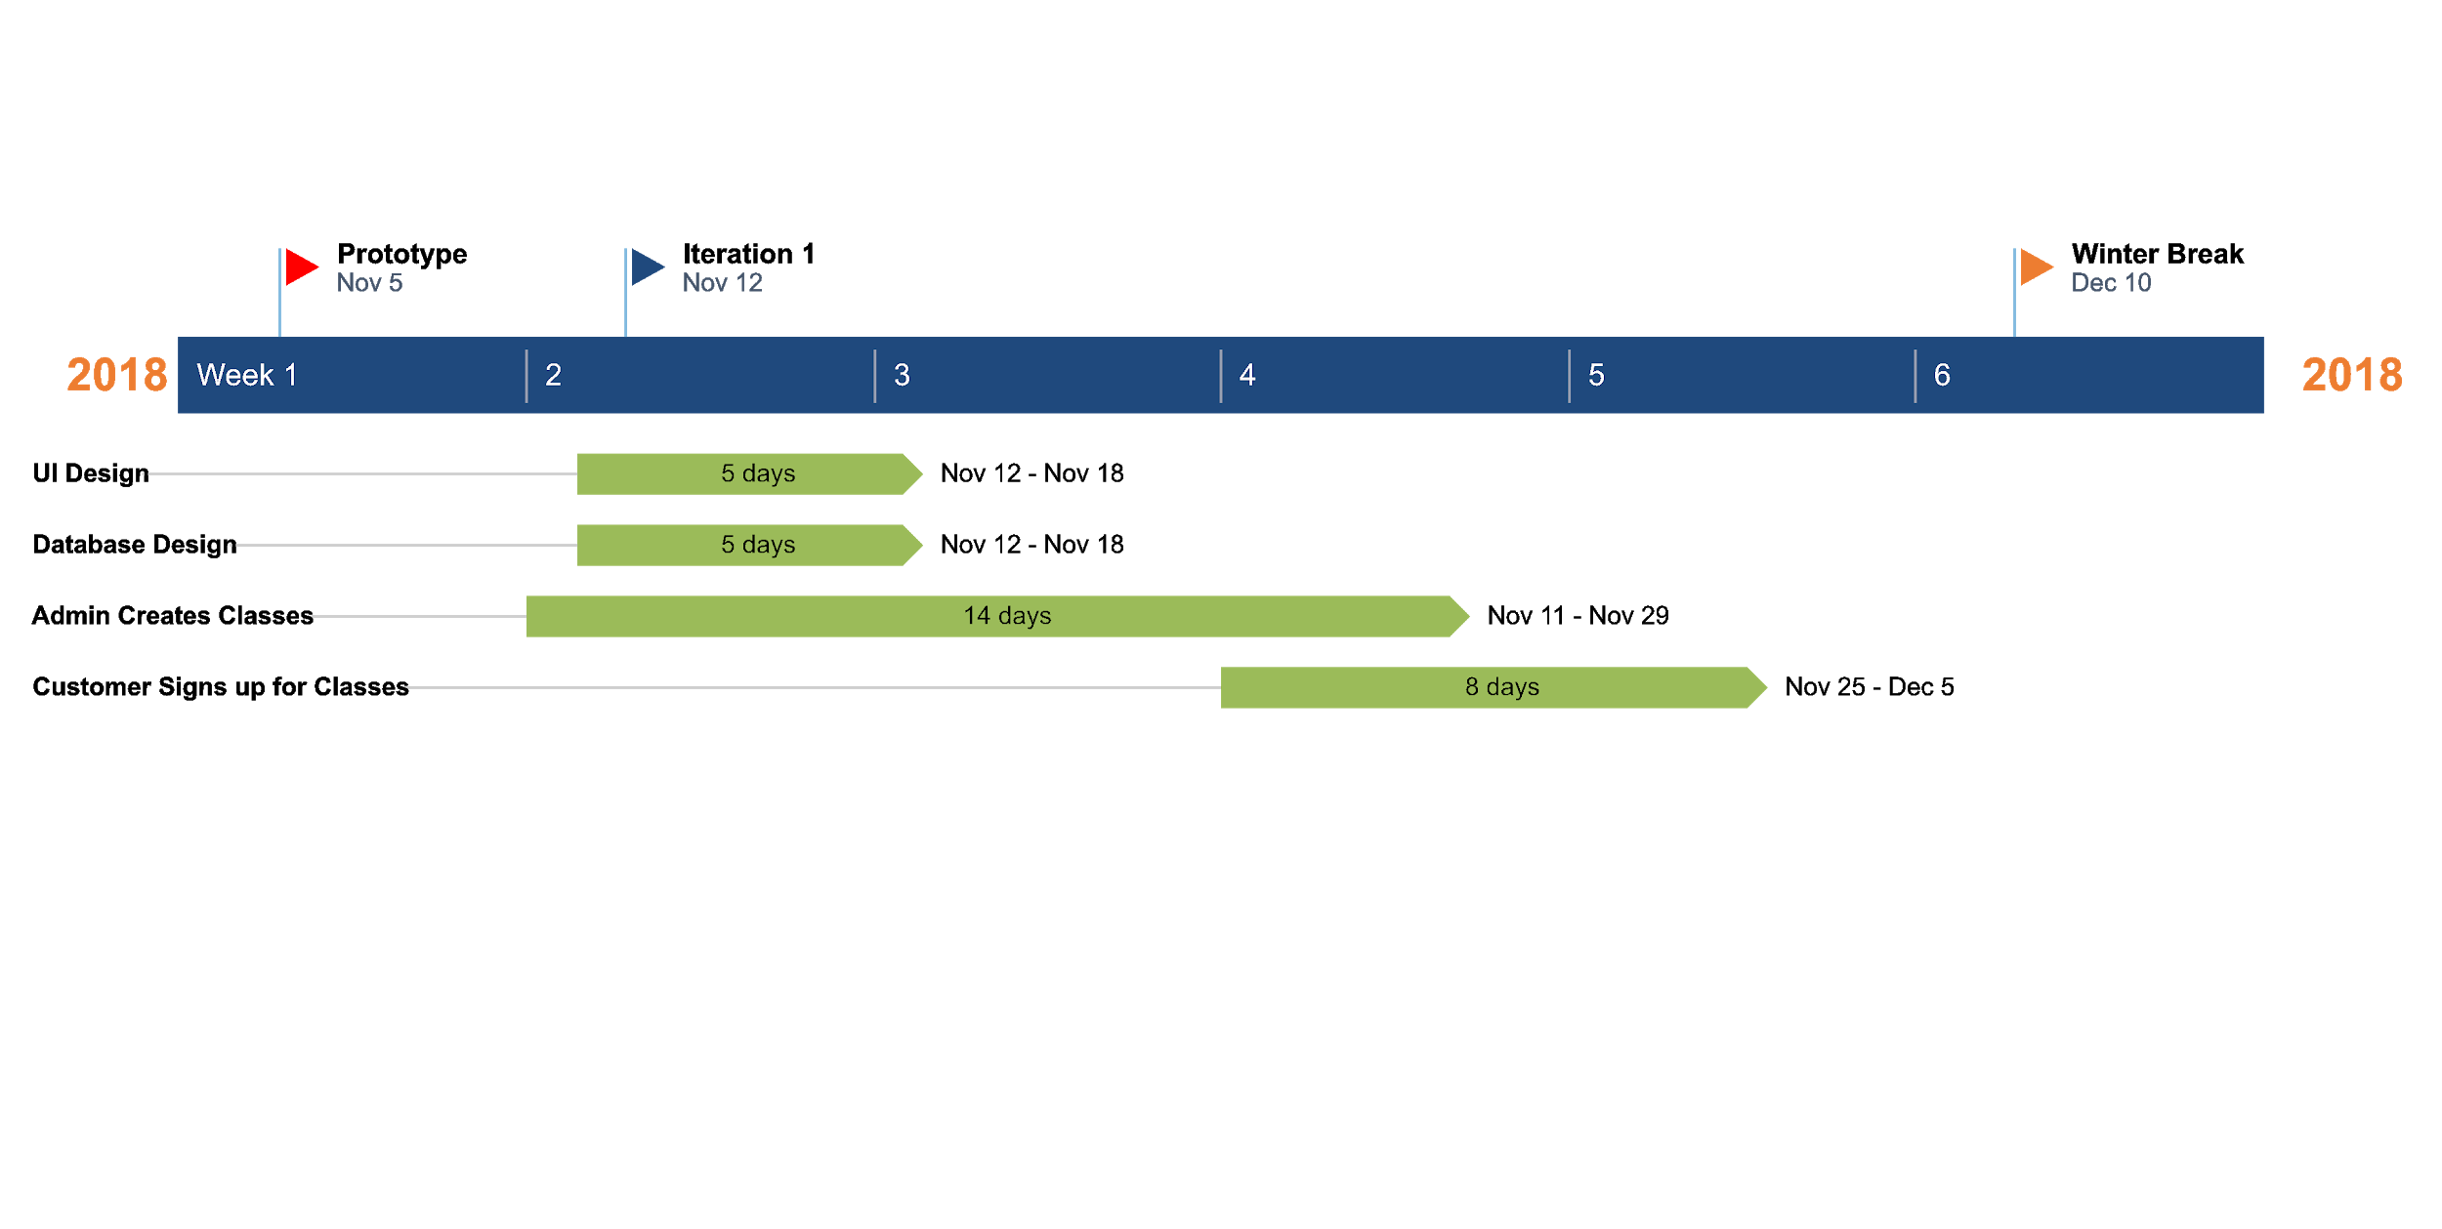
Iteration #1: Nov - Dec 2018
Notes:
Used Google Calendar to display and store classes as calendar events
Embedded calendar doesn’t have a lot of customization
Have to login to Google to send and get data on the calendar (inconvenient)
No payment system
Groundwork for login system
This is our timeline for the first iteration. It started on Nov 12th till Winter Break. We spent 5 days to work on UI and database design.
In this iteration, we worked on 2 most important features of the website, Admin creates class and customer sign up for class.
We use a calendar to display class. Admin creates class as event on the calendar and the customer can choose class to sign up by clicking on calendar event.
There is no payment system yet, however. We also created a login system with premade accounts.

Slide 19
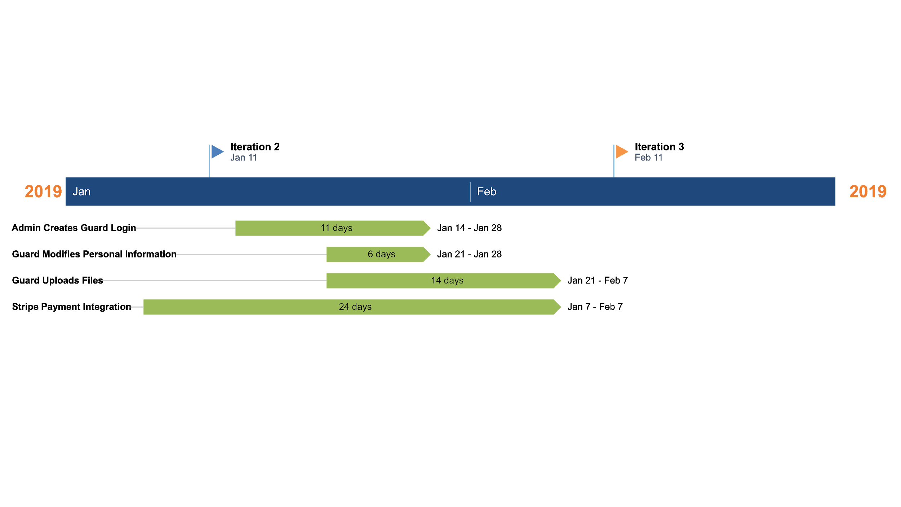
Iteration #2: Jan - Feb 2019
Notes:
Switch from Google calendar to Full calendar, more customization, classes stored in database
Integrate Stripe payment system
Guard can only upload and have 1 document
In iteration 2, we realized Google calendar might not be the best choice as it’s difficult to customize and the Google API library for Ruby is still in alpha and might be changed in the future, which would make it difficult for David to maintain. We switch to Full calendar and it has a lot more customization.
In iteration 2, we implemented payment system. as it was built for developers and is flexible in term of customization. On the other hand, Paypal has less documentation which makes it difficult to implement and maintain. Also, David’s Paypal account got hacked so he’s happy to work with another payment system.
We added the functions for Admin creates account and Guard modifies personal info and upload document functions. The documents and profile picture from the guards are stored on Amazon online storage service.

Slide 20
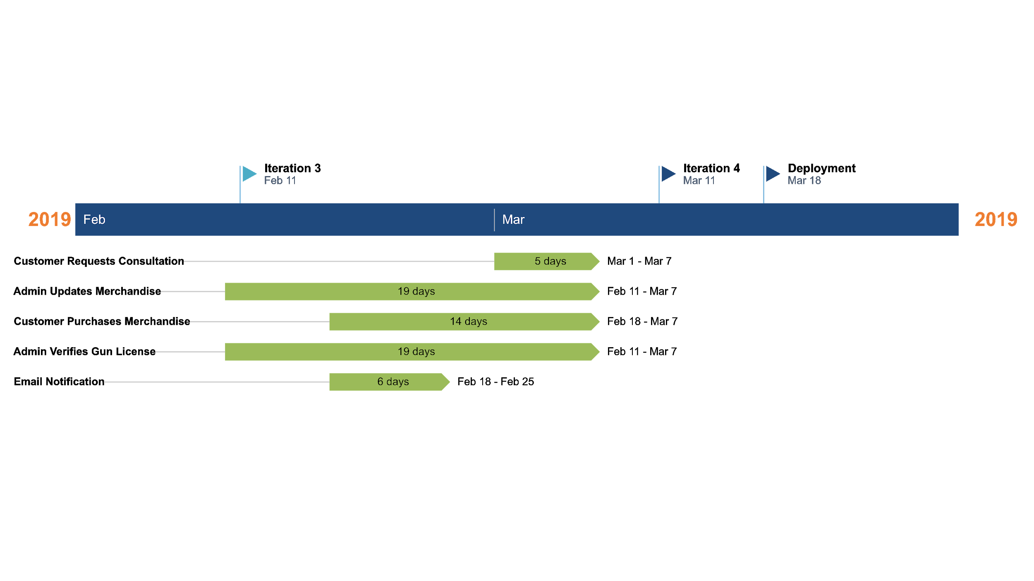
Iteration #3: Feb - Mar 2019
Notes:
Create shopping cart system
The system verifies if the guard has changed their gun license
Client side validation
Using Google email to send emails
In the third iteration, we created a merchandise shop. Admin can add new items that customer can buy. Consultation request form was also added.
One important feature in this iteration is Admin verifies if a Guard has changed their gun license since David will be liable for his guard’s license.
Email notification was implemented.

Slide 21
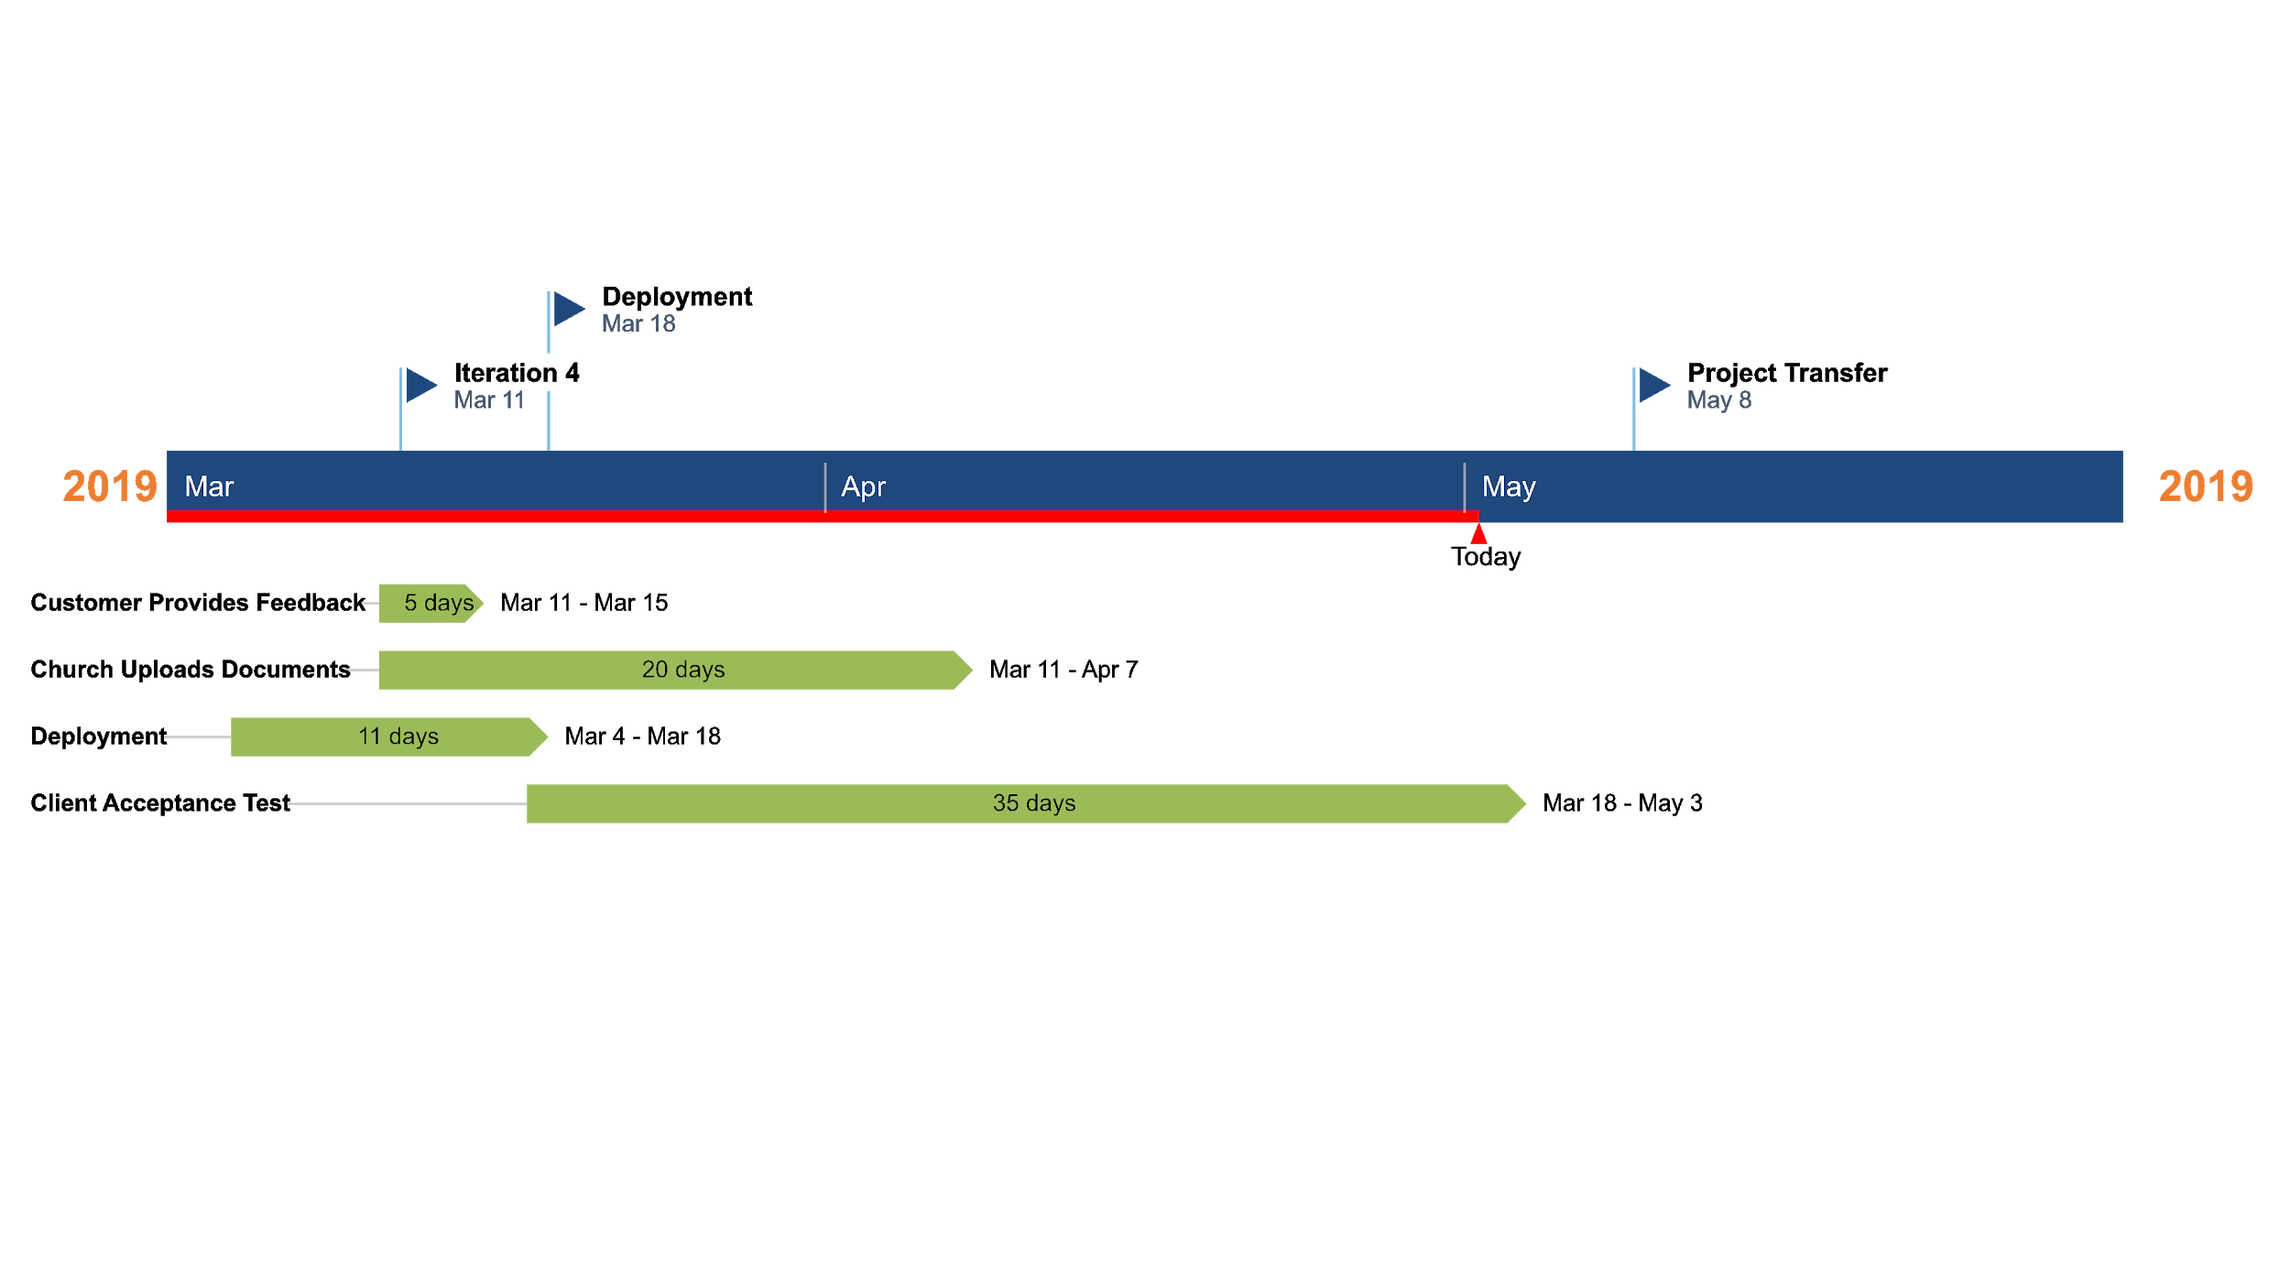
Iteration #4: Mar - Apr 2019
Notes:
Switch from Google email to Sendgrid, more customization and easy to set up. Also works better with heroku server
Guard can upload and have multiple documents.
In the last iteration, we added the function for the church to upload their documents and for the customer to leave feedback.
The website is deployed on Heroku early in this iteration so David can use the website and provide us feedback and things that he wants to change.

Slide 22
Notes:
And now, I will walk you through customer demo for class sign up, consultation request, and merchandise purchase.
This is the landing page. The customer will see Sheepdog Defense Group’s mission statement. Pictures of classes and activity and a video introducing David’s business.
Classes are displayed on the calendar. Customer can click on a class to sign up and fill out their personal information.
We chose Stripe for payment because it’s more development friendly and offers great customization.
For consultation, the customer will only need to fill out a form. These are usually requests from churches that want David’s help to increase their security.
This is the merchandise page. The customer can add one or more merchandises to their shopping cart and checkout when they want. After filling out their info and pay with Stripe, their order will be placed and David will handle the shipping himself.

Slide 23
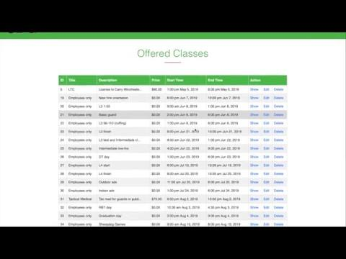
Notes:
This is the Admin page where you can find admin information. There are some buttons as you can see on the screen with different options to view and make necessary changes. I will walk you through some main options in the next few slides. First of all, this is an offered classes page. You can see detailed information of classes, such as the title of it, price and choose further action. If you click to the New Class button, you can add a new class.
The website will pop up a new page to create a new class. Simply fill in required information and hit submit.
You can also view detailed Class Information with the registered customers list
The next option from Admin Page is adding new merchandise. By clicking to that button,you will be directed to this page and fill out information to add a new item.
Another option is viewing the buyer list. This page shows information of buyers and you can take further actions.
This is the churches list with name and address. You can edit or delete church information.
To add a new church, simply fill in the name, address and calendar code. Hit submit when youâ€™re done.
This is consultation list shows information of people who request services from the company.
Admin also can add, view and edit users information on this page.
For example, this is the edit user page where admin can make changes and upload user profile documentation.
To add a new user, admin has to fill out email address, name, and password.

Slide 24
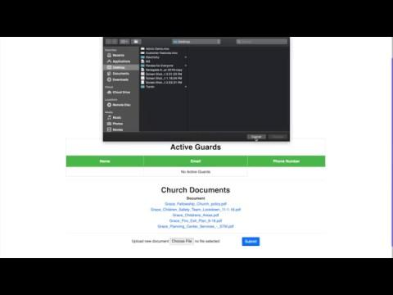
Notes:
-User logins to the system with the username and password given to them by the Admin.
-When they click the login button, they will get the notification alert saying "the portal they are about to enter is private and only reserved for registered guards"
-The guard can modify their information using the edit profile link from the login blocks - they can add documents, address, phone and pictures.
-The guard has access to the church information page. It has the collection of all the churches. They can navigate to a particular church.
-Guard can see all the guard working in this church in the active guard section.
- Guard can view the church documents such as church dress policy, fire exit plan, and emergency evacuation plan.
-The guards also have access to the company portal where they only have read access. They can view and use documents such as an incident report, appropriate use of a firearm and assisting the bomb threat.

Slide 25
Technology Stack

Slide 26
Team Challenges
Different Levels of Experience
Scheduling Conflicts
Off-Site Client

Slide 27
Lessons Learned
Communication is Key

Slide 28
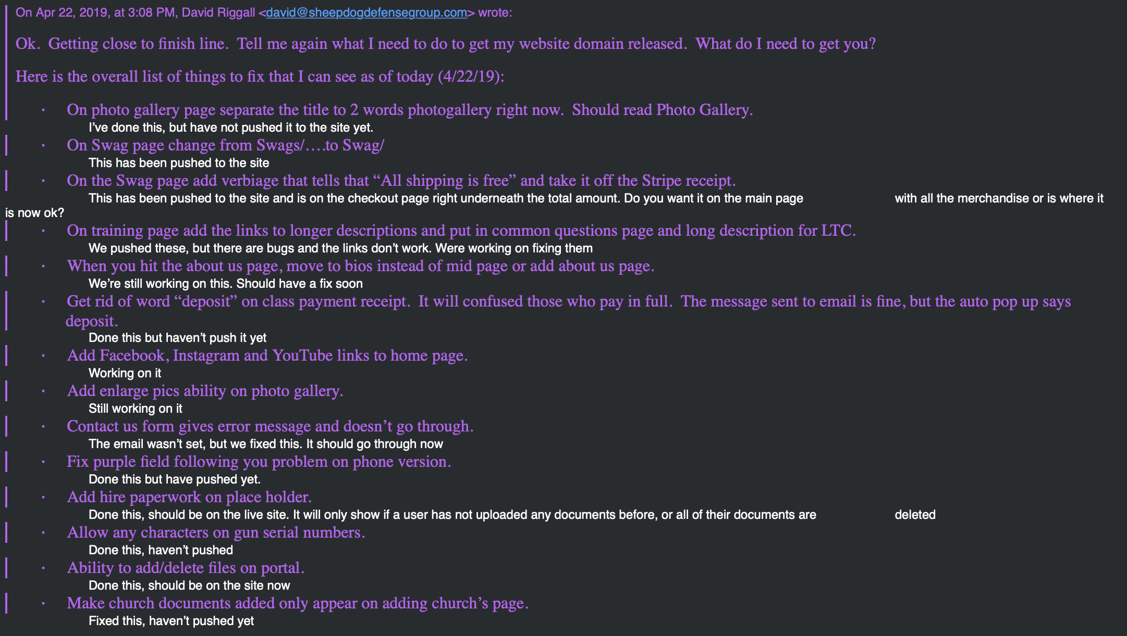

Slide 29
Lessons Learned
Communication is Key
React to Changes
Don’t be Headstrong
Document Early

Slide 30
Release Plan
Performing Client Acceptance Tests
Client has been testing since early April
Transfer of Accounts to Client
Heroku login, AWS S3 account and Stripe login
Update to Official Sheepdog Domain
(www.sheepdogdefensegroup.com)

Slide 31
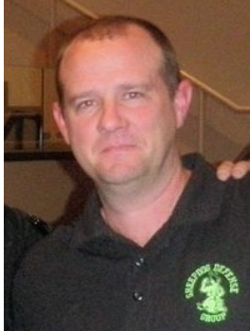
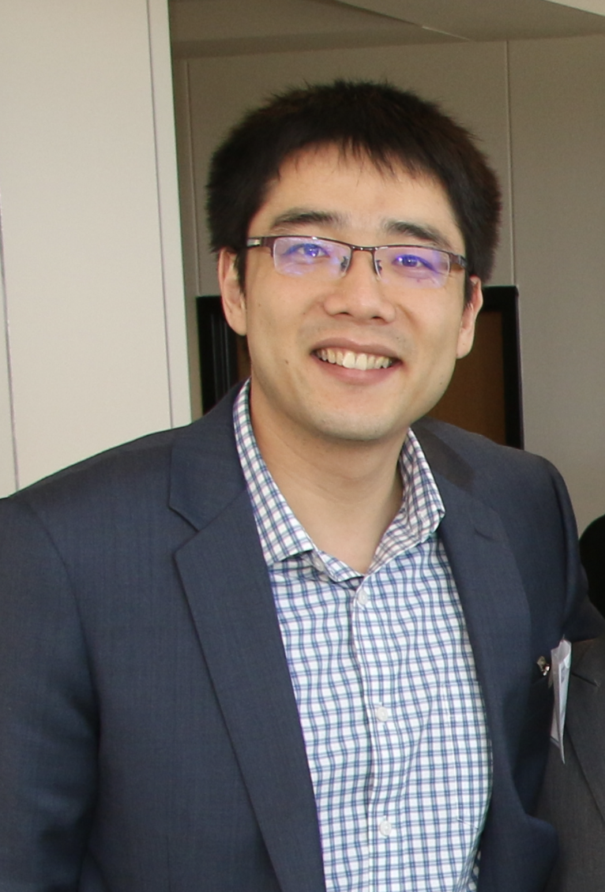
Acknowledgements
The Sheepdog Team would like to thank
David Riggall
And
Dr. Wei

Slide 32
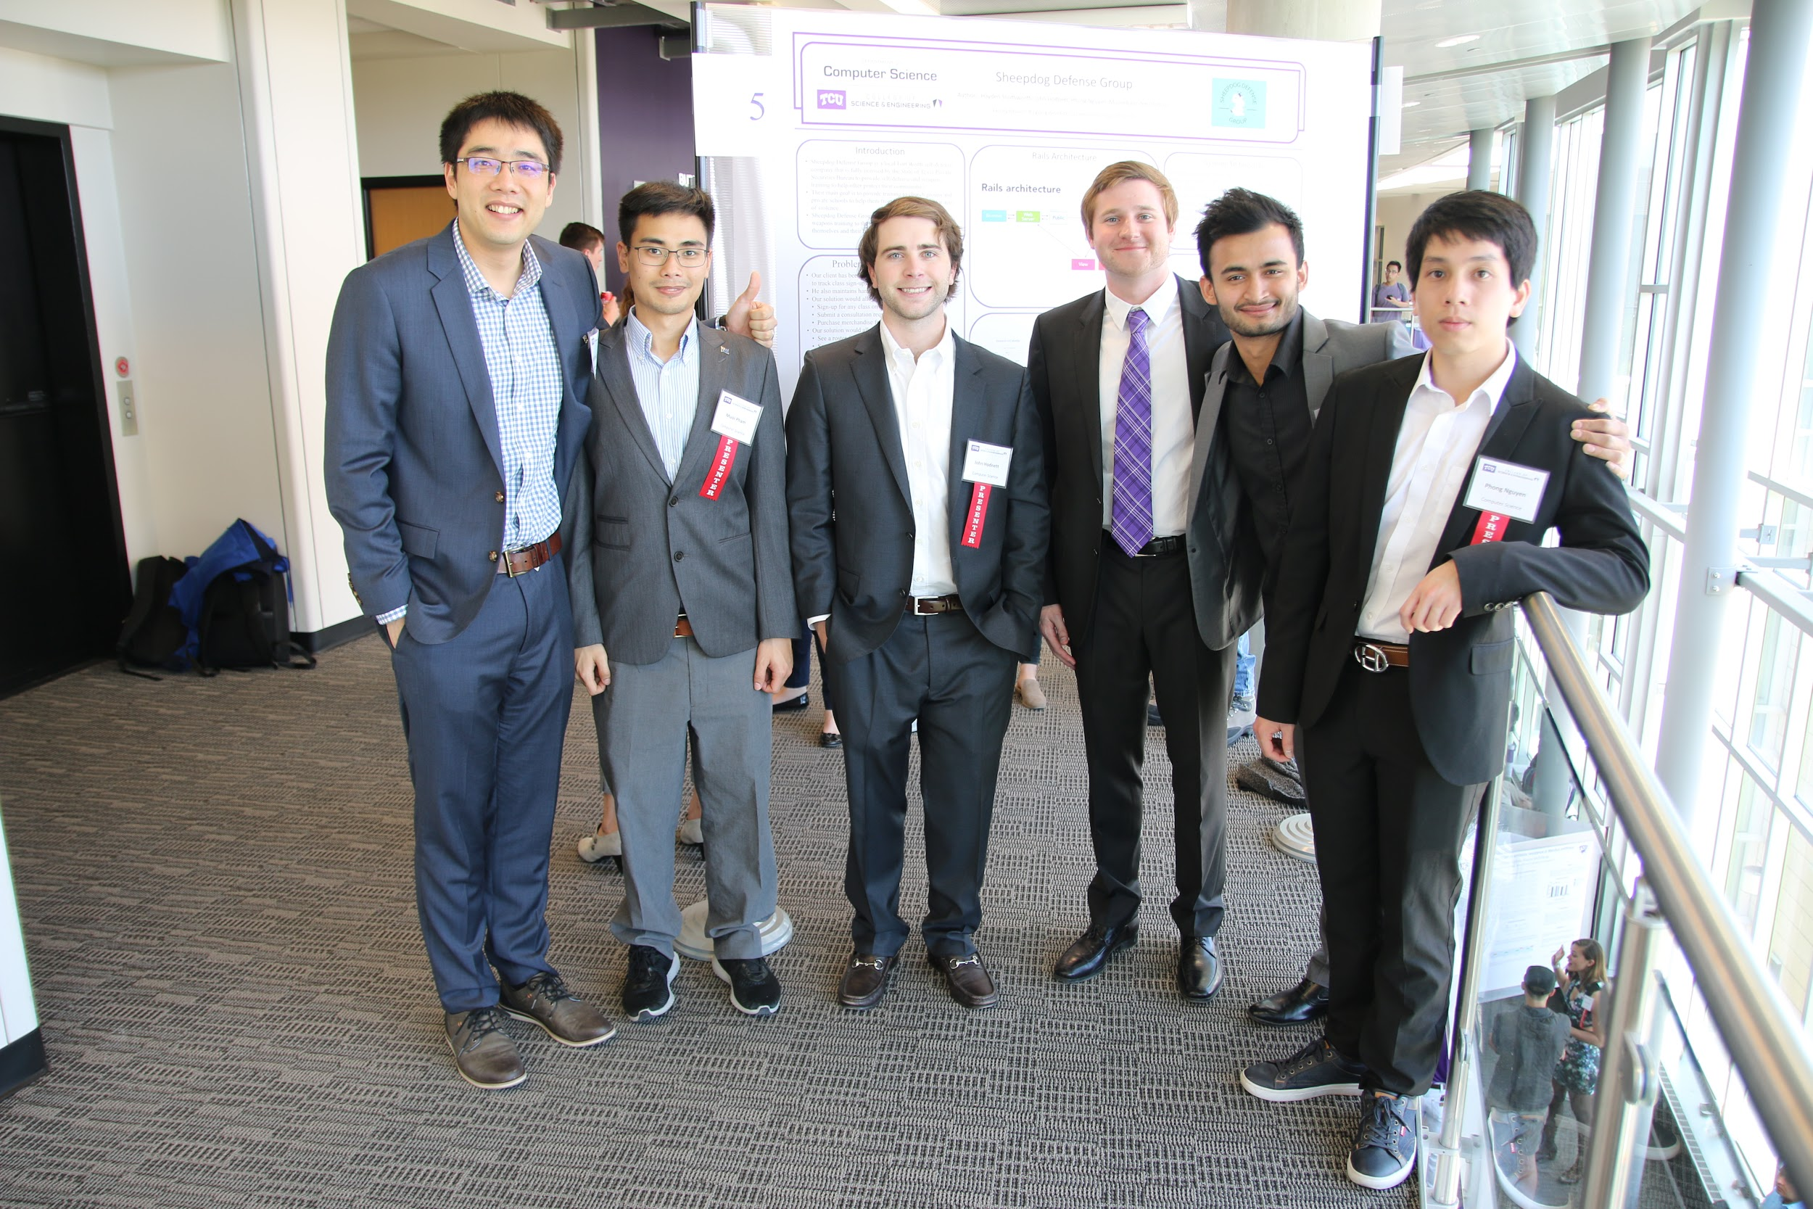
Thanks!

