Slide 1
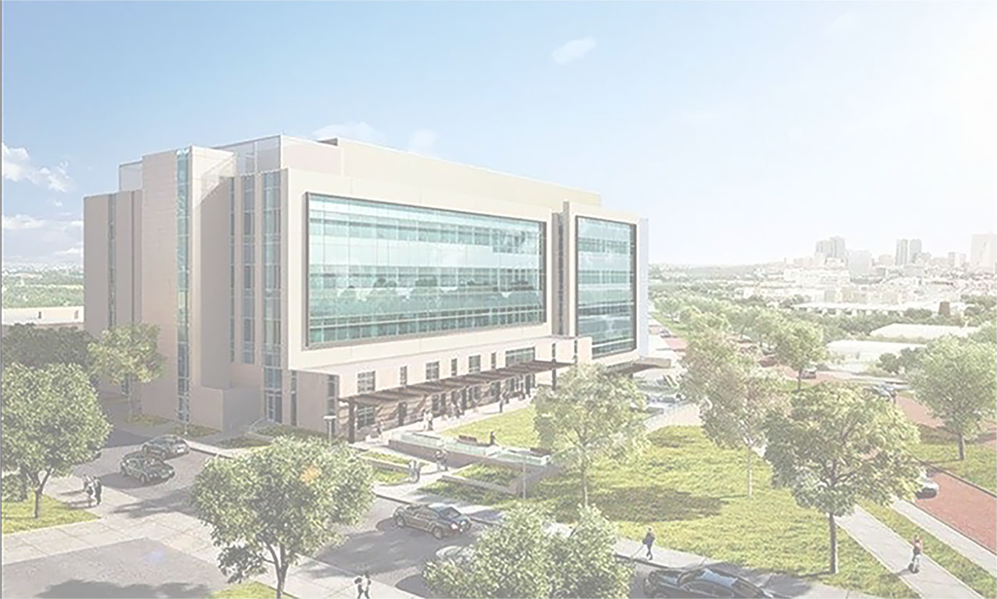
THE LIC SCHEDULING PROGRAM
TCU DEPARTMENT OF COMPUTER SCIENCE
SENIOR CAPSTONE PROJECT
Notes:
Welcome to our senior design capstone project. Today, we will explain the fundamentals behind our project, then dive into the functionality of the application we created, and the conclude with what we have taken away from this project.
Senior capstone project year cs logo
acknowlage dept at end
preview

Slide 2
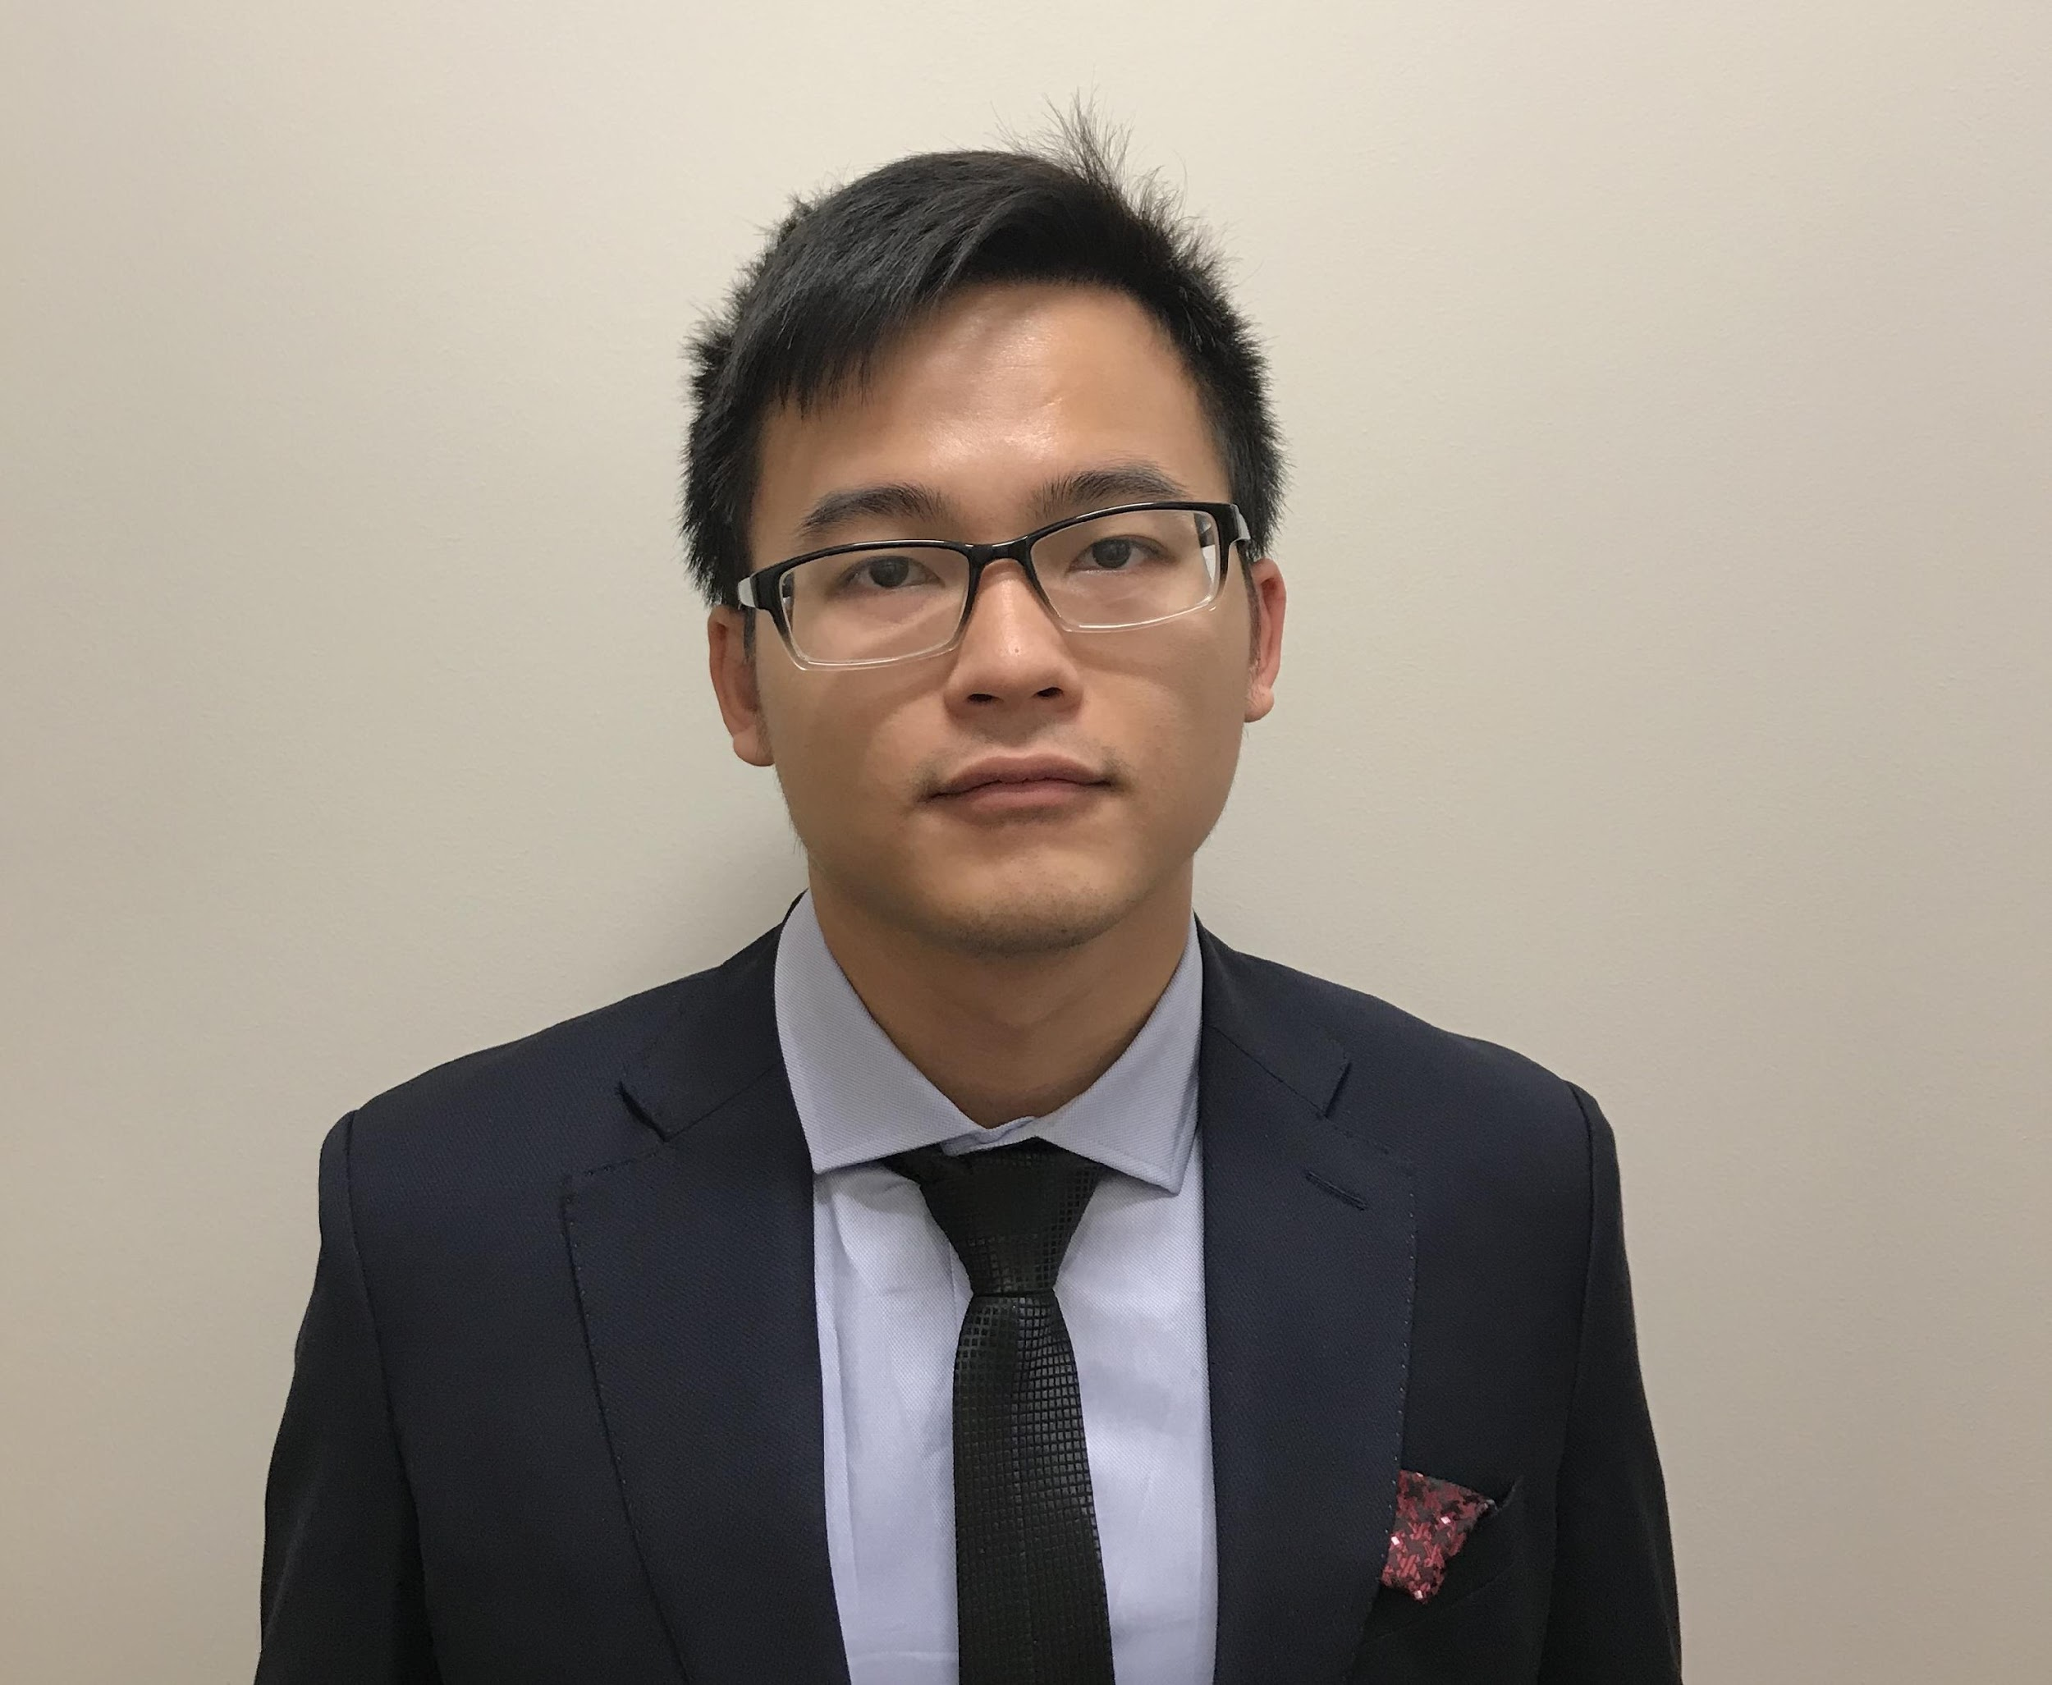
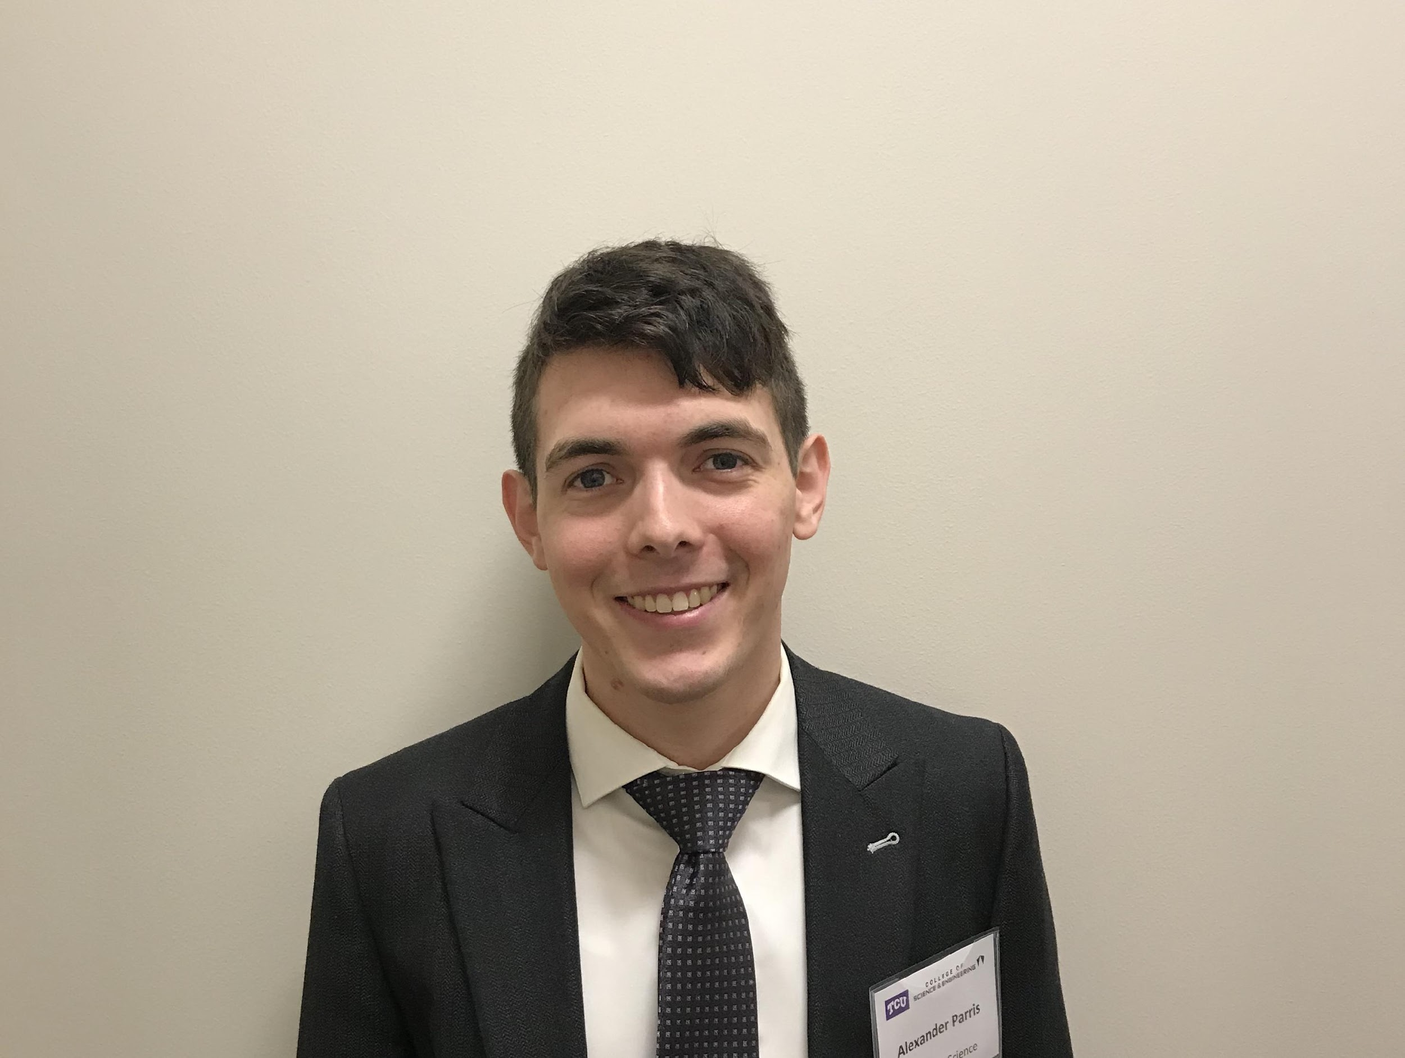
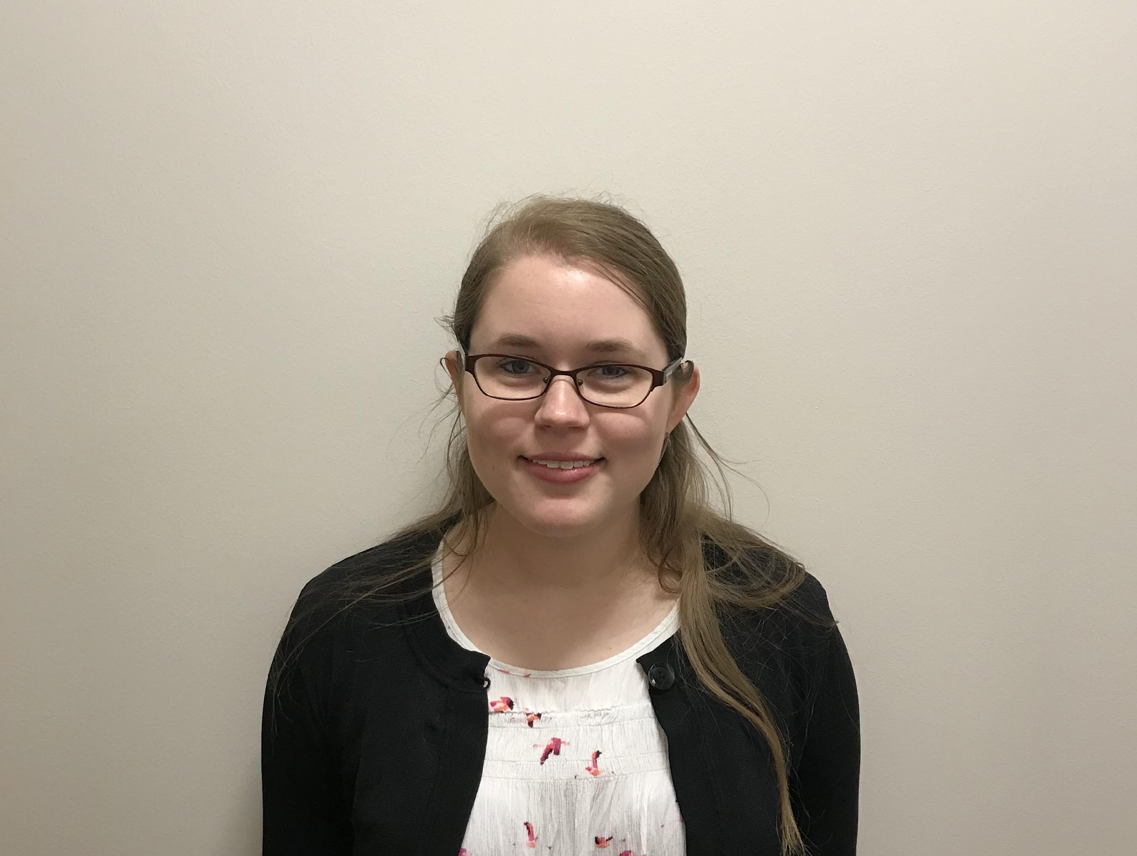
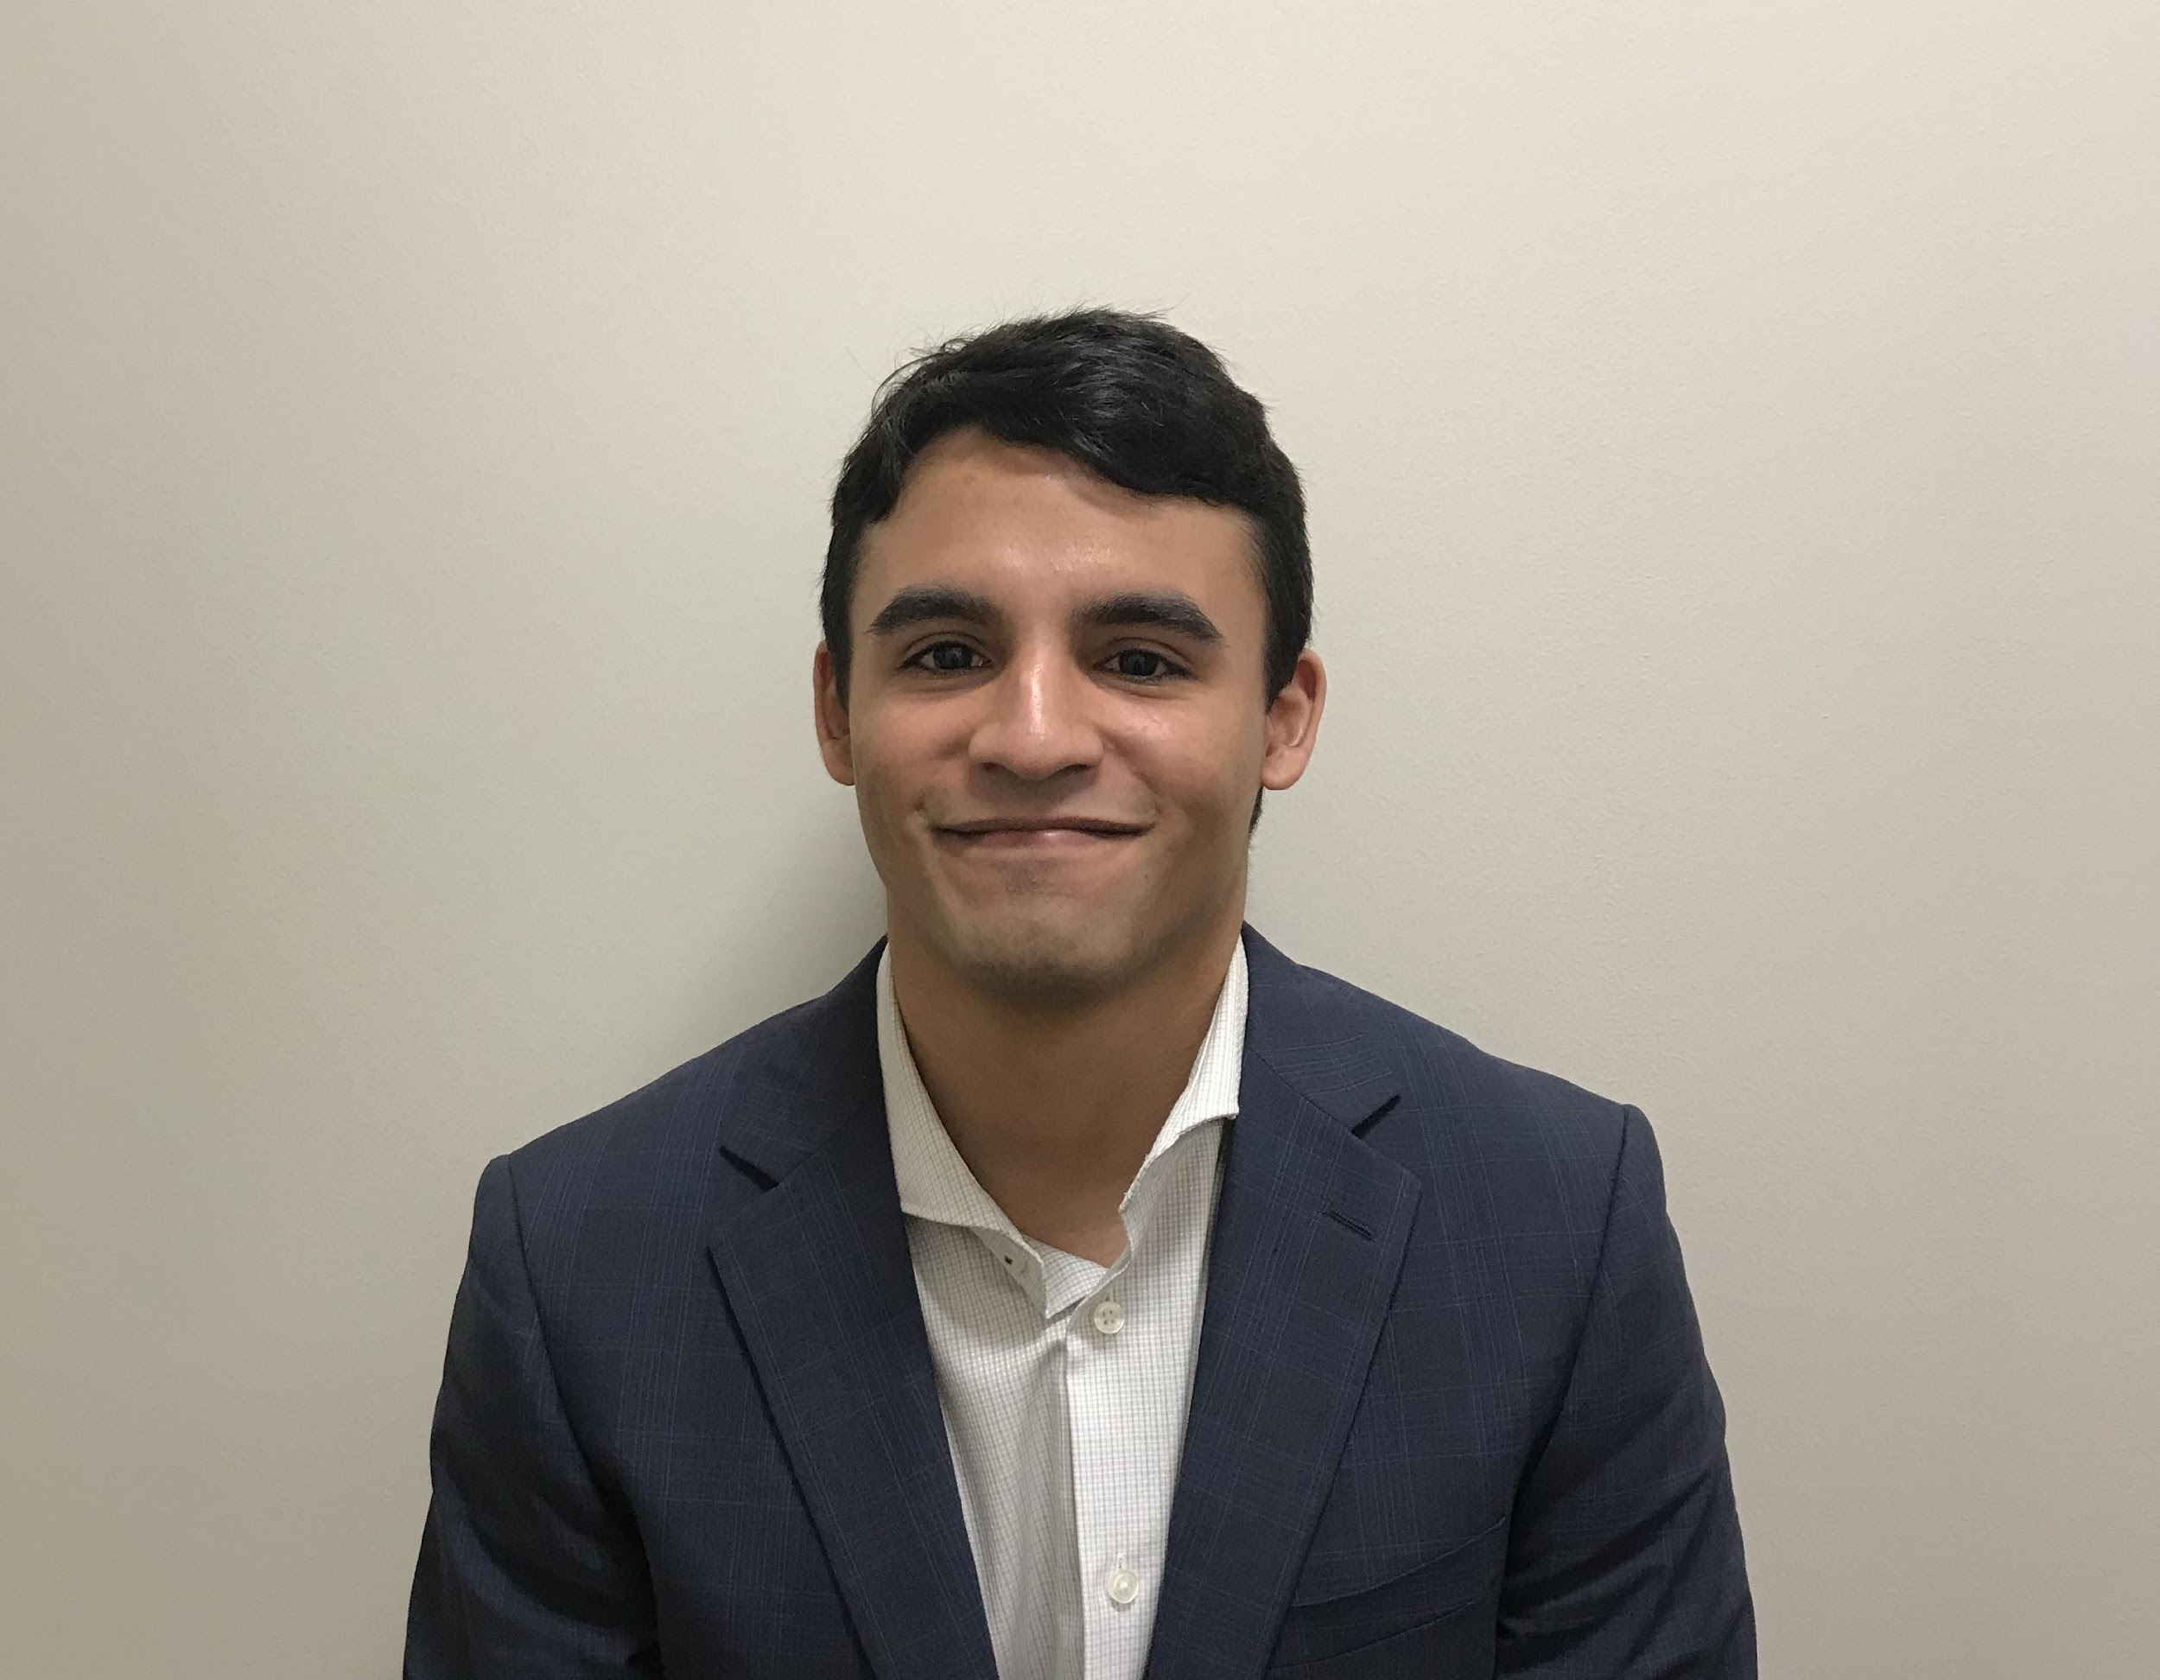
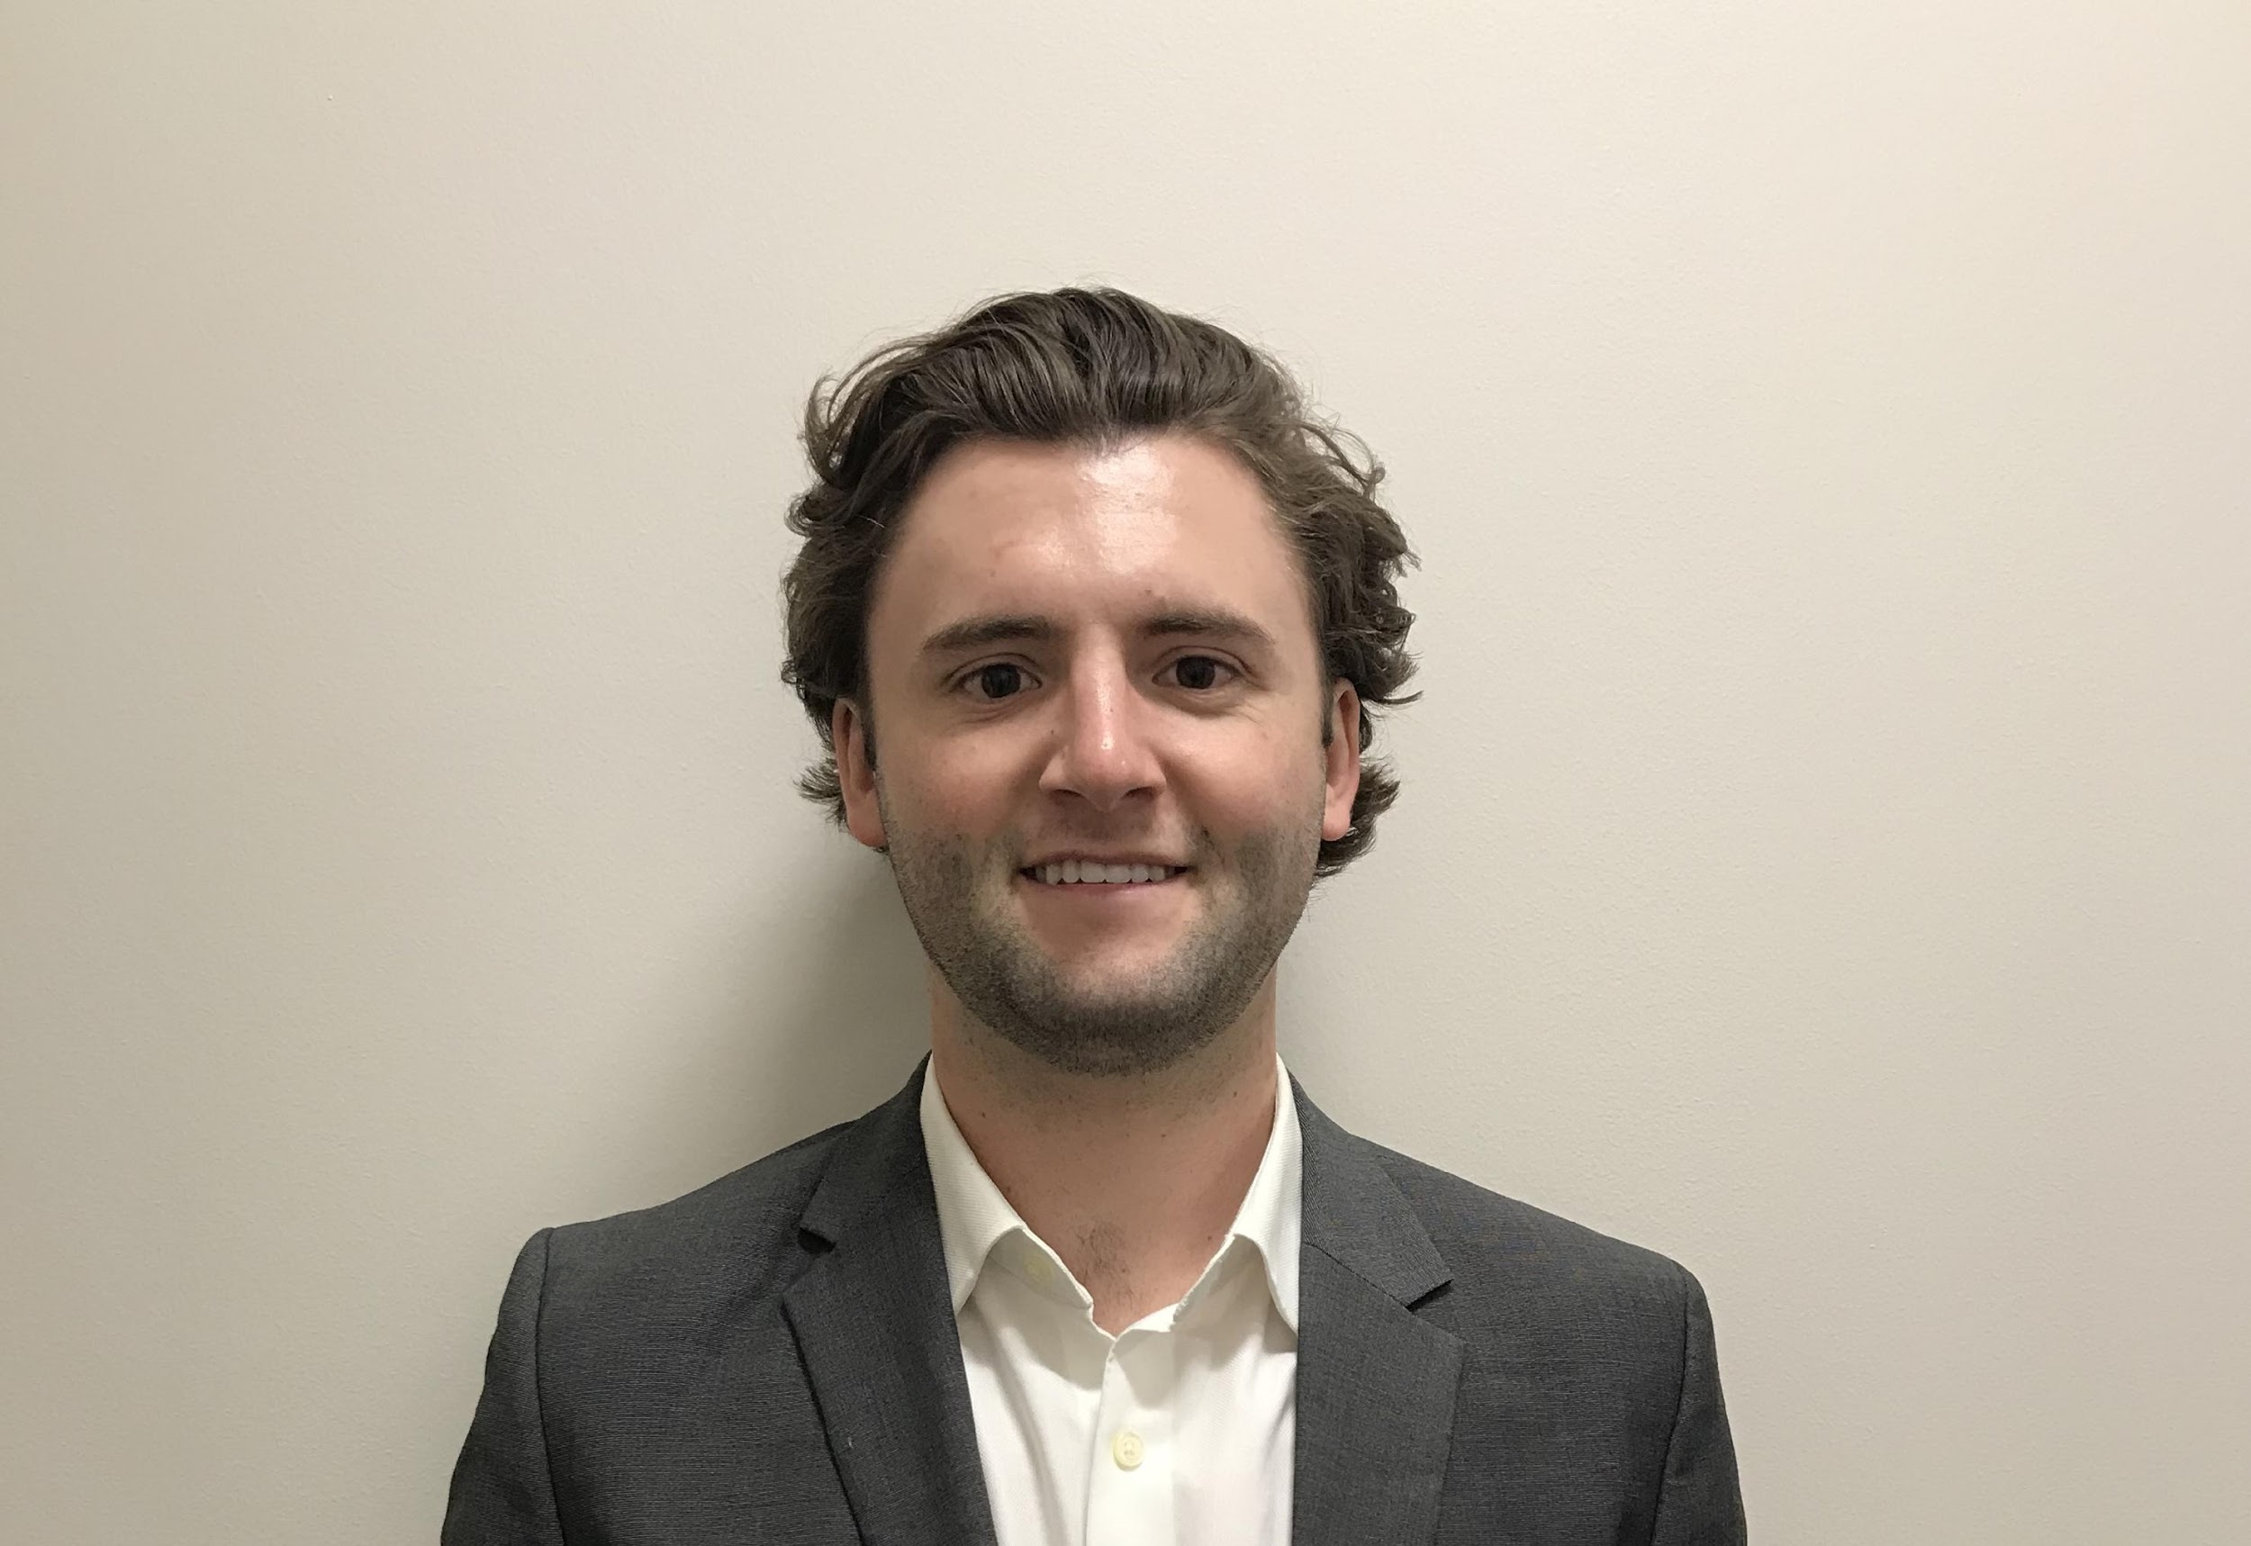


The Yellow Walkman Team
Huy Bui
Alexander Parris
Katie Ortstadt
Zach Alaniz
Justin Herold
Instructor: Dr. Bingyang Wei
Notes:
This project has been a collaboration between the TCU department of Computer Science, and the TCU/UNTHSC School of Medicine. Our team name is the yellow walkman and my name is alexander parris, *We all introduce our names* “. We have all done full stack development, in order for each of us to get the most out of this process. We have been mentored throughout this project by our professor Dr.Wei, and we would also like to acknowledge Kayla Beeler, an administrator at the new med school, who has helped us as well.
what did we do?

Slide 3
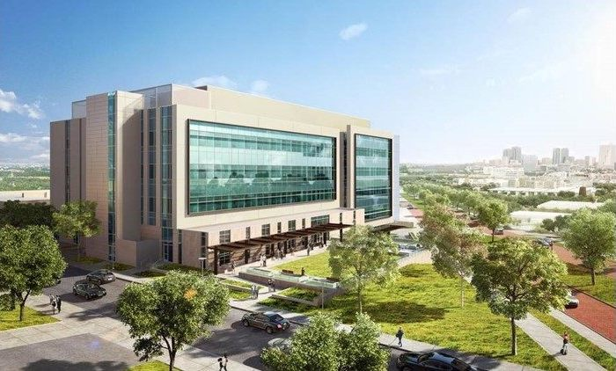
The TCU/UNT Medical School
Officially announced July 2015
Received preliminary accreditation in October 2018
Inaugural class of students starts classes July 2019
60 Students and 500 Doctors
Notes:
“So the TCU/UNTHSC Medical School is an ambitious project, that is projected to have an economic impact of $4Billion annually on Fort Worth annually beginning 2030. It was officially announced in July of 2015. They Received their preliminary accreditation in october of 2018. The Inaugural class of 60 students starts classes in July 2019..

Slide 4
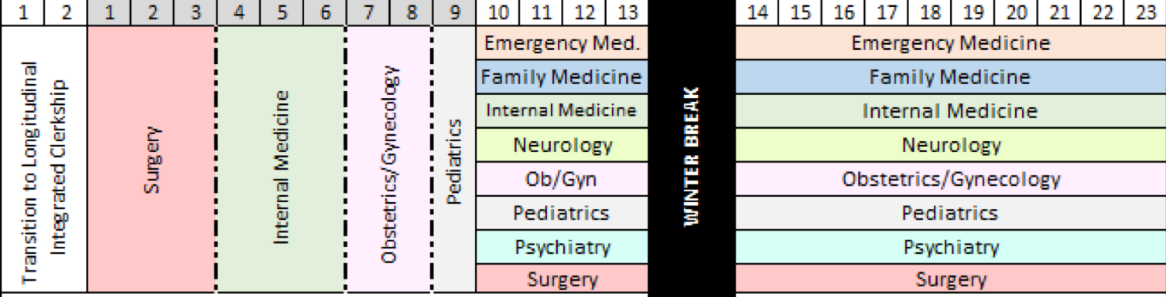

LIC (Longitudinal Integrated Clerkship)
Traditional Block Clerkship
Longitudinal Integrated Clerkship
Notes:
“Our project is centered around the LIC program. LIC stands for longitudinal integrated clerkship. A clerkship is when a student works under a doctor to learn a specific medical specialty. The new med school requires students to complete 8 clerkships, experience with 8 different medical specialties and doctors. Traditionally these clerkships are scheduled one after the other, with several weeks allocated to each specialty. The problem with this is that while a student focuses on one clerkship, they may forget skills they learned from previous clerkships. The LIC program solves this by having students take all their clerkships at the same time. So each student will attend all their clerkships on a 2 week recurring schedule. This allows students to be up to date with each specialty. The new Med school is on the cutting edge of implementing this scheduling model exclusively.

Slide 5
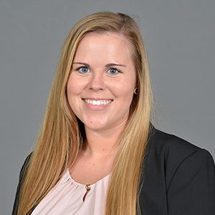
Our Client – Kayla Beeler
Director of LIC
  In charge of student scheduling
Our liaison to the medical school
Provided project requirements
Notes:
Katie - We have been working with our wonderful client, Kayla. Kayla is the director of LIC, so she is in charge of student scheduling. One of the most important things about software development is to know who you are developing for. Instead of making assumptions, we’ve met with Kayla often throughout the project to make sure the software we create meets her needs. Kayla isn’t a technical person, and none of us are medical school students, so frequent communication has been integral in bringing this project together.

Slide 6
The Goal
We need a way to create student schedules
  Creating schedules by hand is impractical
  No existing software that meets needs
  No precedence for this kind of schedule
Notes:
Katie: What problem are we going to solve for Kayla? She need a way to create the student’s schedules. Now imagine you are in charge of making student schedules say, for TCU next semester. You have to get in everyone’s requirements, keep class sizes down, and make sure there are no conflicts. Now imagine you have to do all of this by hand. We don’t want Kayla to have to do all of this by hand! That’s a logistical nightmare! A software solution puts the burden of work on the computer, not poor Kayla. Unfortunatly, there is no existing software that meets this need. The TCU medical school will be the first medical school to use the LIC system for all of its students. While ___ and ___ medical school use LIC, they only provide it for a small handful of students each year. This is what makes the TCU medical school really unique, and this is why they need a unique solution.

Slide 7
The Project Needs
Gather data from the students and doctors
  Names, location, availability, etc.
Design a program that allows students to create schedule
Generate and output students’ schedules
  Compatible format with LCMS+ (Student portal)
Notes:
Katie: We’re going to make student schedules. Great! But what actually goes in to making a student schedule? First, we need to get data. When are doctors available to teach students? What part of the DFW area does the student live in? What are their names and emails? Step one is gathering up all this information.
The second thing our project needs to do is actually allow students to make their schedules. This is the real meat and potatoes of our program.
The last thing our project needs to do is output these schedules. We need a way for Kayla to view and review the schedules. We also want to be able to upload the schedules to the medical school student portal, so students and doctors can access them.
Those are the three main tasks that our program has to be able to do. So now, we’re going to walk you through how we achieve these needs.

Slide 8


Users
Kayla (Admin)
Doctors
Students
Student/Doctor Data
Indicate Availability
Create Schedules
The LIC Scheduling Program
Notes:
Katie - There are three primary users of our system. The first is Kayla. As the LIC administrator, she oversees the entire process. She uploads the student and doctor information, decides when to start the scheduling process, and downloads the schedules at the end. Doctors will use our system to indicate when they are available to take students. And students will use our system to actually create their schedules.

Slide 9
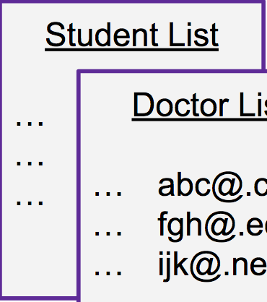
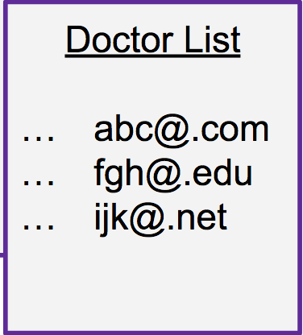
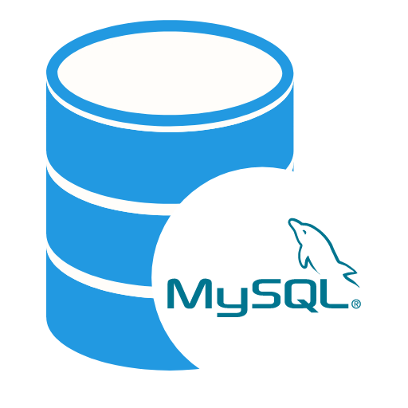
Our Solution
Admin will upload basic student and doctor information
Database
Upload Info

Slide 10
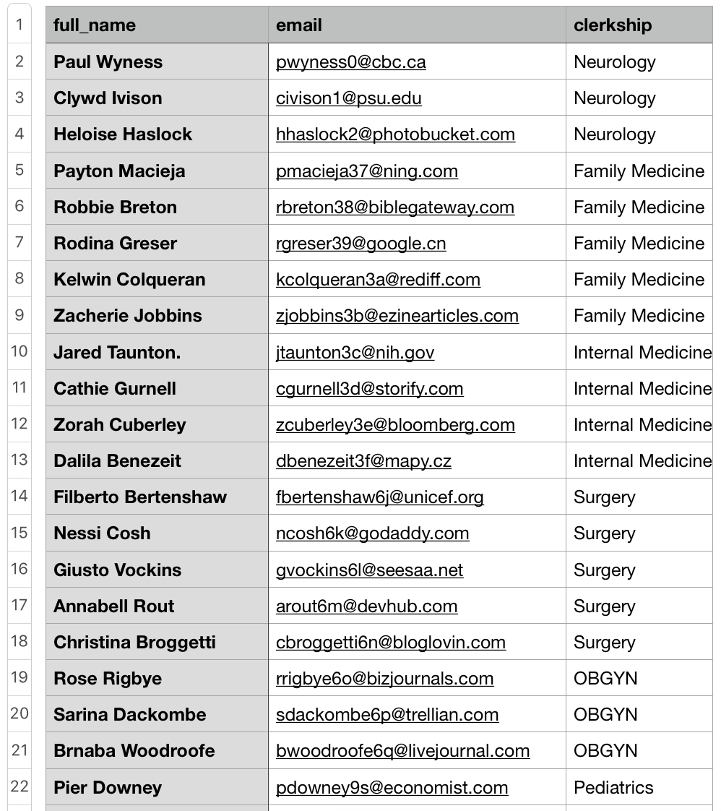
Doctor Data

Slide 11
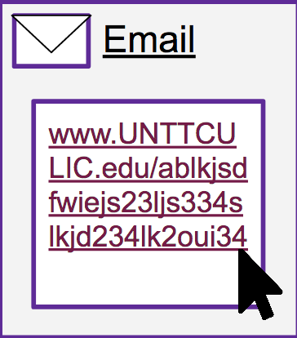
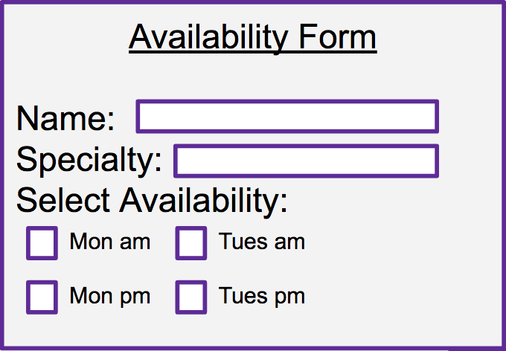
Our Solution
Doctors will be sent a unique link
  This will bring them to the availability & information form
Click Link

Slide 12
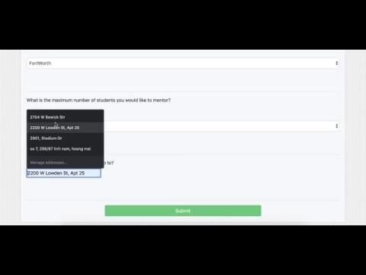

Slide 13
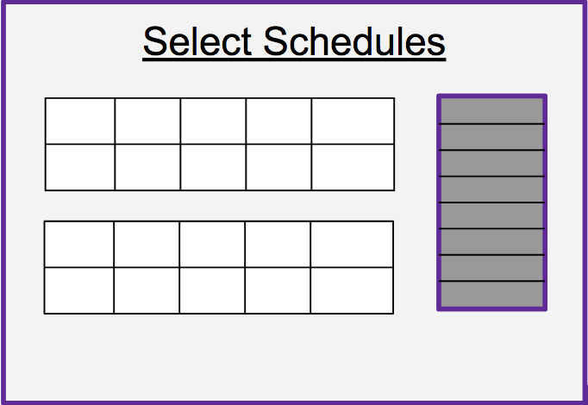
Our Solution
Students will be sent a unique link
  This brings them to the schedule selection page
Click Link

Slide 14
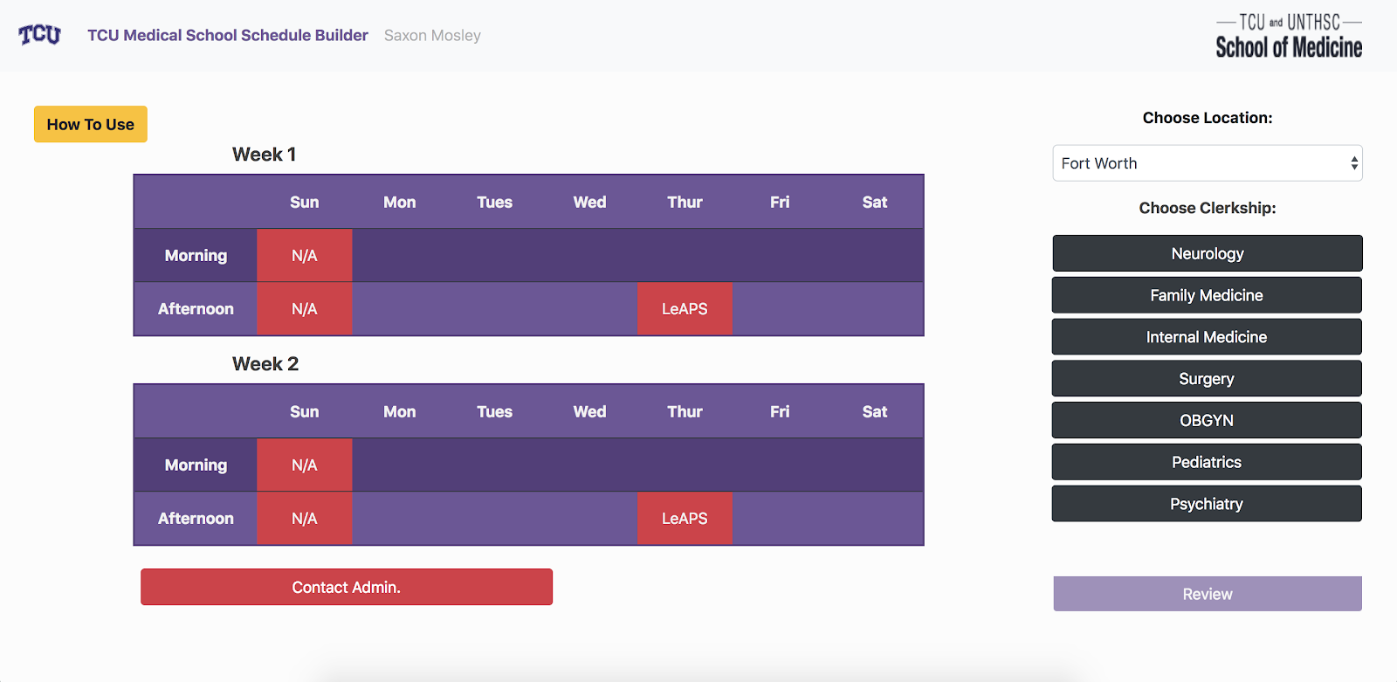

Slide 15
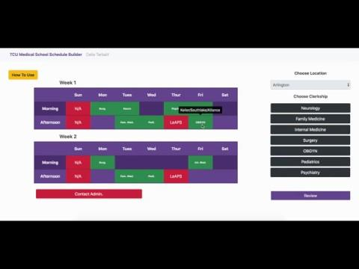

Slide 16
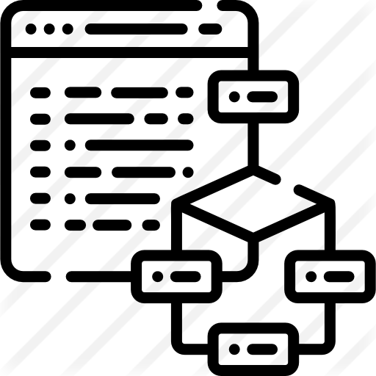
Auto Generate Schedule
The system automatically generates all schedules
  Without students’ input
  Provide a fail-safe in case students cannot select schedules
Algorithm
Database

Slide 17
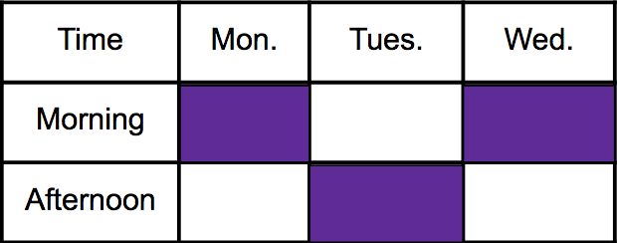
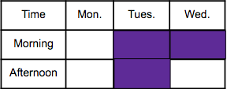
Our Solution
Admins can download, view, and distribute schedules

Slide 18
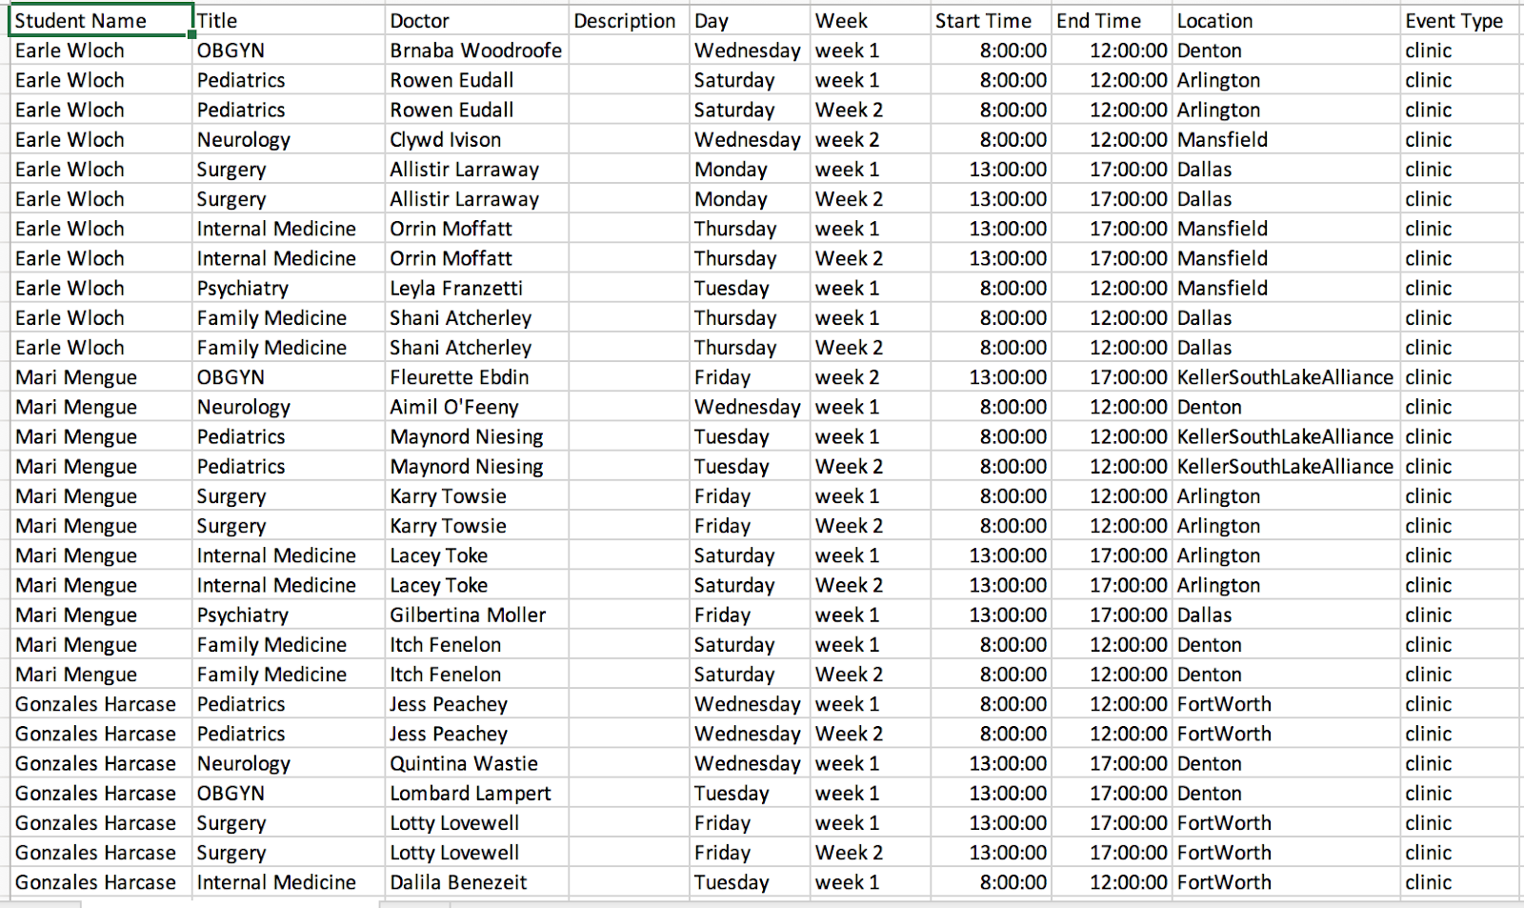
CSV Format

Slide 19
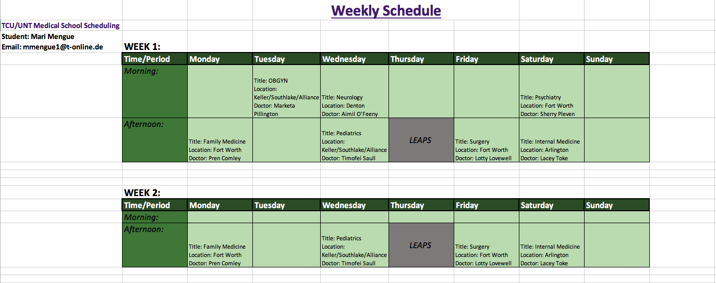
Excel Format

Slide 20
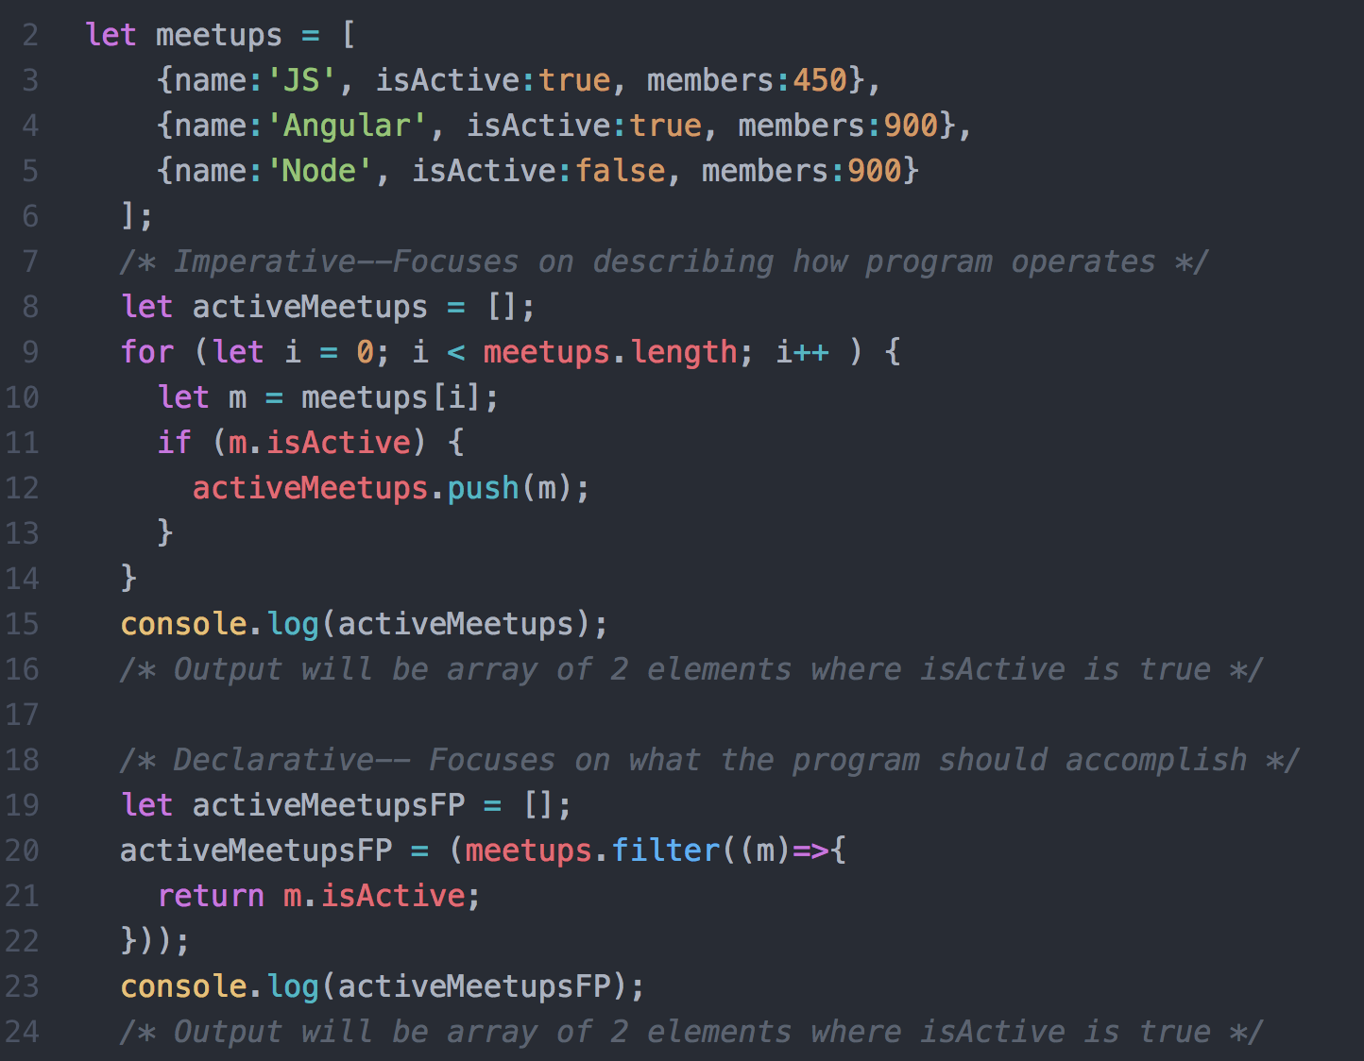


Spring Boot Framework
  Backend – Java, Hibernate
  Frontend – HTML5/CSS, JavaScript, Ajax, JSON, Thymeleaf
Agile software development approach
  Frequent client and team meeting
  Two week sprints
  Total duration of two semesters
Solution Details

Slide 21

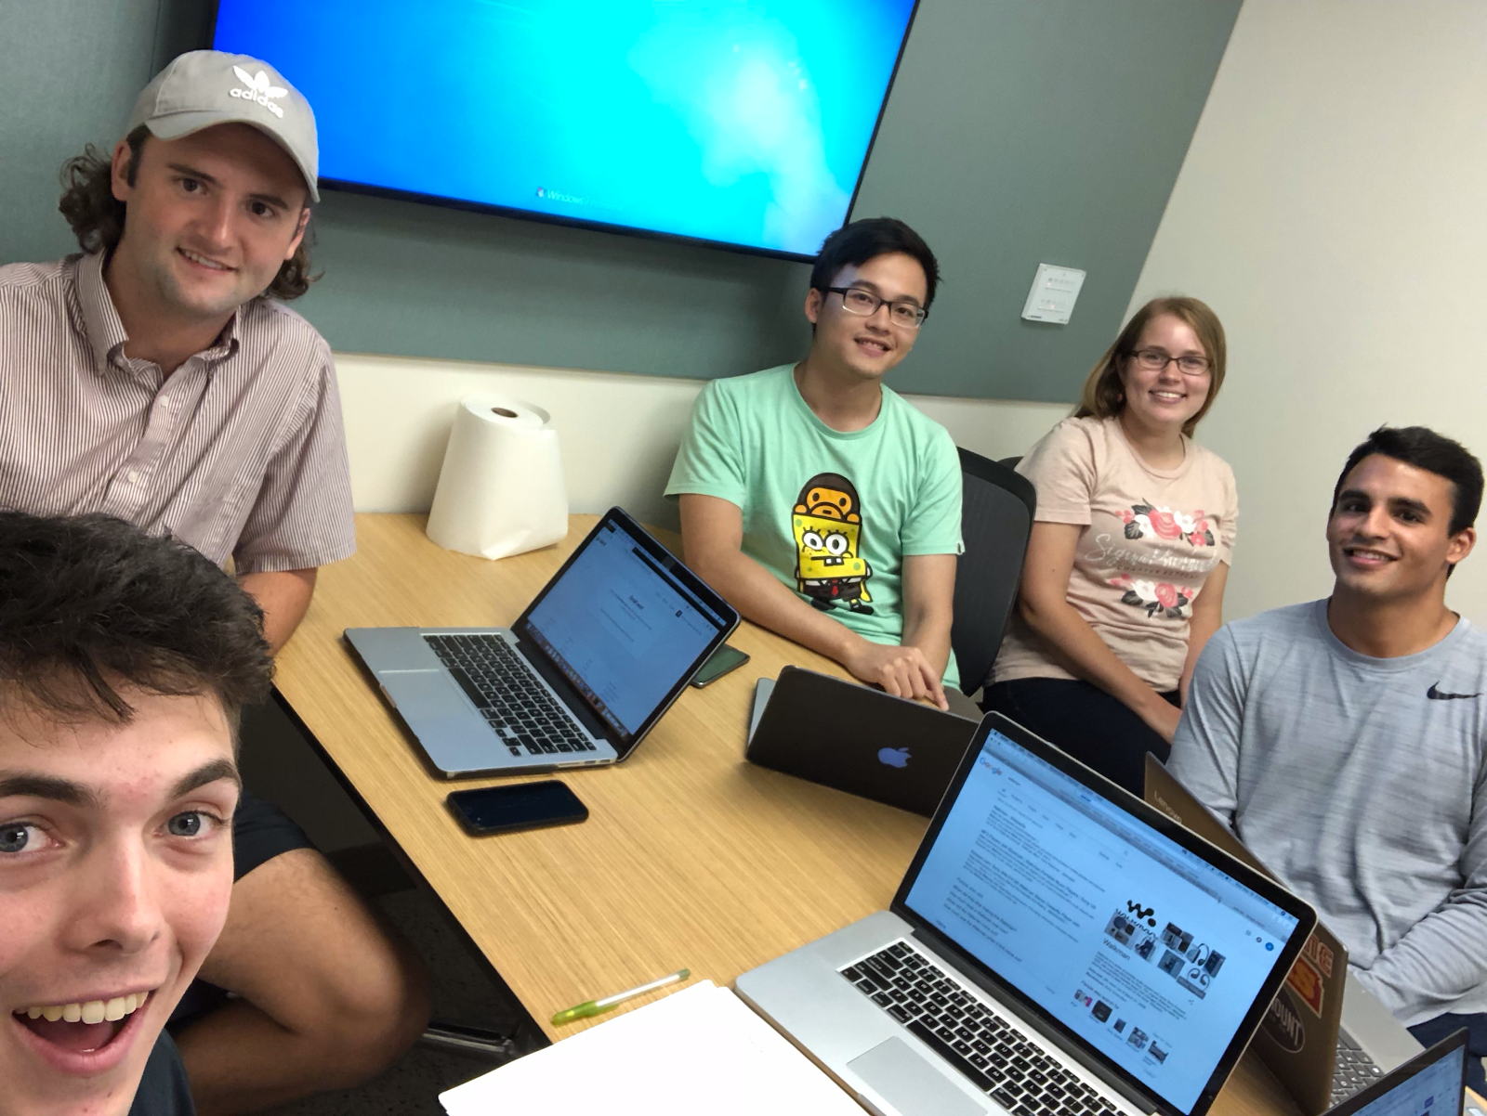
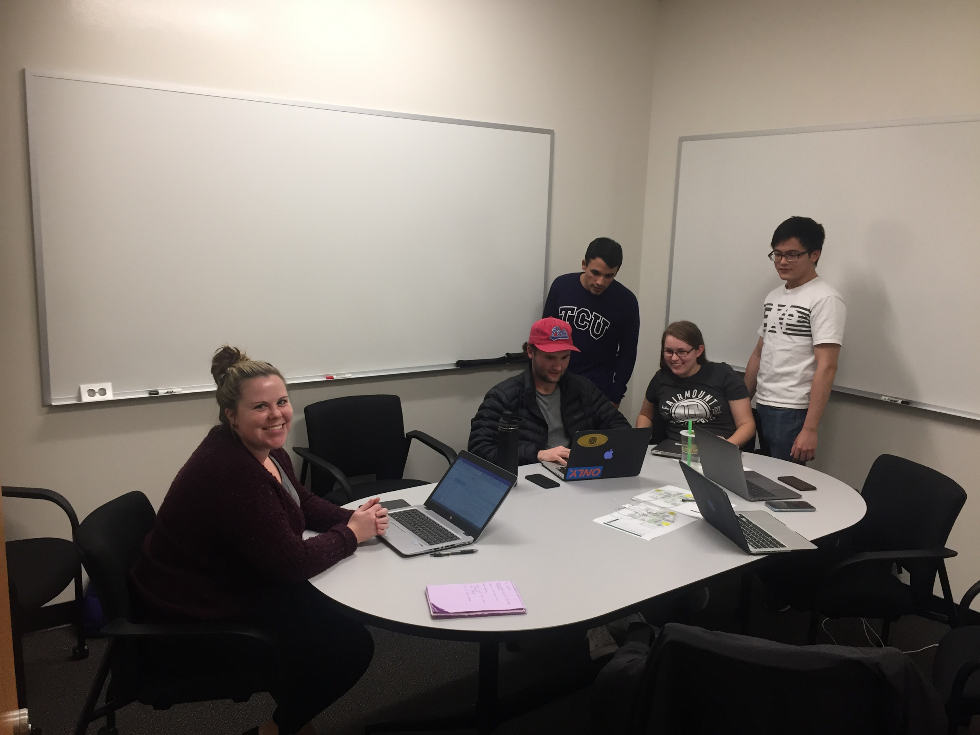

Teamwork/Challenges
Notes:
met twice a week during class time to update requirements, review, and plan
we also tried to meet as often as possible a group to focus on actual coding
With all of our busy schedules there were a lot of times when this was not possible

Slide 22
Acknowledgements

Slide 23
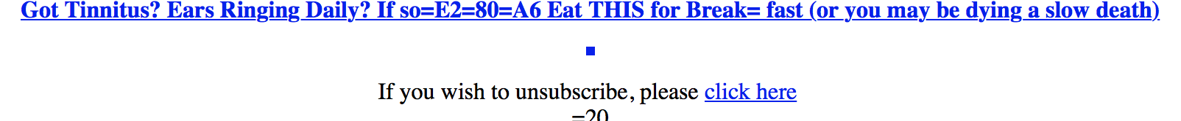
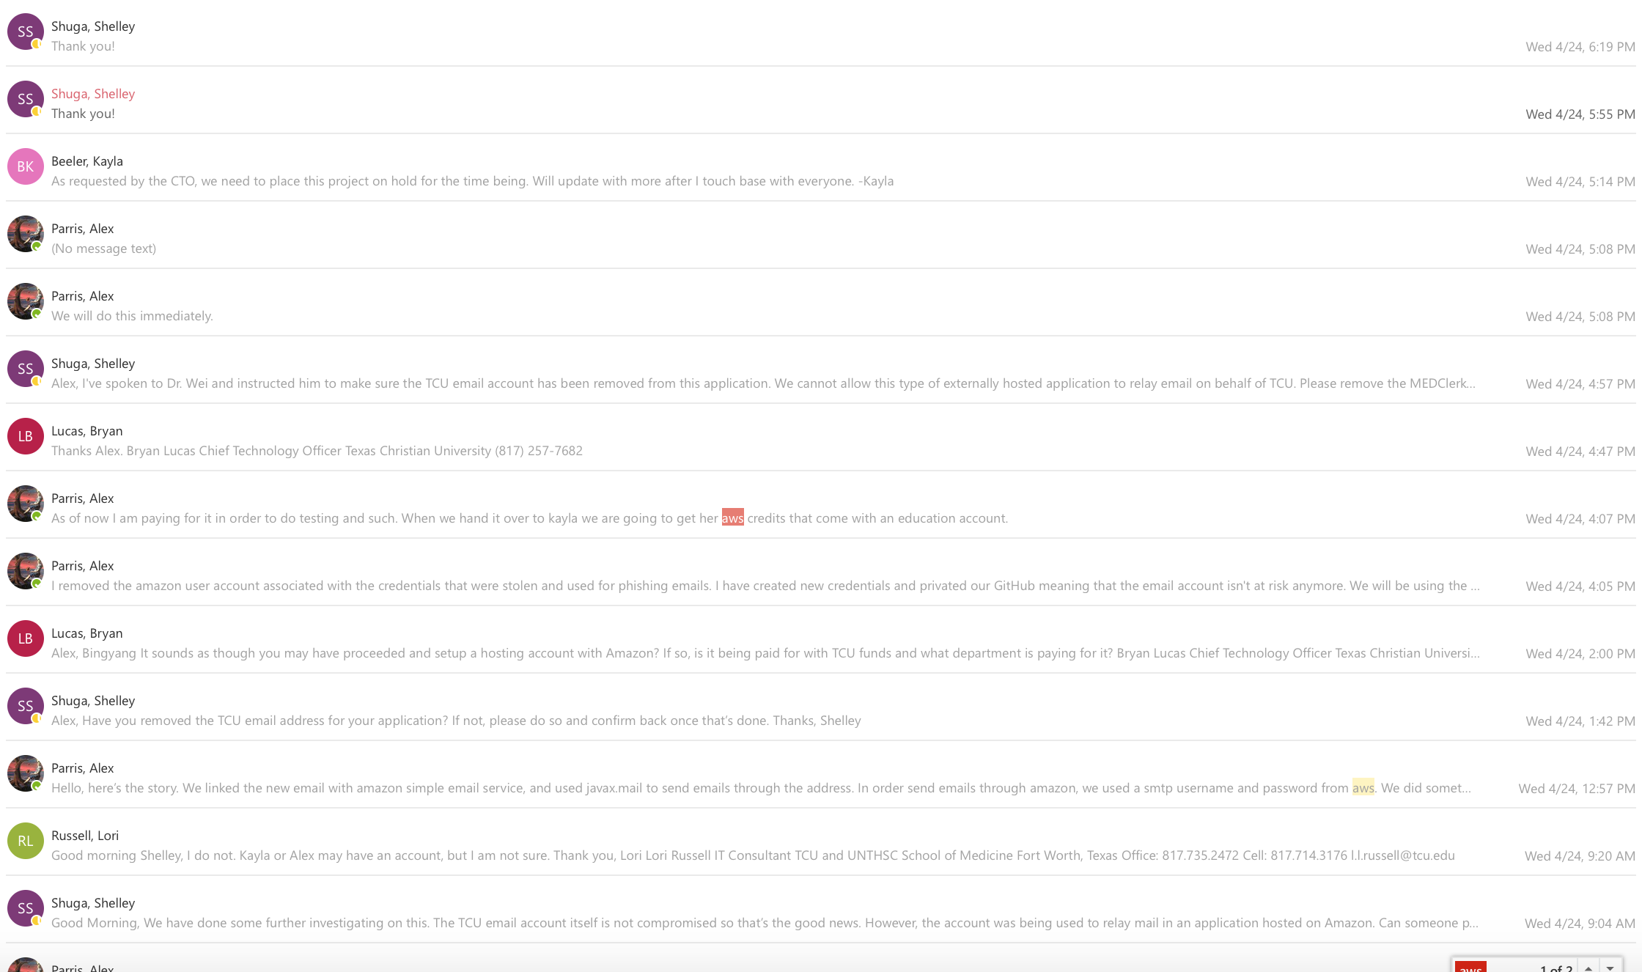
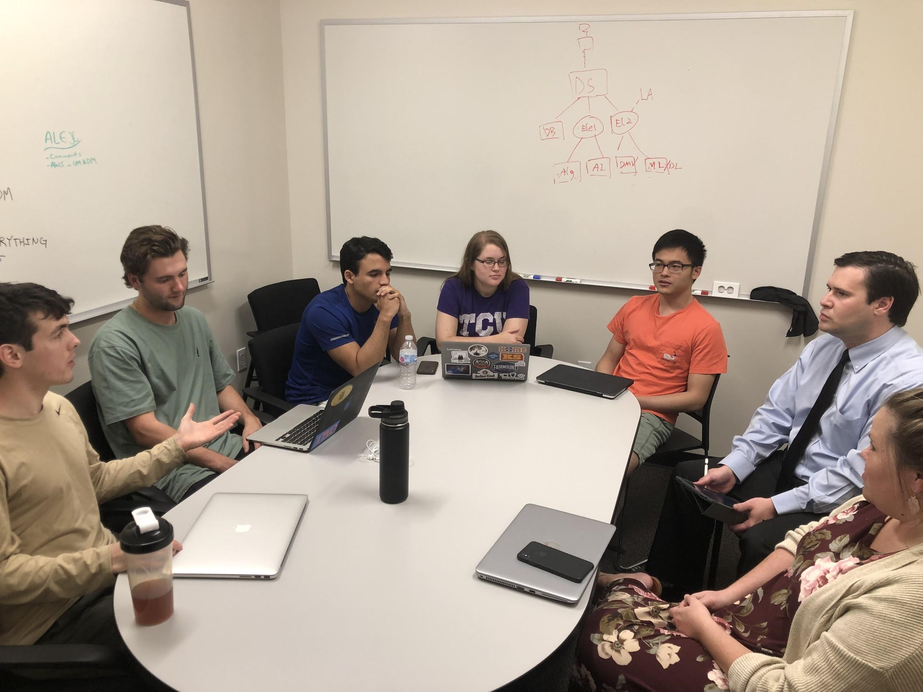
Challenges
Notes:
We don’t want to leave on a bad note, but this presentation wouldn’t be complete without mentioning our biggest stumble. This project requires us to send emails to doctors and students, so they can make schedules using our application. We asked our client, Kayla, if she could procure us an official @tcu.edu email account, so the doctors and students receiving emails wouldn’t think our emails were spam. She requested this email account from TCU IT. We received the email credentials from Kayla, and linked the email to our application. Once we had integrated the email and tested the email system, we pushed the code, along with the email credentials to our public code repository. This happened at about 4:30 AM two weeks ago. At 4:40, ten minutes later, I received an email saying that our @tcu.edu email account had been frozen, because 15,000 suspicious emails had been sent in a short period of time. You can see one of the 15,000 emails sent above, not exactly our work. At this point we were running around with our hair on fire, explaining to the TCU IT department how we posted private tcu email credentials on the open internet. We privated our code repository, changed the account credentials, and added an email tracker that would shut down the account if suspicious activity was detected, all in the hope that TCU IT would unfreeze the account so we could deliver a working project. Their response was, not only are we not giving yall back this account, we are baffled that you ever got an official @tcu.edu account to begin with! They said that our client, Kayla, when she requested the account, never mentioned that a group of students would be linking it to an outside application, and if we had know that information then, we would have declined to give you the account, because it’s against all of our security procedures. So there’s that meeting with TCU IT in the bottom left… That was a fun day. Since then we modified our program to use a free email platform, that is completely disconnected from TCU servers. The big takeaway here is twofold. One, don’t post your password online. And two, communication is key. Make sure that all parties involved on a project are on the same page, before going forward with a feature.

Slide 24
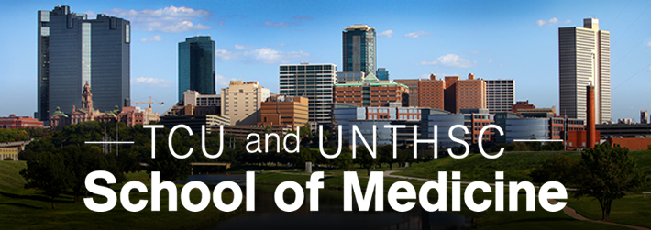
Thank You!
Notes:
thank you to:
Dr. Wei
Kayla Beeler
Trey Ivy
The computer science department

