Slide 1

RIBBIT: A Cost-Effective iOS Hearing Aid App
Duy Dang, Robert Kern, Esteban Kleckner
Capstone Project 2015-2016
Computer Science Department
Texas Christian University
Notes:
Robert

Slide 2
Background
Approximately 20% of the US population who need a hearing aid can afford one
Using Apple’s vDSP to implement an FFT, we strive to create a cost-effective iOS application
By filtering and amplifying certain frequencies we create a more suitable sound for the hearing impaired
Notes:
Robert

Slide 3
Motivation
To provide a cost-effective solution for the hearing impaired
  Hearing aids are expensive
To provide an easy-to-use iOS application
  Easily accessible through the App Store
  iOS standards are designed for usability
Notes:
Robert

Slide 4
Outline
Application Overview
  Why iOS?
Workflow Overview
Prescription Creation
  What is Rx?
  QR Code Generation
Fast Fourier Transform
  System Architecture
  Filtering
  Gain Adjustment
Results
  Processing Delay
  Demo
Notes:
Robert

Slide 5
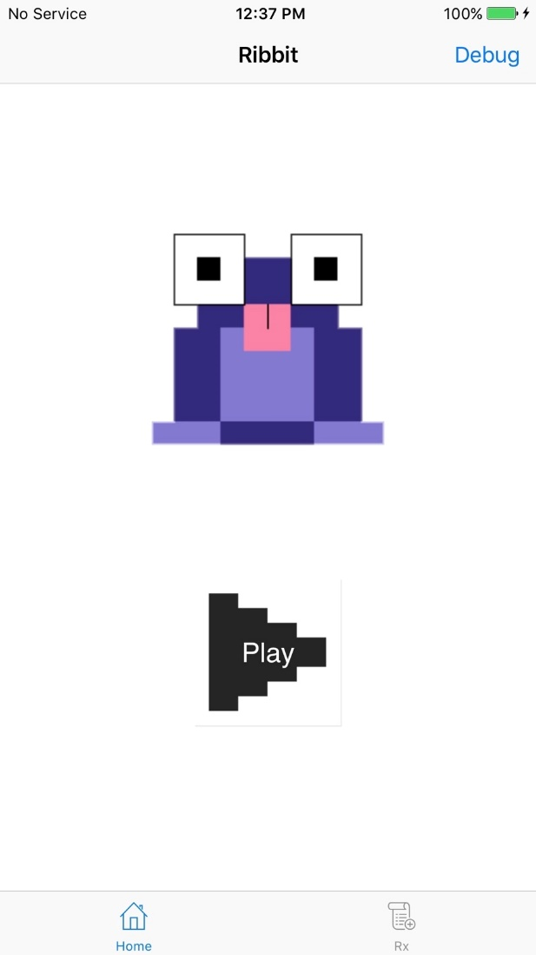
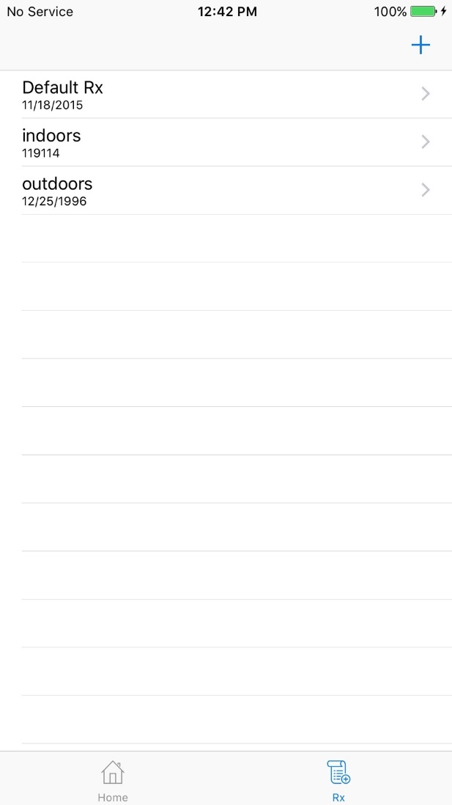
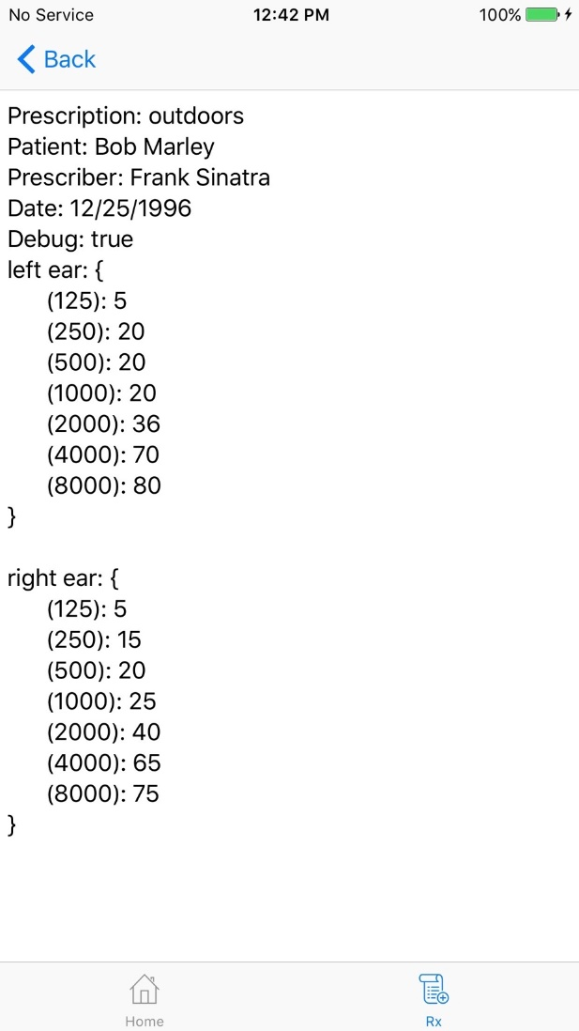
Application
Notes:
Esteban

Slide 6
Why iOS?
Android has a Hardware Abstraction Layer (HAL) that introduces latency
There is already a market for sound processing applications on the App Store
iOS has access to the Accelerate Framework
Notes:
Esteban

Slide 7
An Overview of the Workflow
Hearing test and prescription
Prescription conversion into QR code
QR code load into Ribbit app
Sound modification based on prescription
Notes:
Duy
The user meets with audiologist for a hearing prescription
The audiologist uses the Ribbit web-based tool to generate a QR code that stores all prescription data
The audiologist gives the user access to the QR code
The user uses the Ribbit app to automatically load the QR code in through the phone’s camera
The user clicks the play button on the Ribbit app and starts listening to the output sound

Slide 8
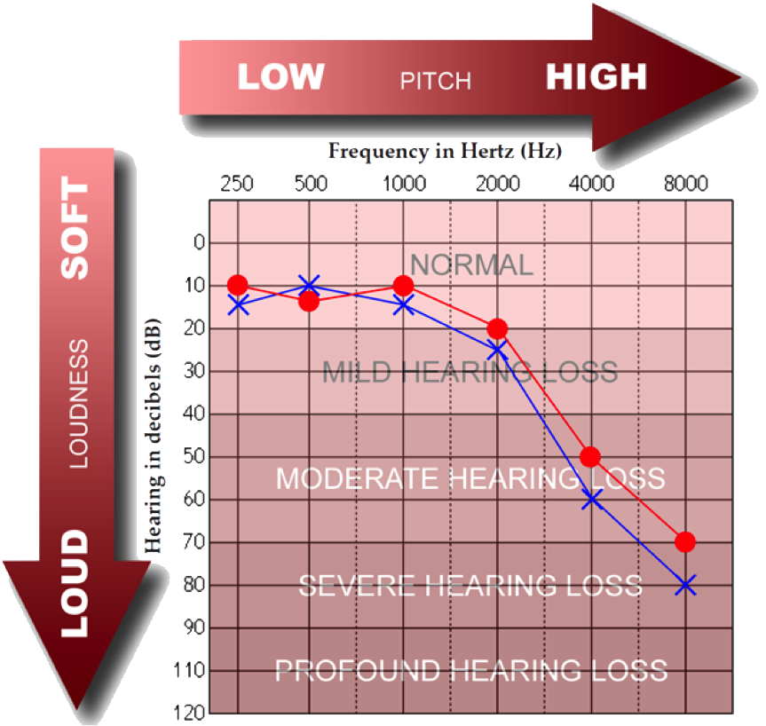
What is Rx?
“Prescription”
In the form of a graph - Audiogram
Demonstrate threshold dB levels at different frequencies
Notes:
Duy
Picture source: http://www.centuryhearingaids.com/blog/tag/how-to-read-an-audiogram-how-to-read-your-hearing-test/

Slide 9
Prescription Creation
A convenient, secure method to load prescription (Rx)
QR code generation is done in a browser
Read into the phone using the camera
Notes:
Duy

Slide 10
Fast Fourier Transform
An FFT is an implementation of a Discrete Fourier Transform
  It works on discrete samples of data
FFT implementation is used to:
  Break the signal into its constituent parts
  Recombine parts into a coherent signal
Utilizing the FFT implementation from Apple’s vDSP Library:
  Apply filtering operation
  Apply gain adjustments
Notes:
Esteban

Slide 11
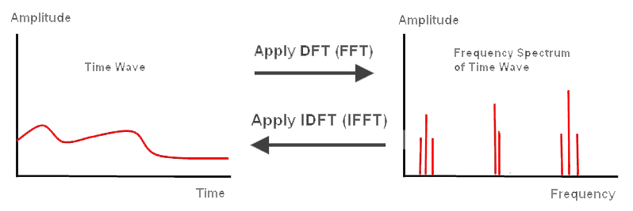
Fast Fourier Transform
Notes:
Esteban

Slide 12
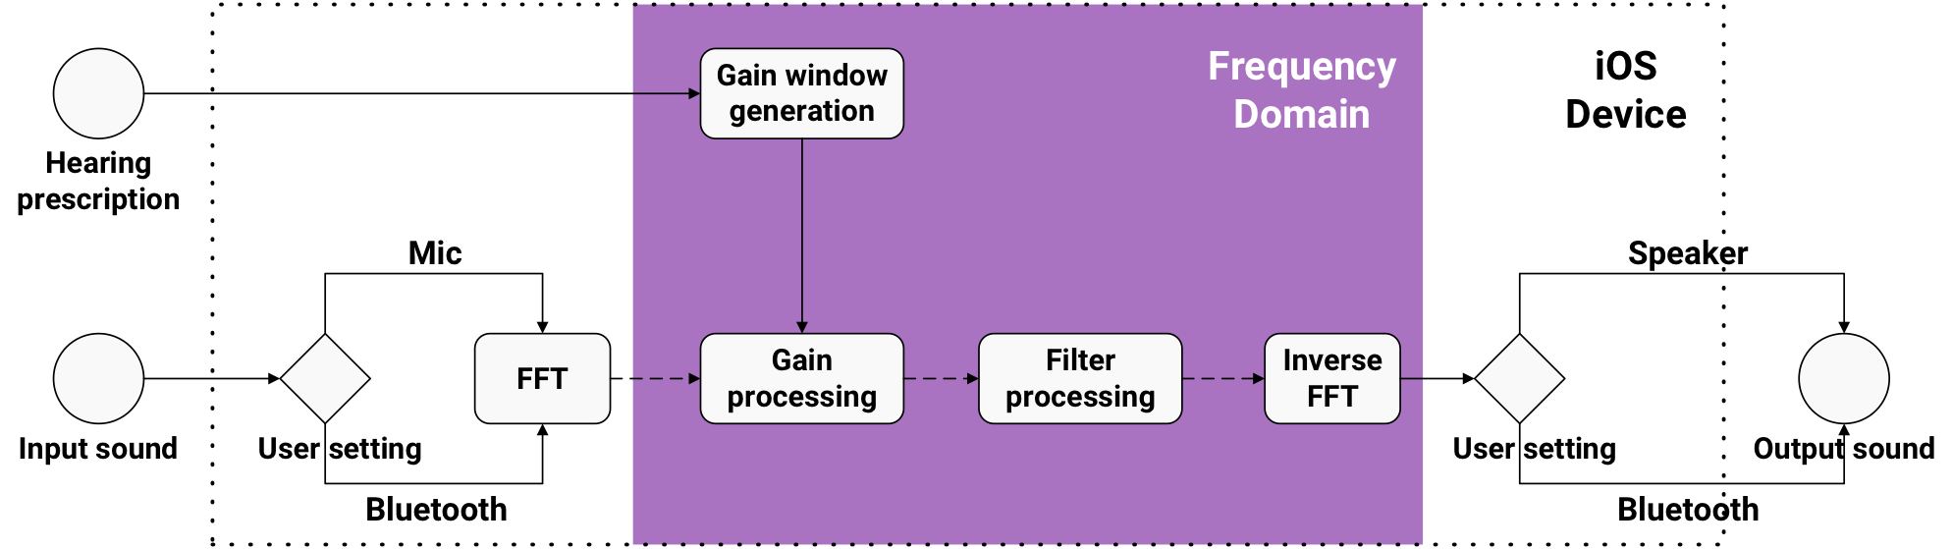
System Architecture
Notes:
Esteban

Slide 13
Filtering
Filtering input sound removes:
  Background Noise
  Sound Artifacts
Filter Window designed:
  To reduce amplitudes between 5 and 24 kHz
  To reduce unnecessary noise
  To be infinitely differentiable
Notes:
Filtering the input sound removes noise and sound artifacts that otherwise impact the user’s ability to fully understand/comprehend speech
Esteban

Slide 14
Filtering
Slice shows difference in spectrum:
  Between input and output spectrum
  After Filtering Window has been applied
Filter Window designed:
  Point 180: ~8.2 kHz
  Point 195: ~8.9 kHz
2.47E-17
1.88E-17
-2.42E-17
Notes:
Filtering the input sound removes noise and sound artifacts that otherwise impact the user’s ability to fully understand/comprehend speech
Esteban

Slide 15
Filtering
Input Signal vs. Output Signal
  Orange – Input Signal
  Blue – Output Signal
Shows the difference between signals after:
  Applying Filter Window
  Applying Inverse FFT
Notes:
Esteban

Slide 16
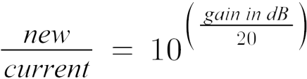
Gain Adjustments
Gain adjusting input sound:
  Increases loudness/volume by a predetermined decibel level
  Increases each frequency component individually
Gain Window designed:
  To take into account spectral leakage
  To be infinitely differentiable
  Formula:
Notes:
Duy
Hearing-impairment: loss of the ability to hear/detect some (usually higher) frequencies at the normal loudness
Hearing aid app gain requirements:
Boost a certain frequency by a specific dB
Calculate the dB values to increase each individual frequency by
Gain processing steps:
Compare the prescription of a normal-hearing person to that of the user
Generate a gain window based on the above comparison so that the window accurately reflect the gap
Vector-multiply the frequency domain signal buffer by the gain window to achieve the boosted signal

Slide 17
Gain Adjustments
Input Signal vs. Output Signal
  Orange – Input Signal
  Blue – Output Signal
Shows the difference between signals after:
  Applying Gain Window
Notes:
Duy

Slide 18
Gain Adjustments
Input Signal vs. Output Signal
  Orange – Input Signal
  Blue – Output Signal
Shows the difference between signals after:
  Applying Inverse FFT
Notes:
Duy
Hearing-impairment: loss of the ability to hear/detect some (usually higher) frequencies at the normal loudness
Hearing aid app gain requirements:
Boost a certain frequency by a specific dB
Calculate the dB values to increase each individual frequency by
Gain processing steps:
Compare the prescription of a normal-hearing person to that of the user
Generate a gain window based on the above comparison so that the window accurately reflect the gap
Vector-multiply the frequency domain signal buffer by the gain window to achieve the boosted signal

Slide 19
Processing Delay
Under 23 millisecond < 50 millisecond threshold
Hardest restriction of this project
We cannot process data from the future, and we cannot be too slow
Notes:
Duy

Slide 20
Results
Filtering
Gain amplification
Clicking
  Filtering
  Gain amplification
  Both?
Notes:
Esteban
Using a cellphone as a hearing aid shows promise
In the future, we would like to test our application in a setting where human trials are possible
By tailoring the application to the user, we offer a more personal experience
Future enhancements would include the elimination of sound artifacts and the inclusion of smart technologies, such as location sensing

Slide 21
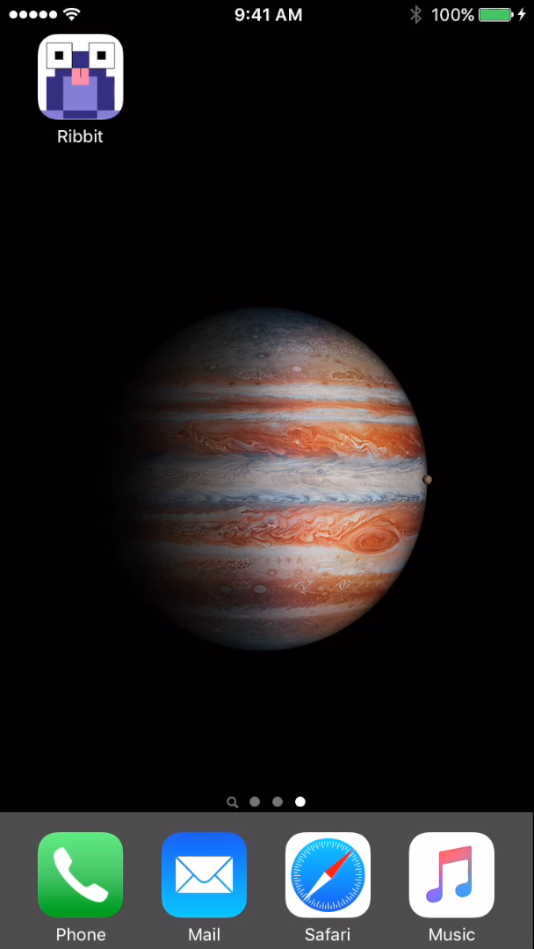
Demo
Launch application
Load prescription via QR code
Start sound processing
Stop sound processing
Notes:
Robert

Slide 22
Questions
Notes:
Robert

