Slide 1

RIBBIT: A Cost-Effective iOS Hearing Aid App
Duy Dang, Robert Kern, Esteban Kleckner
Capstone Project 2015-2016
Computer Science Department
Texas Christian University
Notes:
Robert

Slide 2
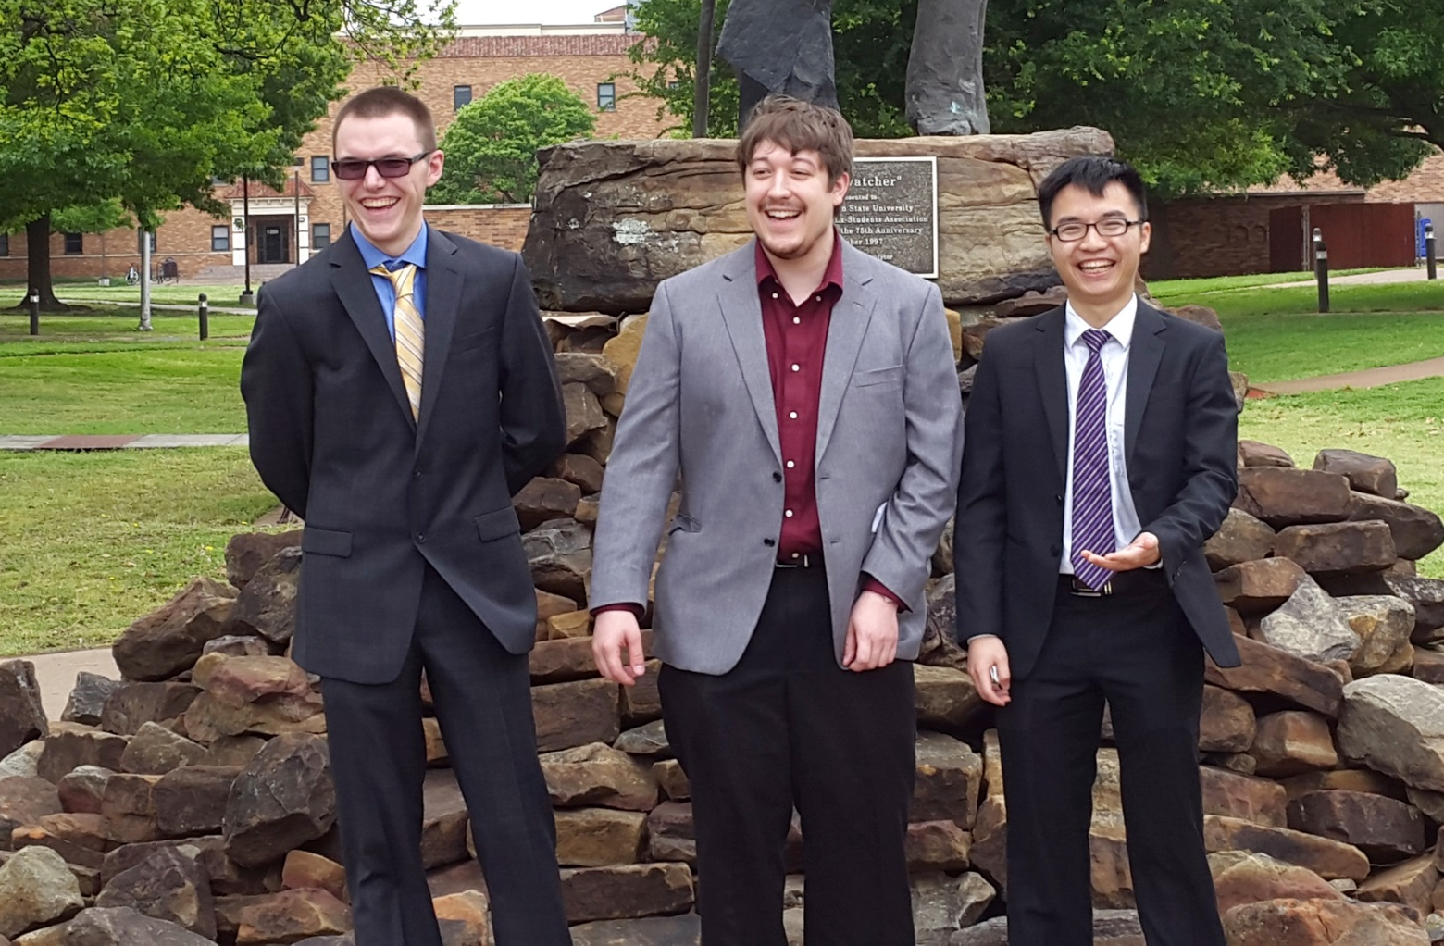
The Team
Robert Kern
Project Lead
Esteban Kleckner
Code Monkey
Duy Dang
Code Monkey
Notes:
Robert

Slide 3
Outline
Working On The Project
Background
30,000 foot View
Application Overview
Prescription Creation
System Architecture
Results
Demo
Notes:
Robert

Slide 4
Project Timeline
Fall 2015
  Met with:
    Client
    TCU Hearing and Speech Clinic
  Determined functionality of application
  Iteration 1: Prototype application
Spring 2016
  Iteration 2: Modified application
  Reached out to Dr. Richardson
  Iteration 3: Finalized application
Notes:
Robert

Slide 5
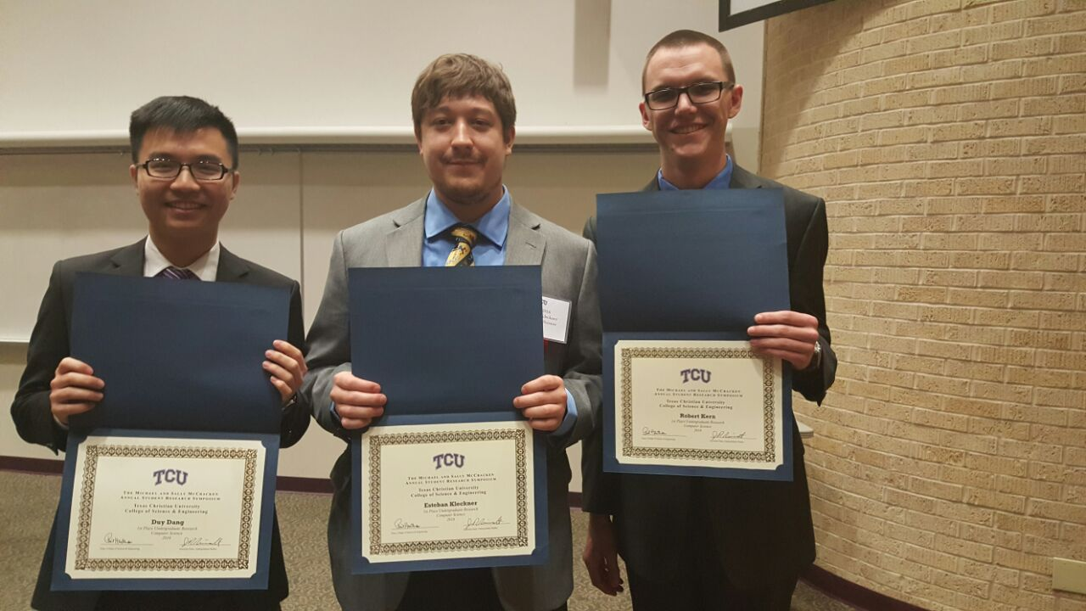
Our Presentations
First Semester Final Presentation
  Dec. 15, 2015
Faculty Presentation
  Feb. 2, 2016
SRS
  Apr. 8, 2016
NTASC Presentation
  Apr. 16, 2016
Final Presentation
  Today
Notes:
Robert

Slide 6
Background
Approximately 20% of the US population who need a hearing aid can afford one
To provide a cost-effective solution for the hearing impaired
  User-friendly
  Easily accessible through the App Store
Notes:
Robert
~37 million people

Slide 7
A 30,000ft View
Obtain prescription from Audiologist
Convert prescription into QR Code
Process sound using prescription
Load QR Code into application
Notes:
Duy
The user meets with audiologist for a hearing prescription
The audiologist uses the Ribbit web-based tool to generate a QR code that stores all prescription data
The audiologist gives the user access to the QR code
The user uses the Ribbit app to automatically load the QR code in through the phone’s camera
The user clicks the play button on the Ribbit app and starts listening to the output sound

Slide 8
Why iOS?
Android has a Hardware Abstraction Layer (HAL) that introduces unpredictable delays
iOS has access to the Accelerate Framework
App Store vs Play Store
Notes:
Esteban

Slide 9
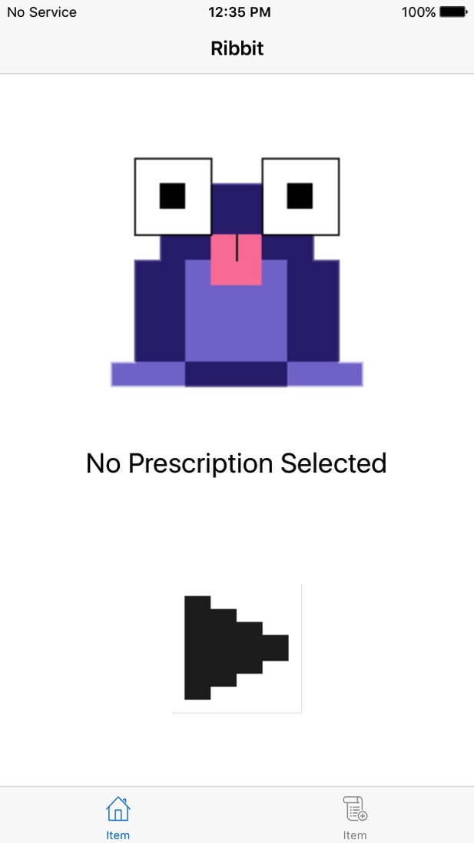
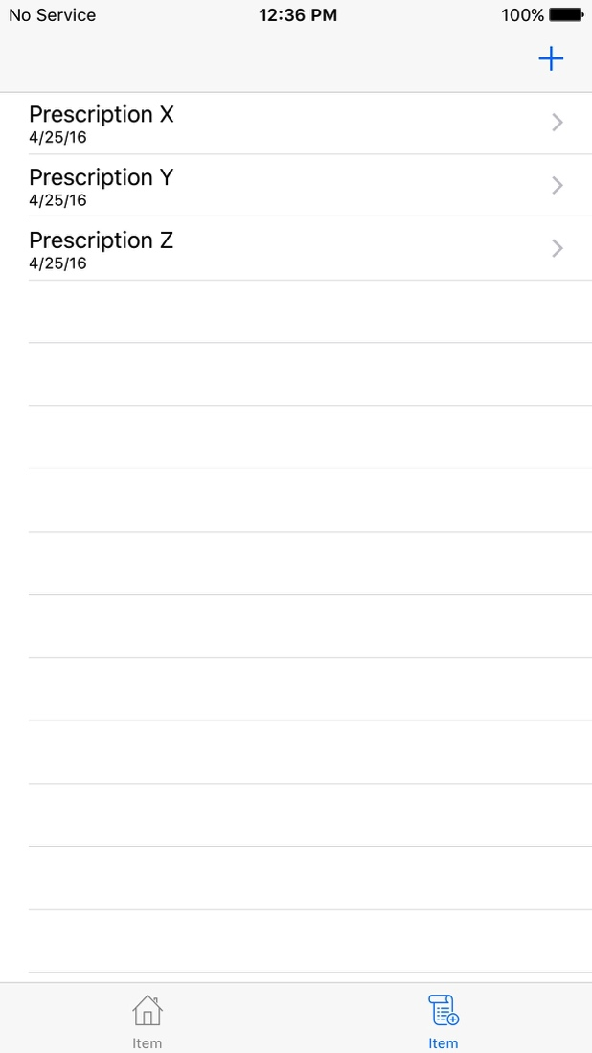
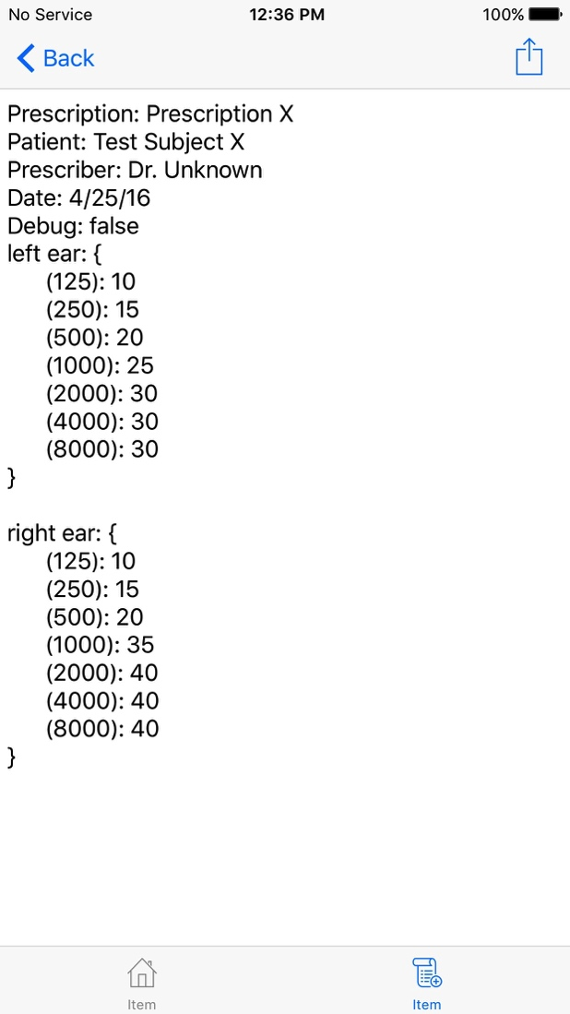
Ribbit Application
Notes:
Esteban

Slide 10
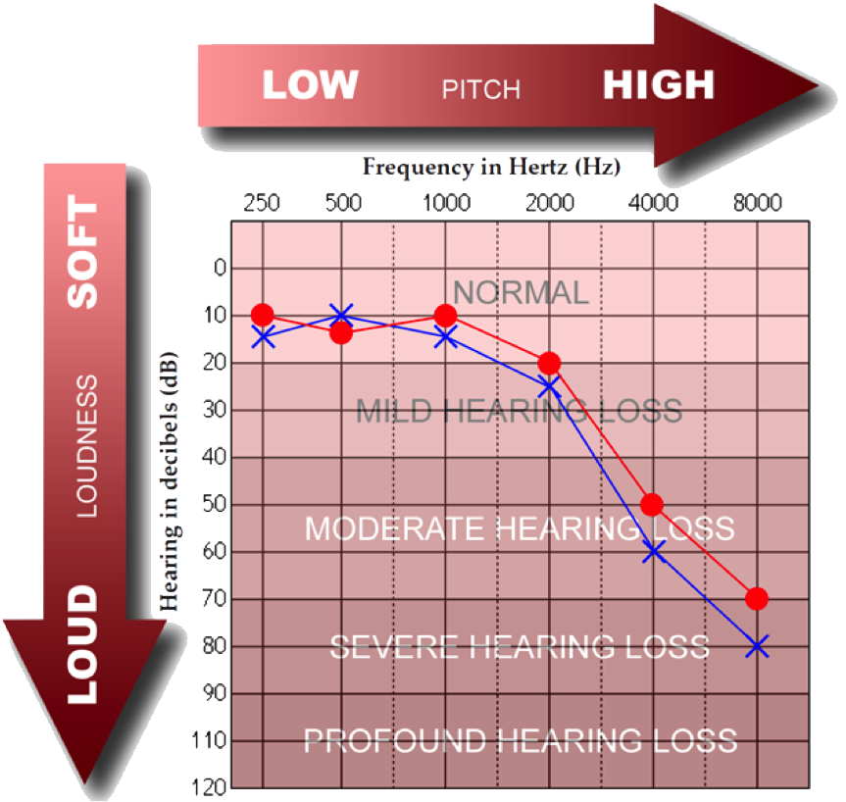
What is Rx?
“Prescription”
In the form of a graph - Audiogram
List threshold dB levels at different frequencies
Notes:
Duy
Picture source: http://www.centuryhearingaids.com/blog/tag/how-to-read-an-audiogram-how-to-read-your-hearing-test/

Slide 11
Prescription Handling
A convenient, secure method to load prescription (Rx)
QR code generation is done in a browser
Load into the phone using the camera
Stored in a SQLite Database, handled by OS
Notes:
Duy

Slide 12
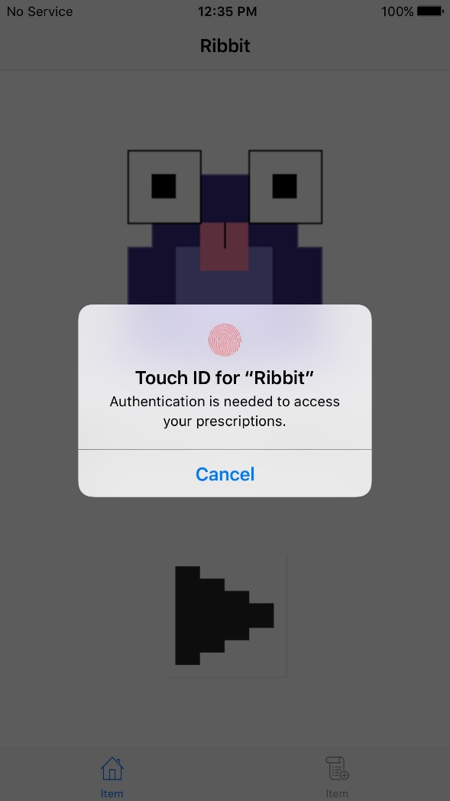
Privacy Preservation
Patient’s data is a privacy issue
Secure patient’s data
Touch ID is our solution
Notes:
Esteban

Slide 13

Prescription Persistence
Saving the prescriptions through CoreData Framework
  SQLite Database inside the application
  Cannot access the database outside the application
Notes:
Duy

Slide 14
Processing Requirements
Delay must be under 50 millisecond threshold
Processing must maintain a high level of precision
Must have a low impact on power consumption
Notes:
Duy

Slide 15
Fast Fourier Transform
An FFT is an implementation of a Discrete Fourier Transform
  It works on discrete samples of data
FFT implementation is used to:
  Break the signal into its constituent parts
  Recombine parts into a coherent signal
Utilizing the FFT implementation from Apple’s vDSP Library:
  Apply filtering operation
  Apply gain adjustments
Notes:
Esteban

Slide 16
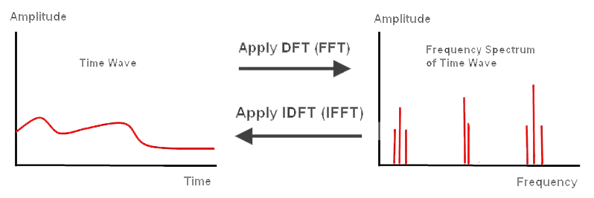
Fast Fourier Transform
Notes:
Esteban

Slide 17
System Architecture
Notes:
Esteban

Slide 18
Filtering
Filtering input sound removes:
  Background Noise
  Sound Artifacts
Filter Window designed:
  To reduce amplitudes between 4 and 24 kHz
  To reduce unnecessary noise
  To be infinitely differentiable
Notes:
Filtering the input sound removes noise and sound artifacts that otherwise impact the user’s ability to fully understand/comprehend speech
Esteban

Slide 19
Filtering
Slice shows difference in spectrum:
  Between input and output spectrum
  After Filtering Window has been applied
Filter Window designed:
  Point 180: ~8.2 kHz
  Point 195: ~8.9 kHz
2.47E-17
1.88E-17
-2.42E-17
Notes:
Filtering the input sound removes noise and sound artifacts that otherwise impact the user’s ability to fully understand/comprehend speech
Esteban

Slide 20
Filtering
Input Signal vs. Output Signal
  Orange – Input Signal
  Blue – Output Signal
Shows the difference between signals after:
  Applying Filter Window
  Applying Inverse FFT
Notes:
Esteban

Slide 21
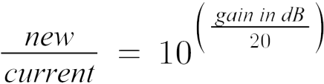
Gain Adjustments
Adjusting input signal’s gain:
  Increases amplitude based on prescription thresholds
  Increases each frequency component individually
Gain Window designed:
  Account for spectral leakage
  To be infinitely differentiable
  Formula:
Notes:
Duy
Hearing-impairment: loss of the ability to hear/detect some (usually higher) frequencies at the normal loudness
Hearing aid app gain requirements:
Boost a certain frequency by a specific dB
Calculate the dB values to increase each individual frequency by
Gain processing steps:
Compare the prescription of a normal-hearing person to that of the user
Generate a gain window based on the above comparison so that the window accurately reflect the gap
Vector-multiply the frequency domain signal buffer by the gain window to achieve the boosted signal

Slide 22
Gain Adjustments
Input Signal vs. Output Signal
  Orange – Input Signal
  Blue – Output Signal
Shows the difference between signals after:
  Applying Gain Window
Notes:
Duy

Slide 23
Gain Adjustments
Input Signal vs. Output Signal
  Orange – Input Signal
  Blue – Output Signal
Shows the difference between signals after:
  Applying Inverse FFT
Notes:
Duy
Hearing-impairment: loss of the ability to hear/detect some (usually higher) frequencies at the normal loudness
Hearing aid app gain requirements:
Boost a certain frequency by a specific dB
Calculate the dB values to increase each individual frequency by
Gain processing steps:
Compare the prescription of a normal-hearing person to that of the user
Generate a gain window based on the above comparison so that the window accurately reflect the gap
Vector-multiply the frequency domain signal buffer by the gain window to achieve the boosted signal

Slide 24
Combination Window
The product of the Filter Window and Gain Window
Created at Prescription Selection time
Used to reduce latency
Notes:
Duy

Slide 25
Combination Window
Combination Window Reduces:
  Latency with less operations
  Noise while Amplifying Sound
Duplicates Effects:
  Filtering Window
  Gain Window
Notes:
Duy
Hearing-impairment: loss of the ability to hear/detect some (usually higher) frequencies at the normal loudness
Hearing aid app gain requirements:
Boost a certain frequency by a specific dB
Calculate the dB values to increase each individual frequency by
Gain processing steps:
Compare the prescription of a normal-hearing person to that of the user
Generate a gain window based on the above comparison so that the window accurately reflect the gap
Vector-multiply the frequency domain signal buffer by the gain window to achieve the boosted signal

Slide 26
The Result
Filtering
Gain amplification
Clicking
  Filtering
  Gain amplification
  Both?
Notes:
Esteban
Using a cellphone as a hearing aid shows promise
In the future, we would like to test our application in a setting where human trials are possible
By tailoring the application to the user, we offer a more personal experience
Future enhancements would include the elimination of sound artifacts and the inclusion of smart technologies, such as location sensing

Slide 27
Partitions of Unity
Use of weight window
  Currently, a linear window from 0 to 1 across 1024 points
  Generated at the start of the application
Apply combination windows to three frames
Overlap Frame
Overlap Frame
+
=
Central Frame
Notes:
Duy
Hearing-impairment: loss of the ability to hear/detect some (usually higher) frequencies at the normal loudness
Hearing aid app gain requirements:
Boost a certain frequency by a specific dB
Calculate the dB values to increase each individual frequency by
Gain processing steps:
Compare the prescription of a normal-hearing person to that of the user
Generate a gain window based on the above comparison so that the window accurately reflect the gap
Vector-multiply the frequency domain signal buffer by the gain window to achieve the boosted signal

Slide 28
Partitions of Unity
Use of weight window
  Currently, a linear window from 0 to 1 across 1024 points
  Generated at the start of the application
Apply combination windows to the central frame and two overlapping windows (overlapping by 50%)
Notes:
Duy
Hearing-impairment: loss of the ability to hear/detect some (usually higher) frequencies at the normal loudness
Hearing aid app gain requirements:
Boost a certain frequency by a specific dB
Calculate the dB values to increase each individual frequency by
Gain processing steps:
Compare the prescription of a normal-hearing person to that of the user
Generate a gain window based on the above comparison so that the window accurately reflect the gap
Vector-multiply the frequency domain signal buffer by the gain window to achieve the boosted signal

Slide 29
Partitions of Unity
Input Signal vs. Output Signal
  Blue – Input Signal
  Orange – Output Signal
Shows the difference between signals without:
  Transition Smoothing
Notes:
Duy
Hearing-impairment: loss of the ability to hear/detect some (usually higher) frequencies at the normal loudness
Hearing aid app gain requirements:
Boost a certain frequency by a specific dB
Calculate the dB values to increase each individual frequency by
Gain processing steps:
Compare the prescription of a normal-hearing person to that of the user
Generate a gain window based on the above comparison so that the window accurately reflect the gap
Vector-multiply the frequency domain signal buffer by the gain window to achieve the boosted signal

Slide 30
Partitions of Unity
Input Signal vs. Output Signal
  Blue – Input Signal
  Orange – Output Signal
Shows the difference between signals after:
  Applying Transition Smoothing
Notes:
Duy
Hearing-impairment: loss of the ability to hear/detect some (usually higher) frequencies at the normal loudness
Hearing aid app gain requirements:
Boost a certain frequency by a specific dB
Calculate the dB values to increase each individual frequency by
Gain processing steps:
Compare the prescription of a normal-hearing person to that of the user
Generate a gain window based on the above comparison so that the window accurately reflect the gap
Vector-multiply the frequency domain signal buffer by the gain window to achieve the boosted signal

Slide 31
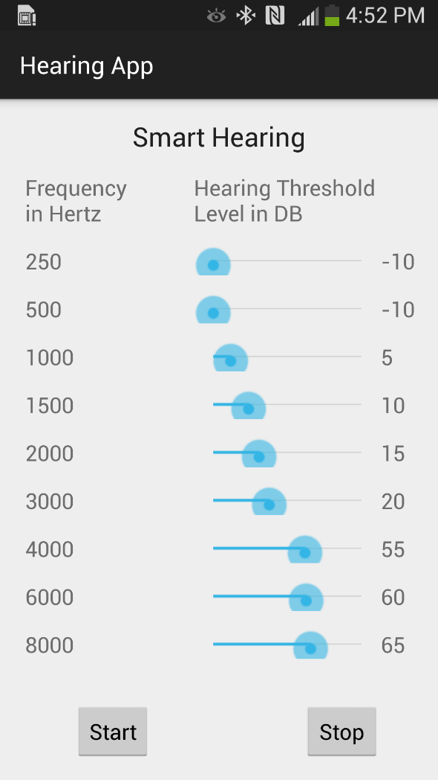
Back to the Beginning
Android
Time-domain
Pitch shifting
Ribbit sounds
Notes:
Robert
Summarize where we’ve come from, and where we are at. Talk about Android, Time-Domain Signal Processing, and then move on to PitchShifting, and finally conclude with where we are at

Slide 32
Lessons Learned
Android is not suited for real time sound processing
FFT is difficult to implement in applications
Procrastination does not bode well for these projects
Notes:
Robert
Summarize where we’ve come from, and where we are at. Talk about Android, Time-Domain Signal Processing, and then move on to PitchShifting, and finally conclude with where we are at

Slide 33
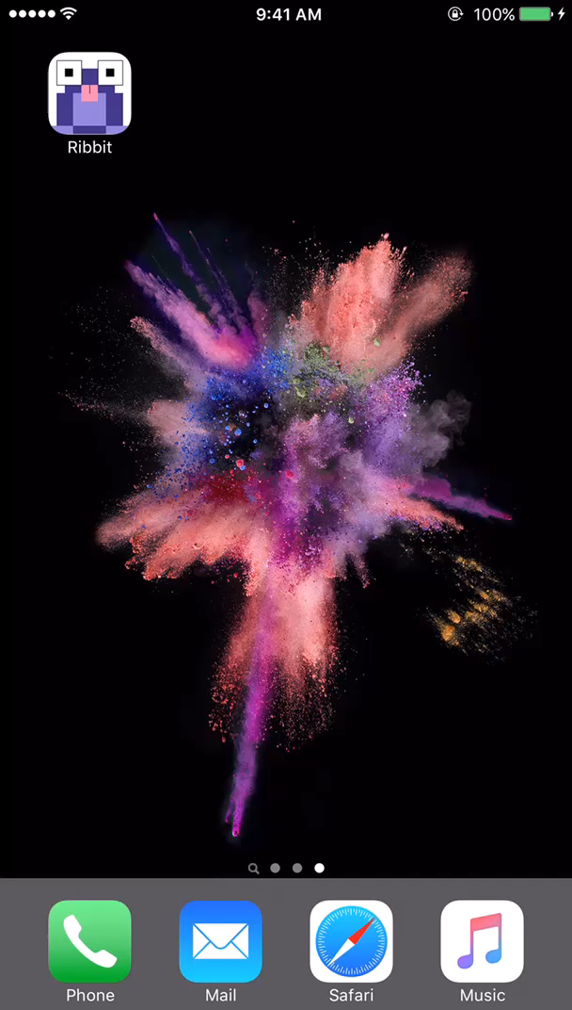

Demo
Notes:
Robert

Slide 34
Acknowledgements
The team would like to thank Dr. Payne for pushing us to reach our end goal, Dr. Ma for giving us a challenging project to work on, Dr. Richardson for helping us through the quagmire that is math, and Katie Grebel for helping with all of the work that was needed to get this project off the ground and heading in the right direction. We would also like to thank Dr. Watts and Tracy Burger from the Miller Speech and Hearing Clinic for helping us understand what goes into audiograms. Finally, Dr. Cooper from Psychology.
Notes:
Robert

Slide 35
Questions
Notes:
Still need an acknowledgement slide.

