Slide 1

Ribbit
Duy dang, Robert kern, esteban kleckner
Notes:
R

Slide 2
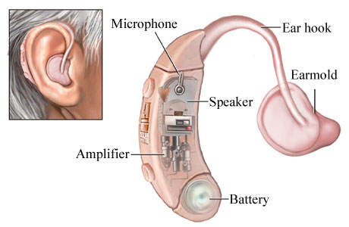
Project background
Hearing aids
  Aim to process and amplify sounds into desirable ranges
However, they are expensive
  Only 20% of people in the U.S. needing a hearing aid have one
Notes:
R

Slide 3
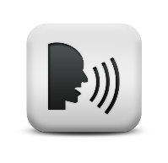
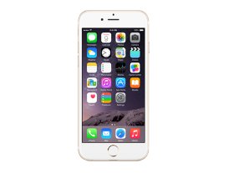
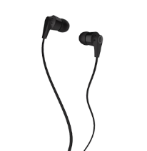
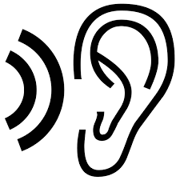
Our idea: an overview
Recent advances have made smartphones more powerful
  There is an opportunity to fill this gap
Input Sound
An App Processes and Outputs
Output Sound
Notes:
R

Slide 4
Major challenges
Tight sound processing delay
  Playback latency must be less than 50ms
User diversity
  Separate sound processing for each ear
User friendly
  Parameter control and adjustments
Privacy protection
  User information must be secured according to HIPAA
Limited resources
  Most of the hearing aid designs are proprietary
Notes:
R

Slide 5
Use case
Notes:
R

Slide 6
The key is sound processing!
How does our App process the sound?
Notes:
R

Slide 7
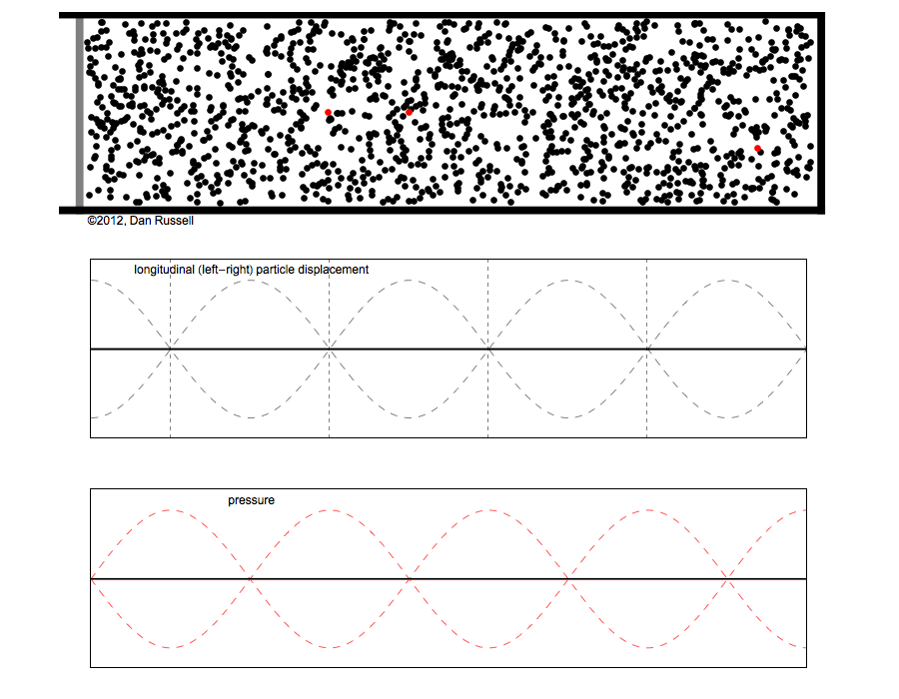
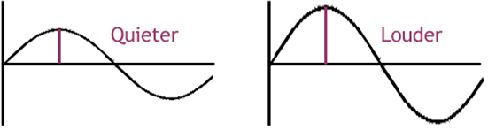
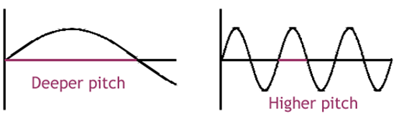
What is sound?
Sounds are vibrations traveling through the air as waves
Composed of a series of amplitudes (loudness )and pitches (quantified by frequencies)
Notes:
Robert
All sounds are vibrations traveling through the air as sound waves. Sound waves are caused by the vibrations of objects and radiate outward from their source in all directions. A vibrating objectcompresses the surrounding air molecules (squeezing them closer together) and then rarefies them (pulling them farther apart). Although the fluctuations in air pressure travel outward from the object, the air molecules themselves stay in the same average position. As sound travels, it reflects off objects in its path, creating further disturbances in the surrounding air. When these changes in air pressure vibrate your eardrum, nerve signals are sent to your brain and are interpreted as sound.

Slide 8
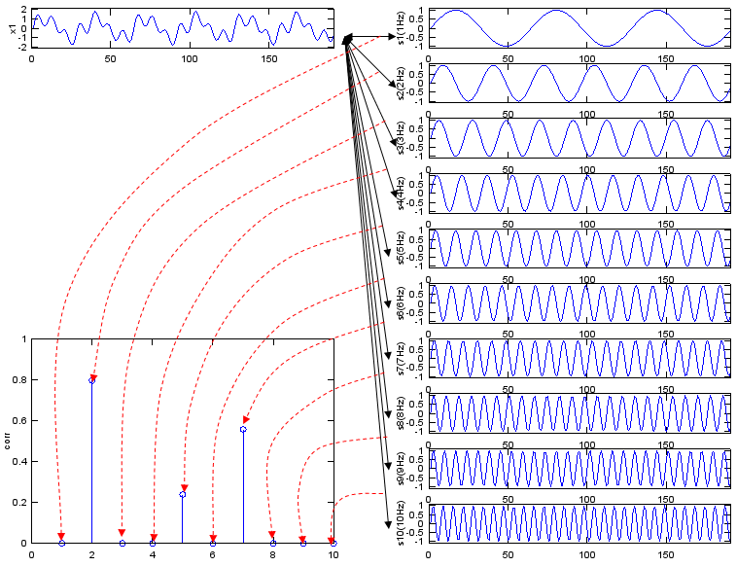
complex sound waves illustrated
Notes:
D

Slide 9
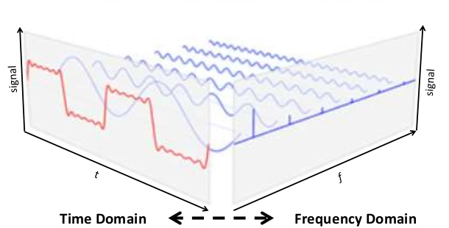
A 3d representation

Slide 10
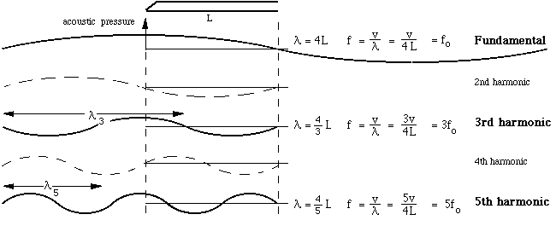
Fundamental and harmonic components

Slide 11
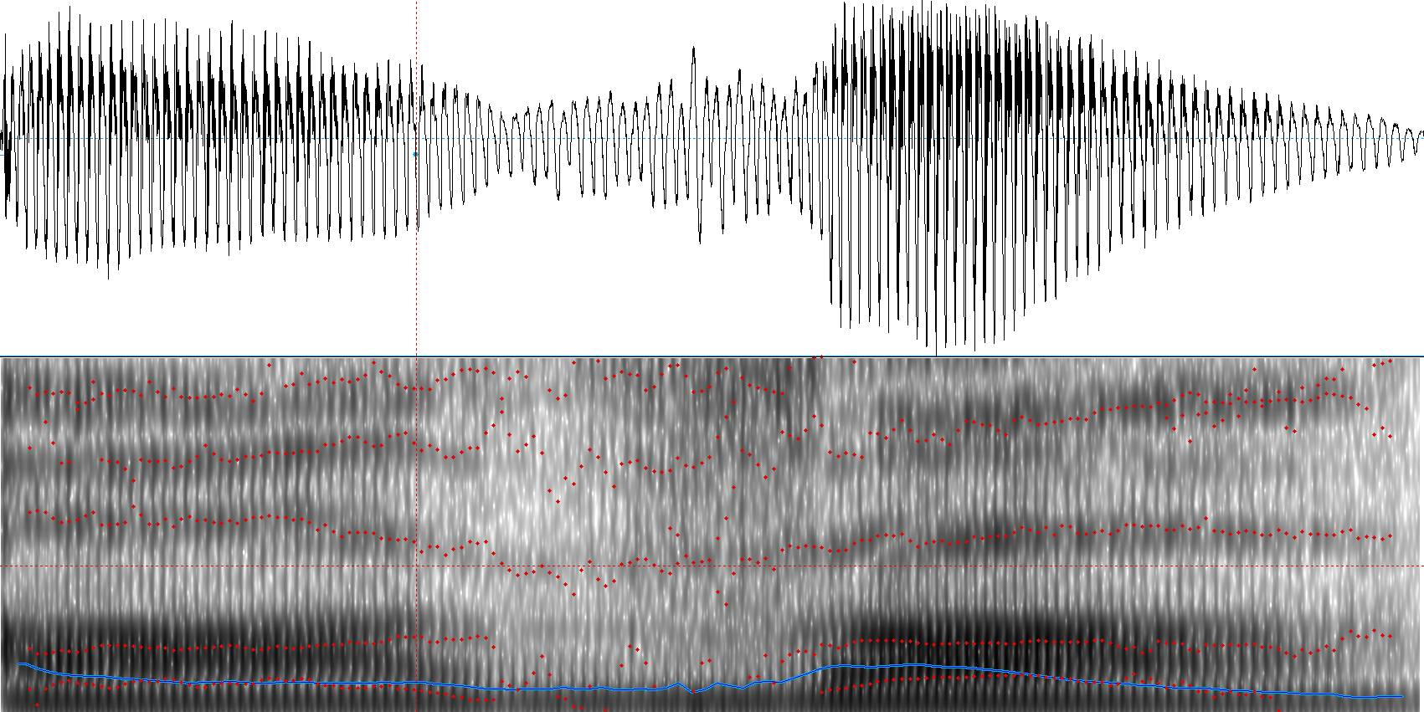
complex Sound wave represented in
Fundamental and harmonic
Sound wave
Harmonics
Fundamental
Notes:
D

Slide 12
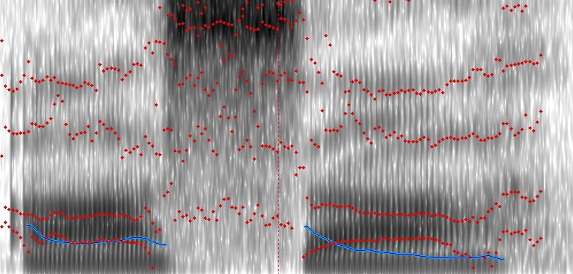
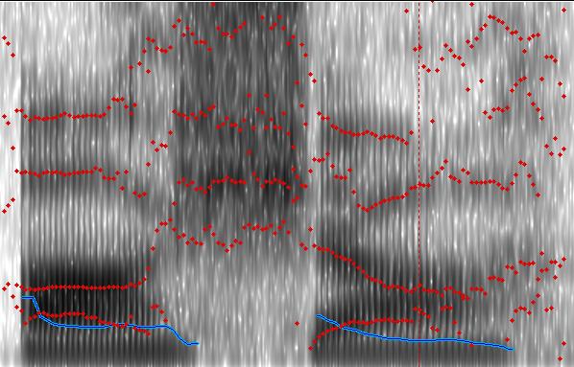
Why cannot hear (understand) sound?
“Asa vs. asha”
Pitch
Pitch
Time
Time
The main task of our App is to amplify the harmonics (in the red circles) of the sound to a desired level
Notes:
D

Slide 13
We need to amplify sound according to the frequency
How to convert sound waves to the frequency domain?
Notes:
D

Slide 14
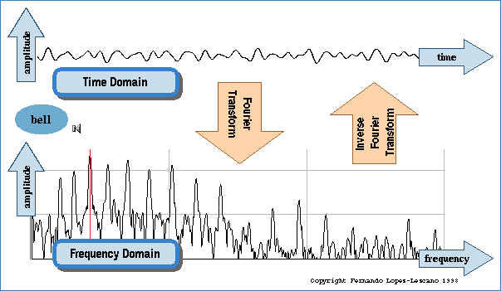
Fourier Transform: domain converter
Notes:
This is how we view both a time domain representation (waveform) and a frequency domain representation (fft) of a particular sound (a bell).
D

Slide 15
Fast Fourier Transform (fft)
An FFT is an implementation of a Discrete Fourier Transform
  It works on a range of data
An FFT reads input from the Time Domain and writes output in the Frequency Domain
  It works on a range of data
https://developer.apple.com/library/prerelease/mac/documentation/Accelerate/Reference/vDSPRef/index.html#//apple_ref/c/func/vDSP_fft_zrip
Notes:
D

Slide 16
What happens next after FFT?
Now, we are in the frequency domain.
What is next?

Slide 17
Filtering certain frequencies
Why?
  One quick and easy way to help the hearing impaired is to remove certain frequencies
  The range of 4 – 8 kHz does not provide information that helps the human mind process speech
  By removing sound/noise in this range we help emphasize speech
Notes:
esteban
“Graph here?”

Slide 18
How to filter?
2. Take the FFT of the AudioBuffer
3. Utilize Frequency Domain to Filter out specific frequencies
4. Take the inverse FFT of processed AudioBuffer
5. Place AudioBuffer back on the queue to be played
1. Take sound off the AudioBuffer
Must occur within 20.833 microseconds
Notes:
Esteban
“UML Diagram or some kind of circular flow chart. We can put up the time it takes to complete one cycle. 1/48000 seconds”

Slide 19
Increase GAINs (amplitude) + SHIFT Frequency
Why?
  Hearing loss -> cannot hear certain important high-frequency components of speech
  Gain -> increase loudness of those frequencies
  Shift -> shift all components in speech to lower frequencies
Notes:
What we want to do in the future
E

Slide 20
Hardware limitations
The biggest inhibitors are the Microphone and Software Limitations
The sample rate is the number of times the microphone samples in 1 second
The iPhone records sound at rates up to 192kHz
However, software limitations limit this rate to 48kHz
Notes:
Esteban
E

Slide 21
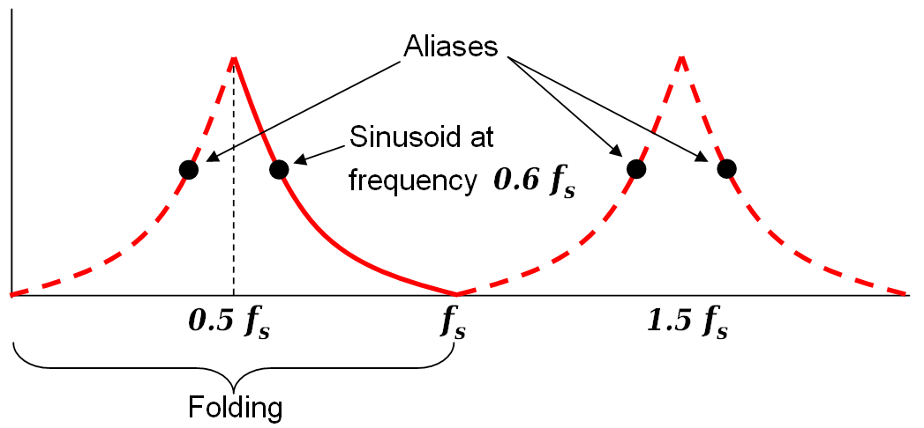
Why worry about the Sampling Rate?
The sample rate is chosen based on the frequencies that want to be preserved during processing
By choosing a rate of 48kHz we guarantee that the range of 0-24 kHz will be relatively free of aliasing
https://en.wikipedia.org/wiki/Nyquist_frequency
Notes:
Esteban
E

Slide 22
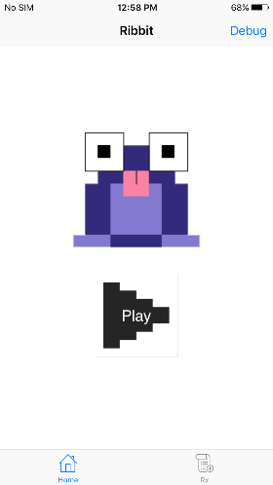
DEMO
Processed sound samples – old and new
QR code
  http://tcuhearing-ribbitcu.rhcloud.com
Notes:
All

