Slide 1

Duy Dang, Robert Kern, Esteban Kleckner
Notes:
robert

Slide 2
Summary of Topics
Sound
Project background
Project requirements
Algorithm
System architecture diagram
Next semester
Notes:
Robert

Slide 3
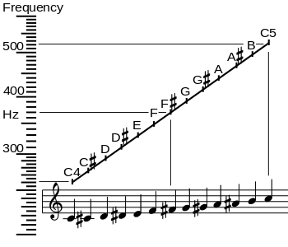
Sound and pitch
Sound is just a series of frequencies and pitches
The ear recognizes these sounds and converts them into signals that we can recognize
Notes:
Robert

Slide 4
Digital Representation of a sound wave
Time (sec) | Amplitude of Wave @ Time
(0/16) | 0
(1/16) | 1
(2/16) | 0
(3/16) | -1
(4/16) | 0
……………………………………………… | ………………………………………………
(16/16) | 0
This wave can be represented by the matrix above. Example: sampling rate= (1/16)sec
Notes:
Duy

Slide 5
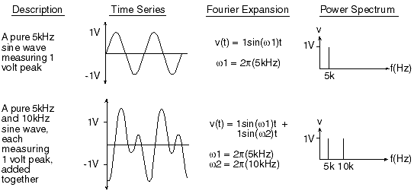
Fourier transforms and frequency
Mathematical process to change from one domain to another
  From the time domain to the frequency domain
An Inverse Fourier transform is the same thing
  From the frequency domain to the time domain
Notes:
Duy

Slide 6
Project background
Hearing aids
  Aim to process and modify sounds into desirable ranges
  However, they are expensive
    Only 20% of people in the U.S. need a hearing aid that have one
Mobile devices
  Recent advances have made smartphones more powerful
  There is an opportunity to fill this gap
Notes:
Duy

Slide 7
General requirements
User must have access to an iPhone
Read in prescription via a QR code
Microphone must support a sampling rate of at least 44.1 kHz
Playback latency must be less than 50ms
User information must be secured to HIPAA requirements
Notes:
Duy

Slide 8
Algorithm (50,000 foot view)
Record sound
Process sound
Play sound
Notes:
Duy

Slide 9
Algorithm (10,000 foot view)
Phone gets sound
Finds the fundamental frequency
  If change is needed, modify the sound by pitch shifting
Play sound regardless if change is needed
Notes:
Esteban

Slide 10

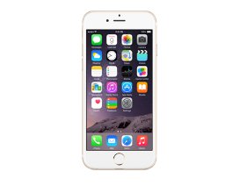
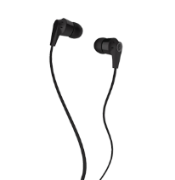

System architecture
(50,000 foot view)
Input Sound
Output Signal
Output Sound
Notes:
Esteban

Slide 11
System architecture
(10,000 foot view)
Notes:
Esteban

Slide 12
Schedule
Task | Completion Date
Iteration 2: Completed Algorithm | January 31, 2016
Faculty Presentation | February 2, 2016
User Manual | February 11, 2016
Iteration 3: Clinical Testing | March 11, 2016
SRS Poster Submission | March 31, 2016
Iteration 4: Final Tweaks | April 1, 2016
Developers Manual | April 5, 2016
SRS | April 8, 2016
NTASC Wichita Falls | April 16, 2016
Complete All Documentation | April 24, 2016
Final Presentation | April 28, 2016
Notes:
Esteban

Slide 13
What’s to come
Updating the algorithm
Prescription model
Human trials
Notes:
Esteban

Slide 14
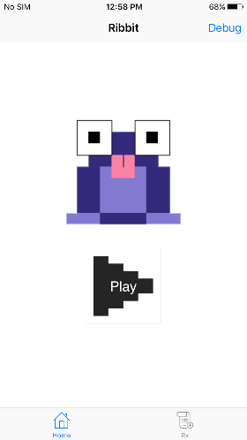
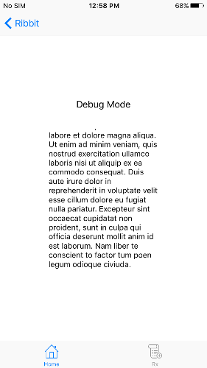
Screenshots of the application
Notes:
Robert

Slide 15
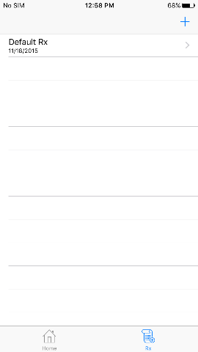
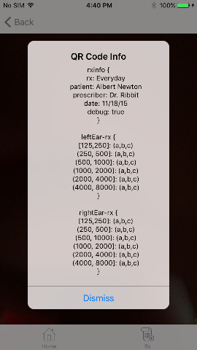
Screenshots of the application
Notes:
Robert

Slide 16
demonstration
Notes:
Robert

