Slide 1
Elemental Kinection
TCU Senior Design Project, 2015-16

Slide 2
Project Team
Samuel Kent
Nathan Johnson
Jack Kempner
Aakash Tyagi

Slide 3
Project Overview
Elemental Kinection looks to improve on tele-rehabilitation by introducing the ability for therapist to dynamically add exercises to the application without the need for programmer assistance
This is achieved through two distinct applications:
User
Therapist

Slide 4
Functional Requirements
General Requirements
Therapists shall be able to create new exercises for the application
Therapists shall be able to prescribe therapy sessions remotely
Therapists shall be able to view results of therapy sessions remotely
Patients shall be able to obtain therapy sessions remotely
Patients shall be guided through exercises by the Kinect application
Patients shall receive real-time and historical assessments of their therapy

Slide 5
Functional Requirements
Kinect Application Requirements
The patient shall be able to navigate the menus of the application with simple gestures as well as with mouse and keyboard
The application shall be able to receive an exercise from either a web or local source
The patient shall be guided through their therapy session by the application via avatar
The patient shall receive real-time feedback on accuracy of exercise and number of repetitions
The application shall be able to store the results of the exercise and either upload them to the server or save them to a file that can be transferred via physical storage medium
Exercises must be either sitting or standing for the Kinect application to register them

Slide 6
Functional Requirements
Database Requirements
Each patient and therapist shall be assigned a unique ID.
One-to-many connection between therapist and their patients
Database shall store therapy session results of each user
Interactions with database shall be through the web application and the desktop application
Database shall store and accept new exercises

Slide 7
Functional Requirements
Web Application Requirements
Each therapist and user shall have a unique login ID and password
Therapist shall have a page that allows them to upload therapy sessions
Therapist shall have a page that allows them to upload new exercises
Therapist shall have a page that allows them to view past result of patients
Therapist shall have functionality to add new patients to the system
Patients shall be able to log in to see their results
Patients shall be prohibited from altering the database

Slide 8
Non-functional Requirements
Product Requirements
Kinect application shall be able to track exercises based on a confidence interval of 0.75 to 1.0
Results shall be displayed in a graphical representation of completed reps and exercises
The web application and database shall have a response time of less than 2 seconds
The Kinect application shall have a response time of less than a second
Patients shall be able to use Kinect application with our provided instructions manual

Slide 9
Non-functional Requirements
Organizational Requirements
The Kinect v2 is the compatible hardware version of the Kinect used in this application
A therapist is required to set up an account for the user and prescribe sessions

Slide 10
Non-functional Requirements
External Requirements
The database shall remove, when possible, personally identifying information
Therapists shall be able to effectively learn gesture builder through online manuals and walkthrough videos

Slide 11
System Architecture

Slide 12
Web Application
Web development for Elemental Kinection

Slide 13
System Architecture

Slide 14
Web Application - General
Web is a highly programmable environment that allows mass customization through a large and diverse range of applications
Web applications are computer programs allowing website visitors to submit and retrieve data to/from a database over the Internet using their preferred web browser
The data is then presented to the user within their browser as information is generated dynamically (in a specific format, e.g. in HTML using CSS) by the web application through a web server

Slide 15
Advantages of web apps
They perform their function irrespective of the operating system and browsers running client side
Web applications are quickly deployed anywhere at no cost and without any installation requirements (almost) at the user’s end

Slide 16
How do web apps work?
Three-layered web application model
The first layer is normally a web browser or the user interface
The second layer is the dynamic content generation technology tool such as Java servlets (JSP) or Active Server Pages (ASP)
The third layer is the database containing content (e.g., news) and customer data (e.g., usernames and passwords, social security numbers and credit card details)

Slide 17
A general web app architecture

Slide 18
Meet Django
Django is a high-level Python Web framework that encourages rapid development and clean, pragmatic design
It’s free and open source
Ridiculously fast – concept to completion as quickly as possible
Fully loaded - includes dozens of extras you can use to handle common Web development tasks
Reassuringly secure, exceedingly scalable and incredibly versatile

Slide 19
Security in Django
Cross site scripting (XSS) protection
Cross site request forgery (CSRF) protection
SQL injection protection
Clickjacking protection
SSL/HTTPS
Host header validation

Slide 20
Popular sites built with Django
Pinterest
Instagram
Bitbucket
Spotify
NASA
Prezi
Eventbrite
Firefox

Slide 21
How to get Django
https://www.djangoproject.com/download/

Slide 22
Database – MySQL
SQL stands for Structured Query Language
SQL lets you access and manipulate databases
MySQL is the world’s most popular open source database
Enables the cost-effective delivery of reliable, high-performance and scalable Web-based and embedded database applications

Slide 23
Database – ER model

Slide 24
Database – User types
Admin
Responsible for maintaining the database, website, and accounts
Therapist
Can act as an admin account
Patient
No personal data stored

Slide 25
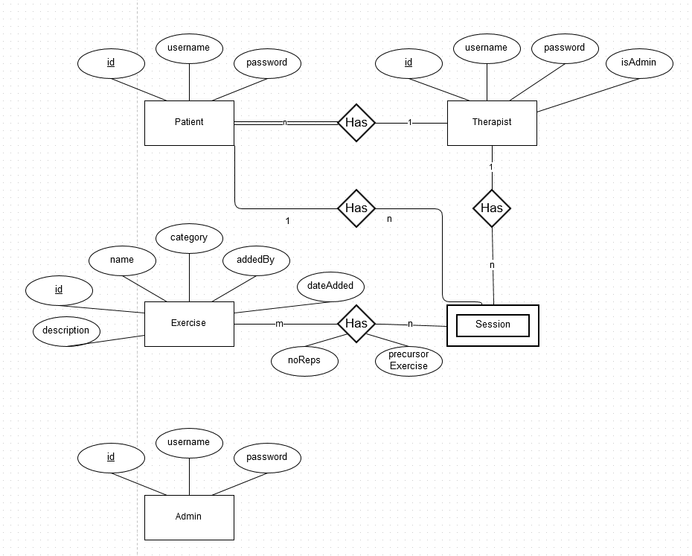
Database – ER model

Slide 26
Database - Exercises
Data on exercises is stored in .gba format
Number of reps per session is stored in the relationship between exercises and sessions

Slide 27
Web App - Development
XAMPP for MySQL server
XAMPP is an integrated server package of Apache, MySQL, PHP and Perl (the AMPP in XAMPP) that all run from a removable drive.
Python 2.7.5
Django 1.7.9
That’s it – start developing!

Slide 28
How much have we done?
Setting up local development server
Setting up database
A running Django application
Ability to create accounts – Admin, Therapist and Patient

Slide 29
Sneak peak – project directory

Slide 30
Sneak peak – models.py

Slide 31
Sneak peak – views.py

Slide 32
Sneak peak – settings.py

Slide 33
Sneak peak – urls.py

Slide 34
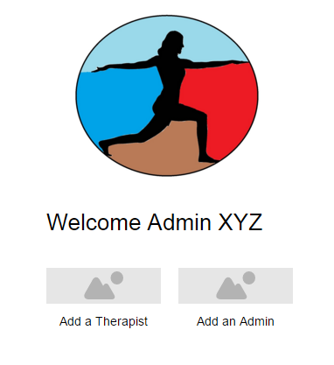
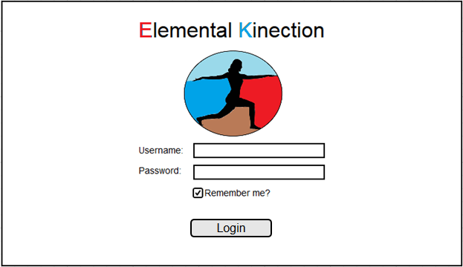
Prototypes
Admin Homepage
Login Screen

Slide 35
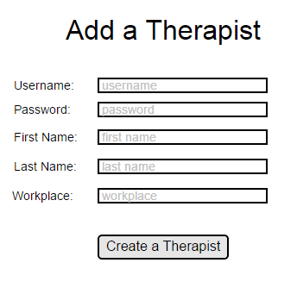
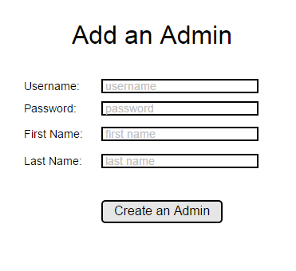
Prototypes
Admin – Create a Therapist
Admin – Create an Admin

Slide 36
Prototypes
Therapist Home Page
Exercise List

Slide 37
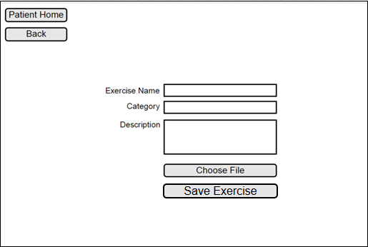
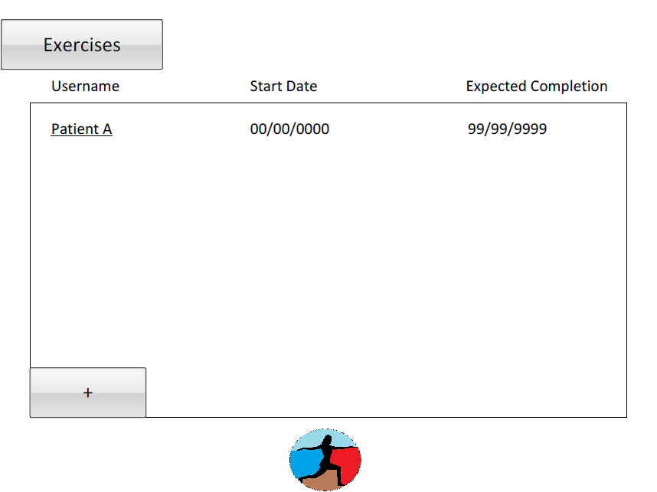
Prototypes
New Exercise
Patient List

Slide 38
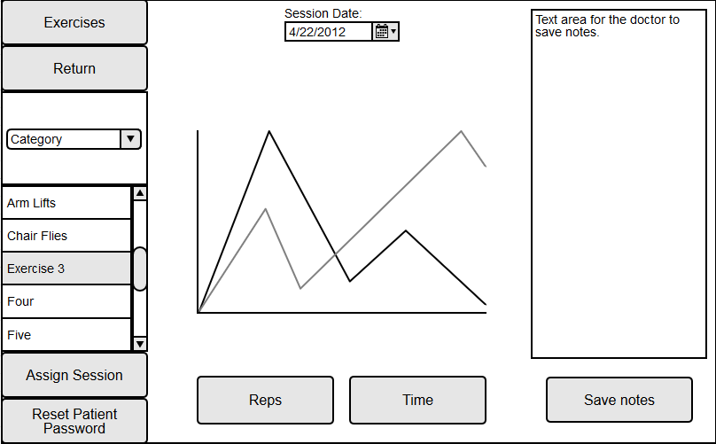
Prototypes
Add New Patient
View Patient

Slide 39
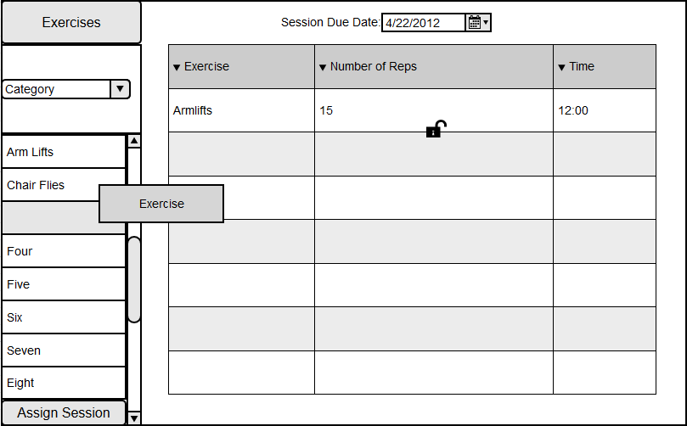
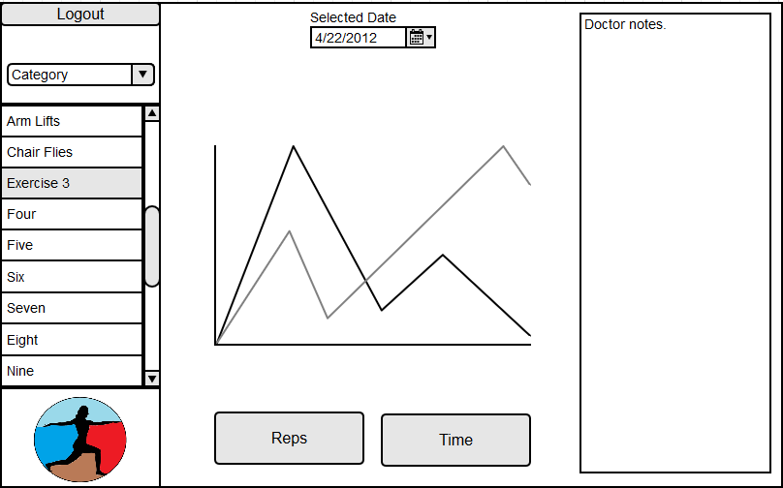
Prototypes
Assign Session
Patient Home Page

Slide 40
The Kinect
Hardware, Software and how it applies to Elemental Kinection

Slide 41
What is a Kinect?
A package of sensing equipment designed for the purpose of motion and audio tracking in a 3 dimensional environment
The Kinect Sensor contains the following components:
1080x1920 color video camera
512x424 Infrared Camera
4 directional microphones
3 Infrared Transmitters for depth sensing
The Kinect for Windows also comes with a converter block for Windows based applications

Slide 42
Kinect - Capabilities
Has an effective range of depth sensing from .5 to 4.5 meters with a field of view 70x60 degrees
Color imaging is captured at 30 fps in good light and 15 fps in low light
The directional microphones can track the origin of sound and focus on specific regions in the Kinect space
The Kinect can track 25 distinct joints, both location and orientation arranged in a skeleton

Slide 43
Kinect - Requirements
The user of the Kinect, in our case the patient or therapist, must have a PC with the following specifications:
An i7 Processor is recommended but the application was developed on i5’s
4GB of RAM (recommended)
DirectX 11 (required)
USB 3.0 Intel or Renesas chipsets (required w/ spotty success on other chipsets)
Windows 8/8.1 (required) haven’t tested Windows 10

Slide 44
Kinect - Limitations
As mentioned previously performance is degraded in poor lighting
The Kinect is unreliable in detecting quick and jerky movements
The Kinect operates most reliably when it has a front on view of the user
A cluttered space can result in the Kinect having difficulty detecting joints

Slide 45
Kinect – Architecture (v2)
The Kinect provides API’s for development of native(C++), .NET, WinRT and Unity (not pictured) applications on the Kinect

Slide 46
Kinect – Data sources
Sensor
Source
Reader
Frame
Frame Ref

Slide 47
Visual gesture builder

Slide 48
Visual gesture builder - continued

Slide 49
Visual gesture builder - finally

Slide 50
Unity

Slide 51
Unity - continued

Slide 52
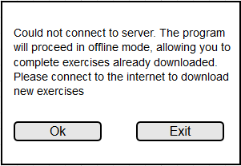
Kinect - Prototypes
Login Screen
Error Screen

Slide 53
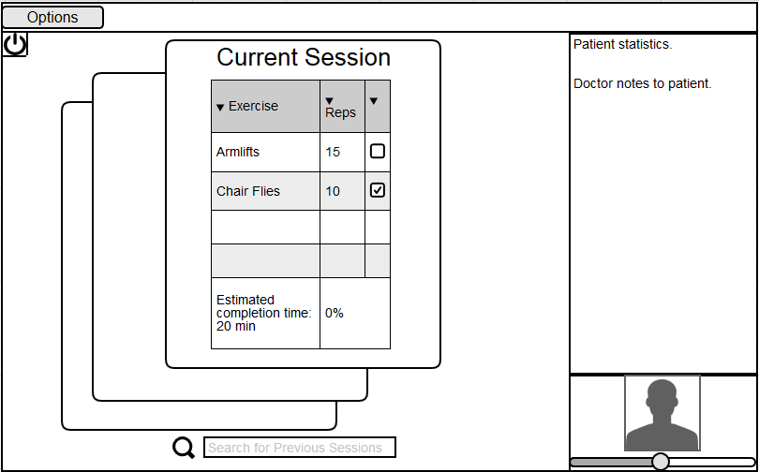
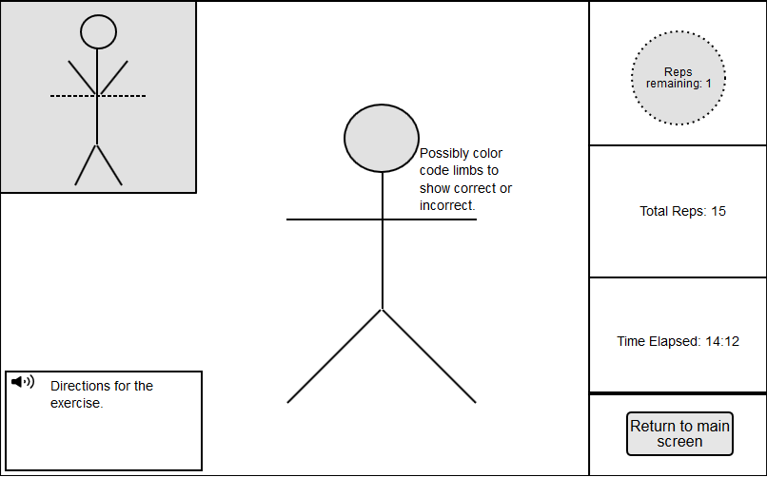
Kinect - Prototypes
Kinect Main Screen
Kinect Exercise Screen

Slide 54
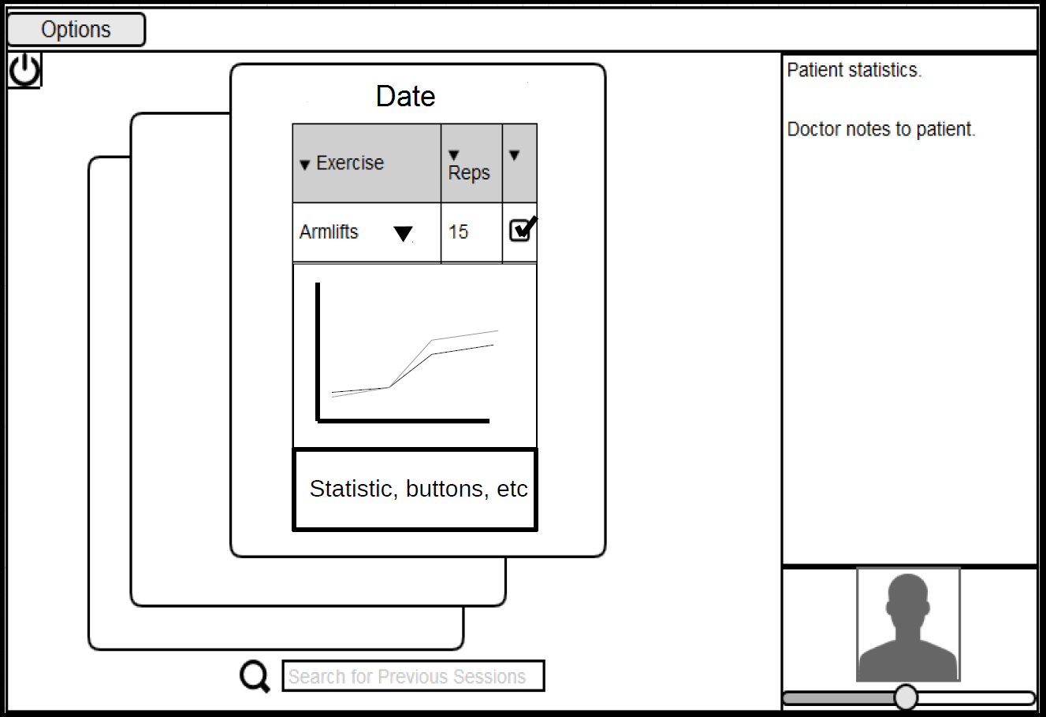
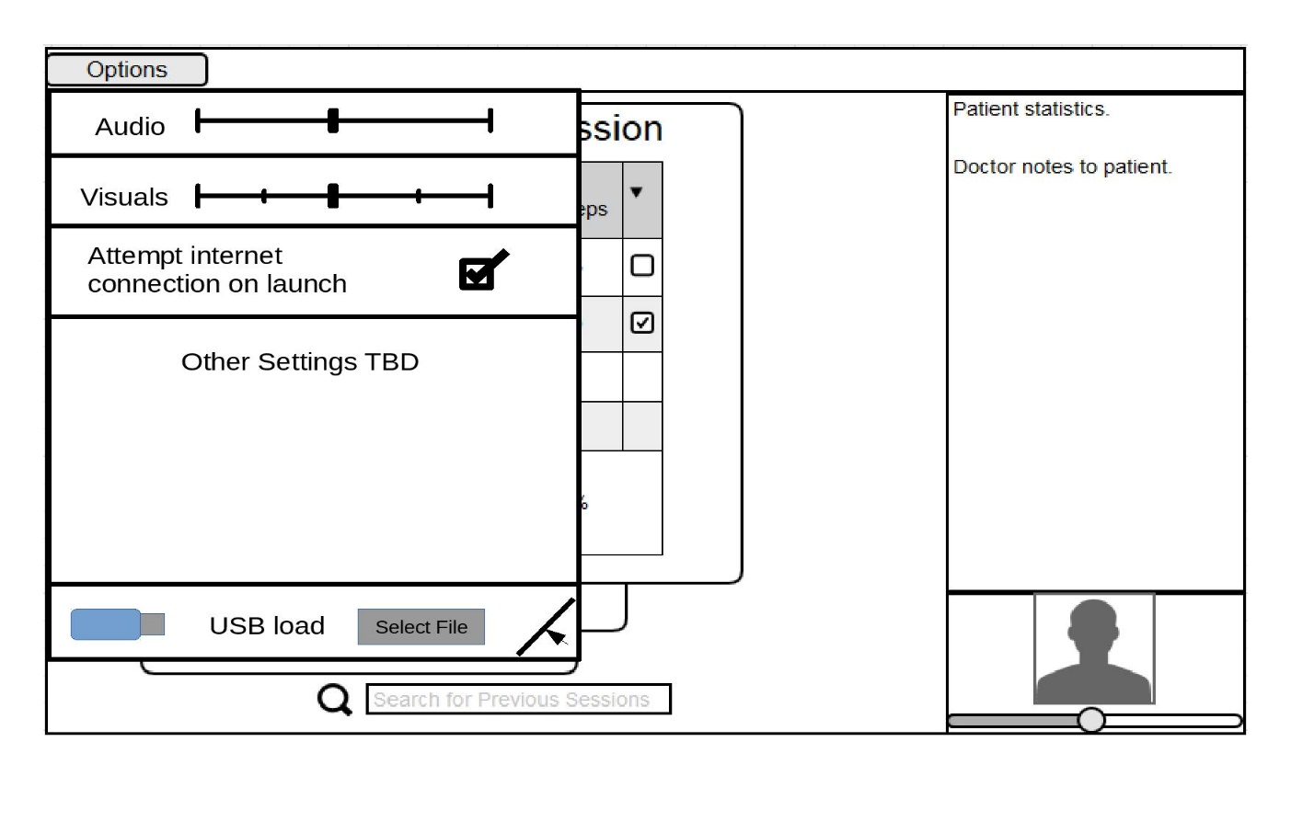
Kinect - Prototypes
View Statistics
View Settings

Slide 55
Machine learning vs Heuristic
How Kinect learns

Slide 58
Milestones and Deliverables
Milestone/Deliverable | Date
Project Plan V1.0 | October 13, 2015
Skeleton Website | October 13, 2015
Project Support Environment | October 15, 2015
Requirements Documentation V1.0 | October 29, 2015
Design Documentation V1.0 | December 3, 2015
Iteration I | December 10, 2015
Iteration II | January 22, 2015
Iteration III | February 26, 2015
Iteration IV | March 25, 2015
NTASC | April 22, 2016
SRS | April 22, 2016
Final Presentation | May 28, 2016
Documents and DVD | May 28, 2016

Slide 59
Iterations
Iteration 1:
Core functionality of application for guiding and measuring exercises is complete
Extent of Unity contribution is decided and environment is created. Beginning stages of integration with Kinect are established
Web-based technologies for the database and website are researched and selected at this point. Core schema of the database is determined. Basic integration of website and database is complete.

Slide 60
Iterations
Iterations 2:
Application for guiding and measuring exercises is in the stage of being combined with Unity for a complete package for users
Method for how therapist will store sessions in the database is finalized.
Interface for therapist to upload and store sessions and new exercises is finalized.
Work begins on linking local applications into the web-based database

Slide 61
Iterations
Iteration 3:
Therapist is able to load new exercises and sessions to web-based site/database
Application is able to update with these sessions and exercises to serve the user
Application is able to transmit results

Slide 62
Iterations
Iteration 4:
A customer ready product is produced
If a client has emerged at this point extensive cooperative testing is conducted
General testing and tweaking is done at this point

Slide 63
Thank you
Questions / Feedback / Suggestion?

