Slide 1

Elemental Kinection
Jack Kempner, Sam Kent, Nathan Johnson, Aakash Tyagi
Capstone Project, 2015-16
Computer Science Department
Texas Christian University

Slide 2
Background
According to the World Health Organization Media Centre, over 15% of the world's population suffer from some type of disability*
Therapy often needs to be continued at home
Take-home sessions may not be completed effectively or at all
[*] http://www.who.int/disabilities/world_report/2011/report/en/
Notes:
Rewrite this.

Slide 3
Project Overview
Several other therapy projects also use the Kinect: Reflexion Health, Kinect’in Therapy, and others
Elemental Kinection differentiates itself by using machine learning
Elemental Kinection is divided into two distinct components:
  Desktop Application
  Web Application
Notes:
Add more detail on machine learning.

Slide 4
Goals
Therapists will be able to dynamically add new exercises
Sessions will be able to be sent remotely to a patient’s desktop
The Kinect v2 will provide feedback on performed exercises
Both the therapist and patient will be able to view session results

Slide 5
Technical Introduction
Elemental Kinection utilizes the following technologies:
  Kinect v2
  Microsoft Visual Gesture Builder
  Unity 3D
  Django
  Amazon Web Services

Slide 6
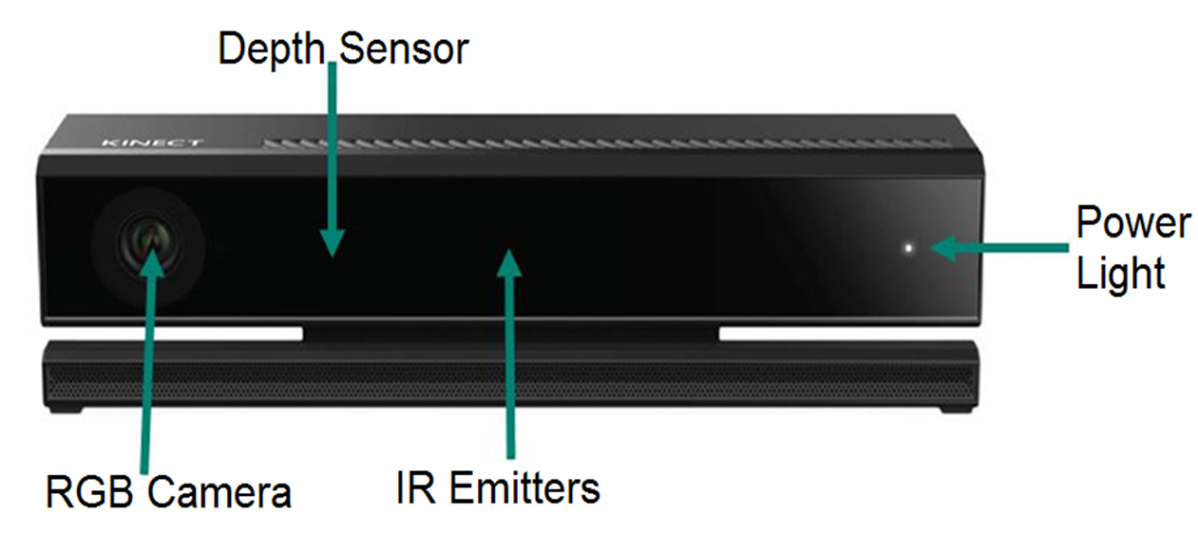
What is the Kinect v2?
The Kinect Sensor contains the following components:
  1080x1920 color video camera
  512x424 IR camera
  3 IR transmitters for depth sensing
The Kinect for Windows comes with a convertor for use with a PC

Slide 7
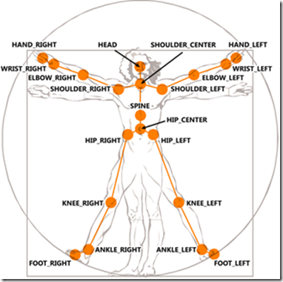
Kinect - Capabilities
Has an effective range of depth sensing from .5 to 4.5 meters with a field of view 70x60 degrees
Color imaging is captured at 30 fps in good light and 15 fps in low light
The Kinect can track 25 distinct joints, both location and orientation arranged in a skeleton

Slide 8
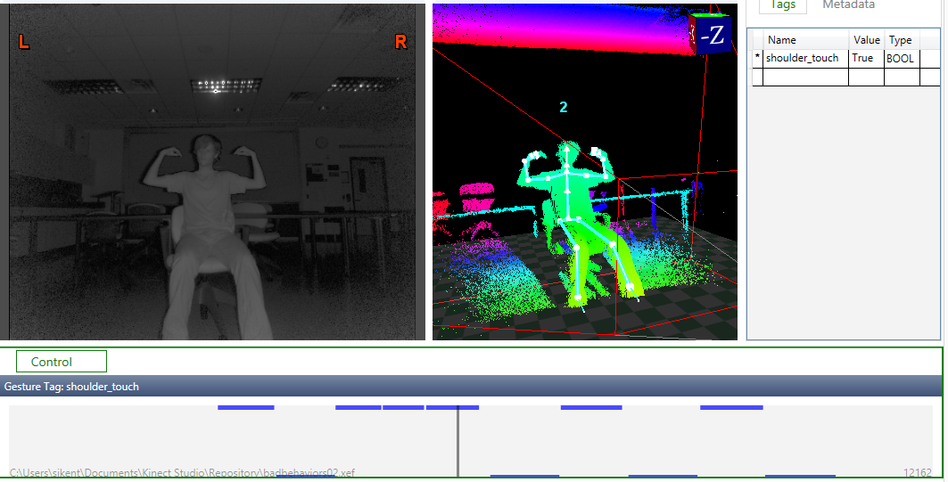
Visual Gesture Builder
Notes:
Write more on VGB.

Slide 9
Comparison
Heuristics
Machine Learning
Heuristics is considered a "Code-Driven" problem
Allows the programmer direct control
Can be more “strict” than machine learning
Machine learning is considered a “Data-Driven" problem
Exact definition of recognition is left up to algorithm
Can be “loose” in its recognition of gestures

Slide 10
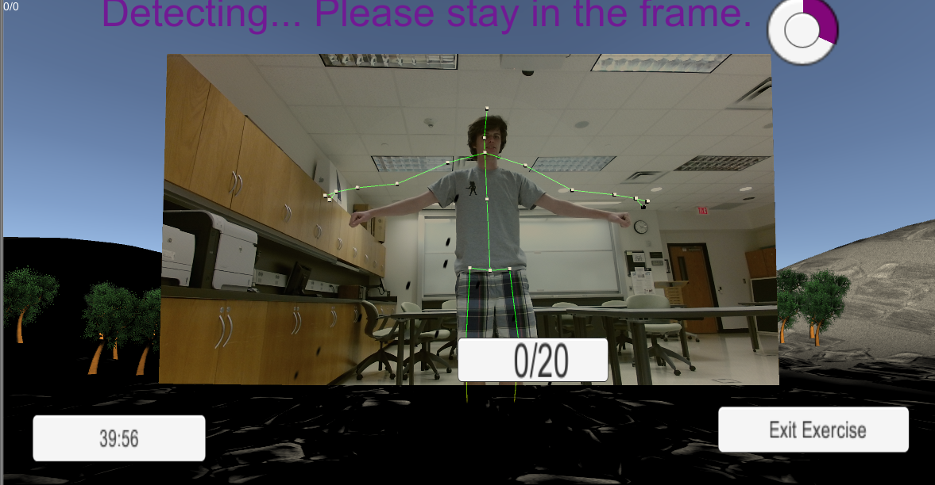
Unity 3D
Game development engine
Communicates with Kinect to track exercises
Displays statistics to patient in a graph format
Creates a more interesting environment background
Notes:
Cut down on Unity?

Slide 11
Web Technologies
3 different parts: Django, MySQL, and Nginx
Django is a Python based MVC web framework used to design the app's functionality
MySQL is the database used to store the collected data from therapists and patients
Nginx is the web-server used to serve the files and load-balancing for various protocols
Everything works together on AWS (Amazon Web Services)

Slide 12
Django
Django is a high-level Python Web framework that encourages rapid development and clean, pragmatic design
Ridiculously fast – concept to completion as quickly as possible
Fully loaded - includes dozens of extras you can use to handle common Web development tasks
Reassuringly secure, exceedingly scalable and incredibly versatile

Slide 13
System Architecture

Slide 14
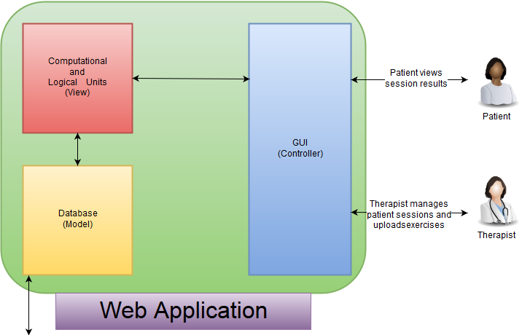
System Architecture

Slide 15
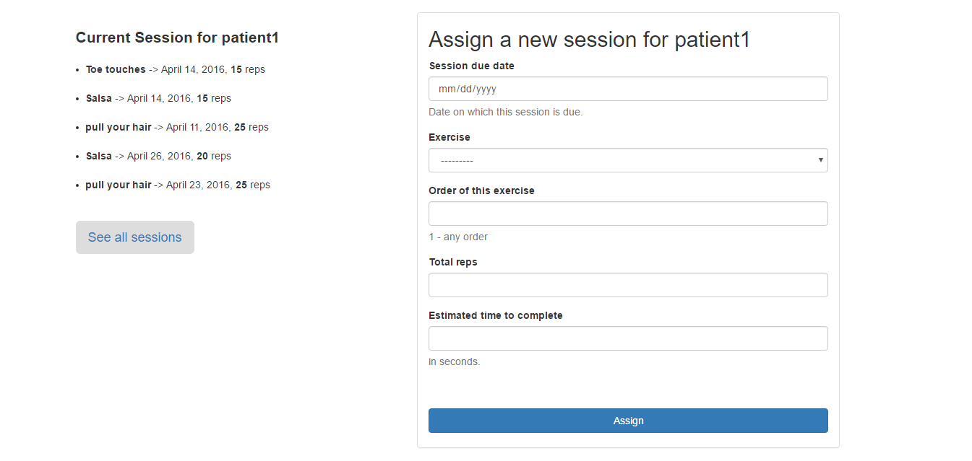
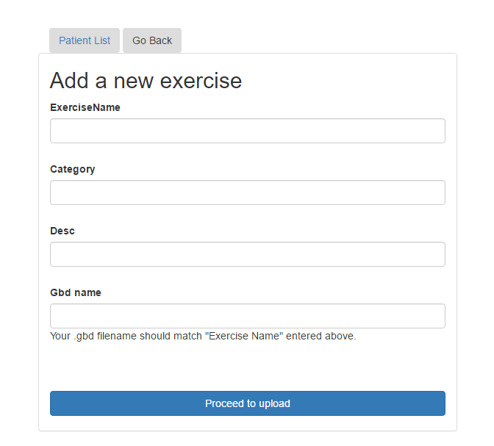
Web app – setting up the sessions
Therapist uploads an exercise to website
Therapist assigns a therapy session
Notes:
Discuss generating sessions, including uploading exercises. Add as many slides as needed.

Slide 16
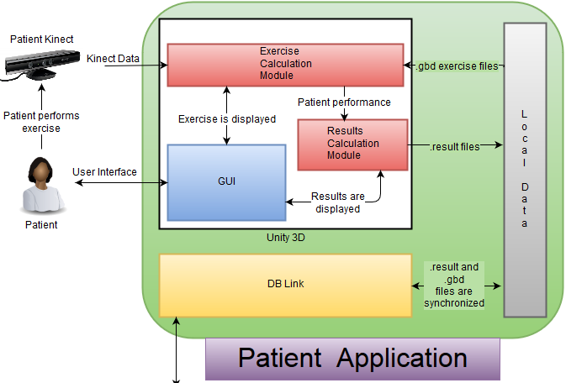
System Architecture
Notes:
Make the section with the Kinect pop out?
Update with latest version.

Slide 17
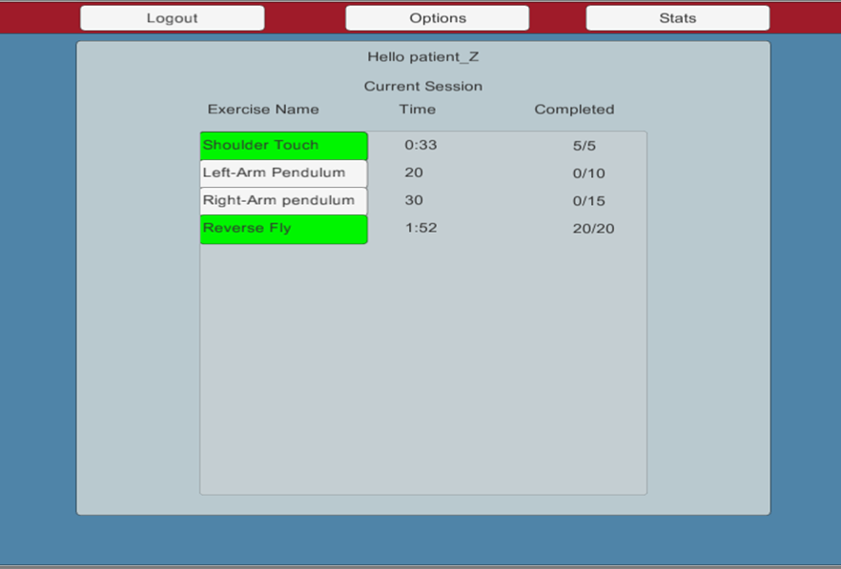
Desktop app – completing sessions
Assigned sessions are presented to
the patient upon logging in
Green exercises are complete
White are incomplete

Slide 18

Desktop app – completing sessions
Patient exercise results are uploaded to the web application

Slide 19
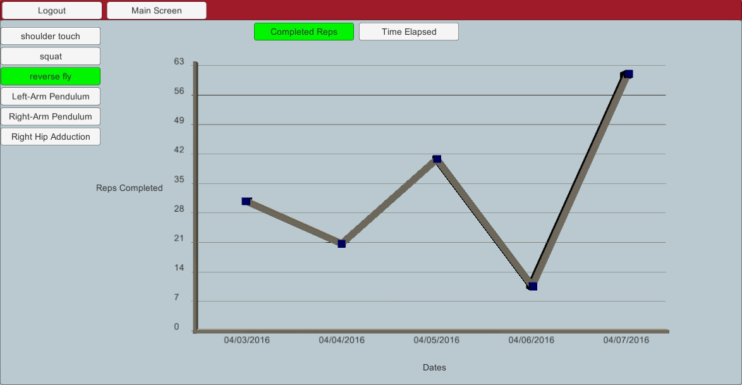
Viewing results
Patients have two options to view previous sessions.

Slide 20
Problems
Unity
  Models
  Importing .gbd files
  Mono is behind latest .net
  Graphing and displaying results
  Learning Curve
Django
  Deploying the app on AWS had a high learning curve
  Finding a free host that allows database access was difficult

Slide 21
Our Progress
Results
In Progress
  Microsoft Visual Gesture Builder can be used to dynamically add new exercises
  Unity has several tools to create an application easily, but has a steep learning curve
  Django provides an easy and fast web framework, but has to be used with other load balancing and server tools
Sending results from the desktop application to the web application
Continued accuracy testing with various body types
Completing bug testing
Notes:
Update and add future work.

Slide 22
Thank you
Questions / Feedback / Suggestion?

