Slide 1
Elemental Kinection
TCU Senior Design Project, 2015-16

Slide 2
Project Team
Samuel Kent
Nathan Johnson
Jack Kempner
Aakash Tyagi

Slide 3
Project Overview
Elemental Kinection looks to improve on tele-rehabilitation by introducing the ability for therapist to dynamically add exercises to the application without the need for programmer assistance
This is achieved through two distinct applications:
User
Therapist

Slide 4
Background to the Problem
Transportation to and from therapy office
In house therapy with real time feedback
Personalized programs on an open platform

Slide 5
Other Kinect projects
NeuMimic
Stroke Recovery with Kinect
Jintronix
x-tech

Slide 6
How is Elemental Kinection different?
We use machine learning instead of traditional heuristics
Individual clinics have the ability to upload exercises that they use
Feedback and communication between therapist and patient

Slide 7
Requirements
Functional
General
Application
Database
Web App
Non-Functional
Product
Organizational
External

Slide 8
System Architecture

Slide 9
The Kinect
Hardware, Software and how it applies to Elemental Kinection

Slide 10
What is a Kinect?
A package of sensing equipment designed for the purpose of motion and audio tracking in a 3 dimensional environment
The Kinect Sensor contains the following components:
1080x1920 color video camera
512x424 Infrared Camera
4 directional microphones
3 Infrared Transmitters for depth sensing
The Kinect for Windows also comes with a converter block for Windows based applications

Slide 11
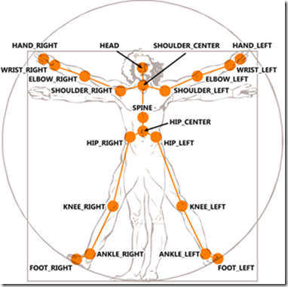
Kinect - Capabilities
Has an effective range of depth sensing from .5 to 4.5 meters with a field of view 70x60 degrees
Color imaging is captured at 30 fps in good light and 15 fps in low light
The directional microphones can track the origin of sound and focus on specific regions in the Kinect space
The Kinect can track 25 distinct joints, both location and orientation arranged in a skeleton

Slide 12
Visual Gesuture Builder

Slide 13
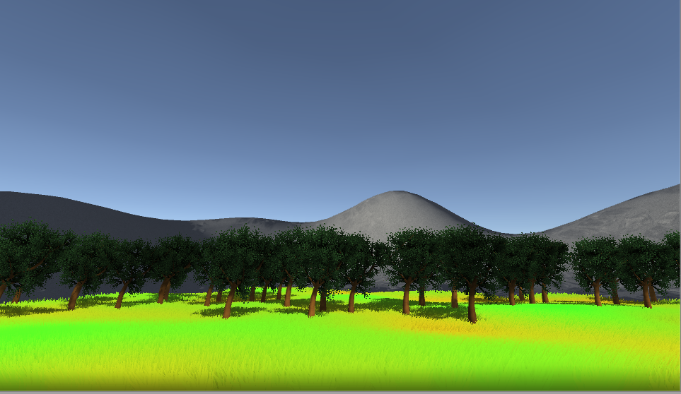
Unity
Terrain
Environmental Effects
More engaging application

Slide 14
Unity Advantages
Allows us to use prebuilt 3D assets to populate the game scene
Comes packaged with models that can be animated with the Kinect

Slide 15
Machine learning vs Heuristic
How Kinect learns

Slide 16
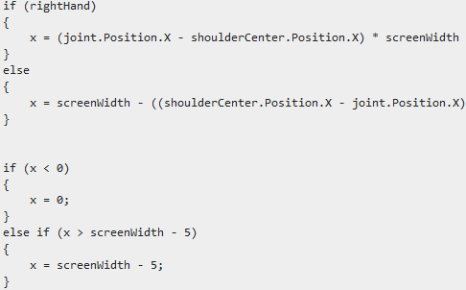
Machine Learning vs Heuristics
Heuristic exercises – hardcoded into the program
Accurate
Limited to exercises preprogrammed

Slide 17
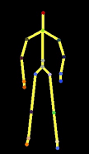
Machine Learning vs Heuristics
Machine Learning through Gesture Builder
Allows new exercises to be added after program is compiled
Requires Kinect SDK

Slide 18
Comparison
HEURISTIC
Heuristics is considered a "Code-Driven" problem
Allows the programmer direct control
Can be more “strict” than machine learning
MACHINE LEARNING
Machine learning is considered a “Data-Driven" problem
Exact definition of recognition is left up to algorithm
Can be “loose” in its recognition of gestures

Slide 19
System Architecture

Slide 20
Web Application
Web development for Elemental Kinection

Slide 21
Web Application - General
Web is a highly programmable environment that allows mass customization through a large and diverse range of applications
Web applications are computer programs allowing website visitors to submit and retrieve data to/from a database over the Internet using their preferred web browser
The data is then presented to the user within their browser as information is generated dynamically (in a specific format, e.g. in HTML using CSS) by the web application through a web server

Slide 22
Advantages of web apps
They perform their function irrespective of the operating system and browsers running client side
Web applications are quickly deployed anywhere at no cost and without any installation requirements (almost) at the user’s end

Slide 23
How do web apps work?

Slide 24
Meet Django
Django is a high-level Python Web framework that encourages rapid development and clean, pragmatic design
It’s free and open source
Ridiculously fast – concept to completion as quickly as possible
Fully loaded - includes dozens of extras you can use to handle common Web development tasks
Reassuringly secure, exceedingly scalable and incredibly versatile

Slide 25
Security in Django
Cross site scripting (XSS) protection
Cross site request forgery (CSRF) protection
SQL injection protection
Clickjacking protection
SSL/HTTPS
Host header validation

Slide 26
Popular sites built with Django
Pinterest
Instagram
Bitbucket
Spotify
NASA
Prezi
Eventbrite
Firefox

Slide 27
How to get Django
https://www.djangoproject.com/download/

Slide 28
Database – MySQL
SQL stands for Structured Query Language
SQL lets you access and manipulate databases
MySQL is the world’s most popular open source database
Enables the cost-effective delivery of reliable, high-performance and scalable Web-based and embedded database applications

Slide 29
Database Schema

Slide 30
Database – User types
Admin
Responsible for maintaining the database, website, and accounts
Therapist
Can act as an admin account
Patient
No personal data stored

Slide 31
Database - Exercises
Data on exercises is stored in .gbd format
Number of reps per session is stored in the relationship between exercises and sessions

Slide 32
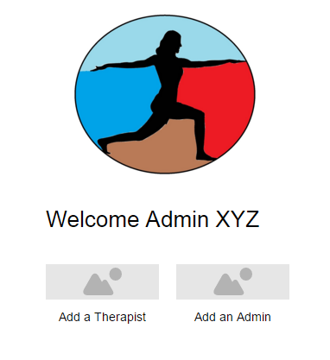
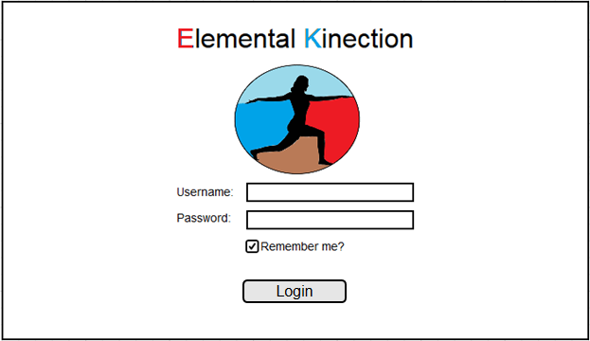
Prototypes
Admin Homepage
Login Screen

Slide 33
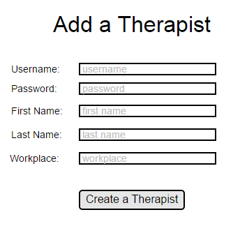
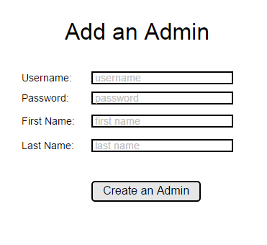
Prototypes
Admin – Create a Therapist
Admin – Create an Admin

Slide 34
Prototypes
Therapist Home Page
Exercise List

Slide 35
Problems
Things that were not as friendly as expected:
Unity Models
Using .gbd files in Unity

Slide 36
Unity Disadvantages
All visuals are objects
Some issues with connecting Unity models with the kinect joints
Requires custom built Microsoft Packages for .gbd files to be added

Slide 37
Milestones and Deliverables
Milestone/Deliverable | Date of Completion
Project Plan V1.0 | October 13th, 2015
Skeleton Website | October 13th, 2015
Project Support Environment | October 15th, 2015
Requirements Documentation V1.0 | October 29th, 2015
Design Documentation V1.0 | December 3rd, 2015
Iteration I | December 10th, 2015
Iteration II | January 22nd, 2016
Faculty Presentation | February 2nd, 2016
Users Manual | Febuary 11th, 2016
Iteration III | February 26th, 2016
Iteration IV | March 25th, 2016
SRS Abstract | March 3rd, 2016
SRS | April 8th, 2016

Slide 38
Our Progress
Application for guiding and measuring exercises is in the stage of being combined with Unity for a complete package for users
Method for how therapist will store sessions in the database is finalized.
Interface for therapist to upload and store sessions and new exercises is finalized.
Work begins on linking local applications into the web-based database

Slide 39
Thank you
Questions / Feedback / Suggestion?

