Slide 1


Developing a Mobile Application to Assist Probationers with Better Decision Making
Senior Capstone Project
Computer Science Department
Texas Christian University
Notes:
Matt
***SENIOR CAPSTONE PROJECT*** <-- must say this here
Introduce team
Introduce People

Slide 2

Team
Matthew Butz – CITE
Zachary Morris – CS
Marcus Beal – CS
David James – CITE
Sponsor
  TCU Institute of Behavioral Research
Notes:
IBR designed screens

Slide 3
Topics
MakeSafe Background
Requirements and Goals
Schedule
Software Overview
  StaySafe and KeepSafe
Issues Encountered
Takeaways
Results and Future Work
Notes:
Marcus
Don’t read on screen exactly

Slide 4


Background
Disease Risk Reduction in criminal justice systems
  No policies or care integration
Project Sponsor:
  Institute of Behavioral Research at TCU
  Funded by grant to TCU through NIDA/NIH
Multi-phase research project
&
Notes:
Matt
Who are our sponsors? What do they do?
Where did they get their funding from? Why?
What prompted IBR to start the DRR2/StaySafe project?
What were the positive results from earlier projects that pushed them into this application?
What is their end-goal for this application?
DRR1 and risk reduction

Slide 5
Project Requirements
An application for Android tablets
12 self-administered, didactic sessions
User interactions saved for analysis
Minimal administration, training, and maintenance
Free to probation departments through IBR
Post-delivery version updates
Notes:
Marcus
IBR’s Requirements:
Why does MakeSafe exist?
What are we supposed to make? StaySafe app
What makes StaySafe different? Self-paced guided learning
How are they preforming research? Save interactions for analyses
What makes it low-maintainance?
Why is IBR making this free? By asking probationers to participate for parole compensation fee
Why did they need version updates? different curriculum for a variety of subject areas (HIV/Women’s Issues/…) reusable

Slide 6
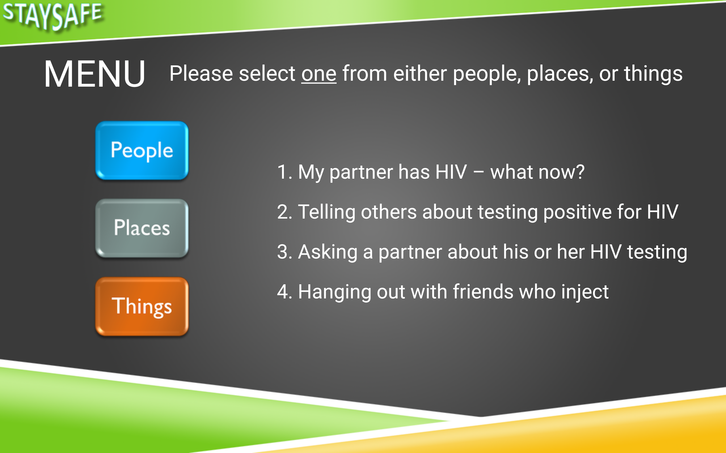
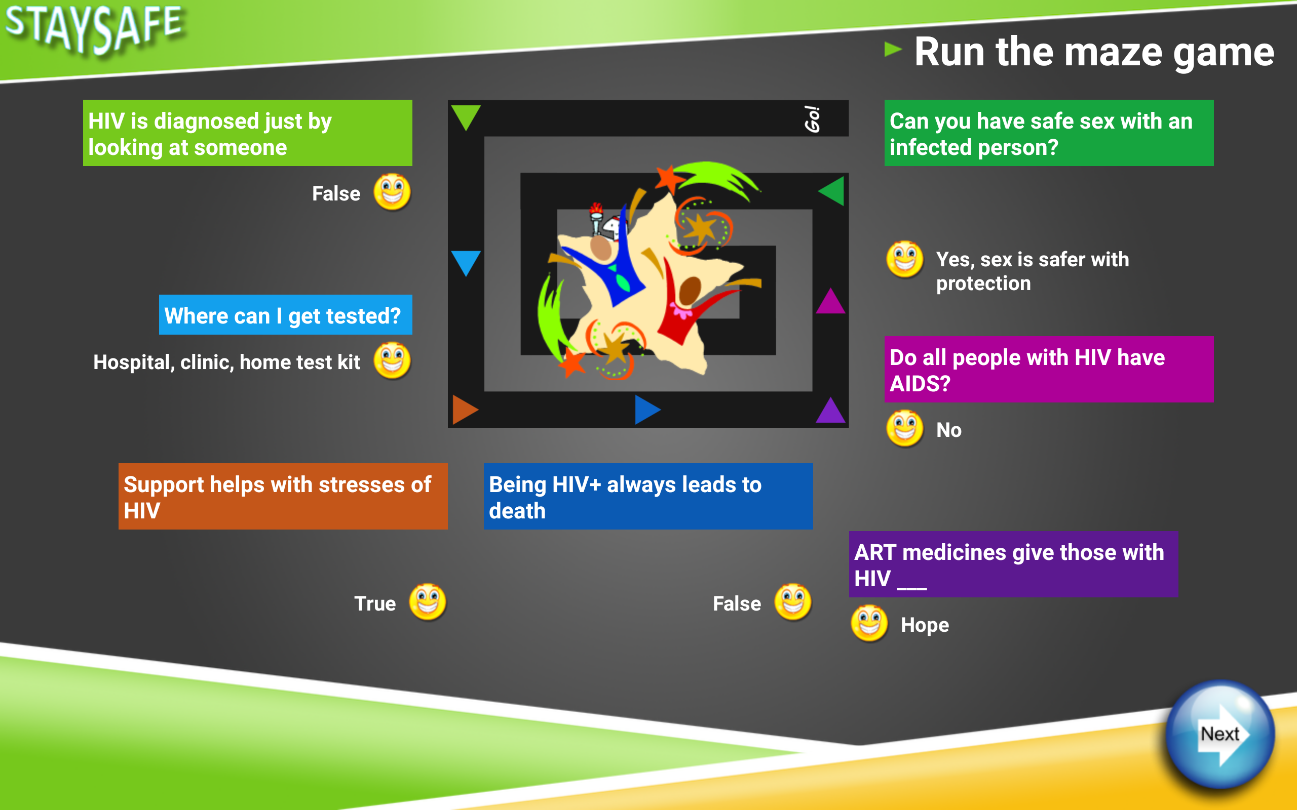
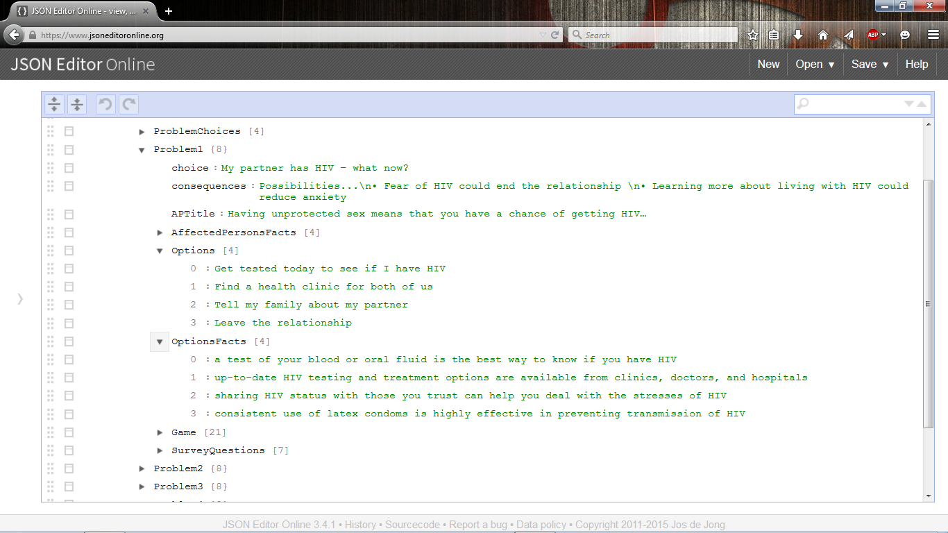
Project Goals
Extensive feedback opportunity
Meeting requirements
Simple curriculum updates
Application sustainability
Facilitate IBR research
Notes:
David
Why did we want finish early? Theater test by IBR; verify functionality for research
Why did we have to make KeepSafe? 1600+ unique text fields
What makes this application sustainable? Shell – can stick any curriculum into the app and still functions as specified
How was the app “out-of-the-way” for IBR research? Self-su

Slide 7
Project Schedule
Iteration 1 (Ended 1/9)
  First delivery of application with initial design
  Requirements gathering
  Application framework
Iteration 2 (Ended 1/30)
  Main functionality
  Initial data variable export
Notes:
David
Why did we want finish early? Theater test by IBR; verify functionality for research
Why did we have to make KeepSafe? 1600+ unique text fields
What makes this application sustainable? Shell – can stick any curriculum into the app and still functions as specified
How was the app “out-of-the-way” for IBR research? Self-su

Slide 8
Project Schedule
Iteration 3 (Ended 3/19)
  Functional application
  User acceptance testing
  Initial curriculum publishing application
Iteration 4 (Ended 4/1)
  Support for all dynamic content
  Revisions, testing, bug corrections
Final Delivery (4/23)
Notes:
David
Why did we want finish early? Theater test by IBR; verify functionality for research
Why did we have to make KeepSafe? 1600+ unique text fields
What makes this application sustainable? Shell – can stick any curriculum into the app and still functions as specified
How was the app “out-of-the-way” for IBR research? Self-su

Slide 9


MakeSafe Software
StaySafe
Application for Android tablets
The interaction point for probationers
Reads in content dynamically
Outputs research data
KeepSafe
Simple interface to edit complex JSON file
Publishes new versions of the StaySafe curriculum
Standalone Java application
Notes:
Marcus
2 parts of the MakeSafe solution
StaySafe
Android
User=Probationers
Dynamic content
Facilities research
KeepSafe
Versatility of any computer
Allows editing of StaySafe content; only IBR
Saves in JSON; read in efficiently by tablet
Simple utility for IBR
1600 variables and values

Slide 10
Notes:
Marcus
2 parts of the MakeSafe solution
StaySafe
Android
User=Probationers
Dynamic content
Facilities research
KeepSafe
Versatility of any computer
Allows editing of StaySafe content; only IBR
Saves in JSON; read in efficiently by tablet
Simple utility for IBR
1600 variables and values

Slide 11
StaySafe Session Structure Overview
1
12
2
Participant Choice
Introduction
11
3
Break from usual learning
Similar content; increased interaction
  Videos
  Games
  Facts
First interaction with StaySafe
Guided walkthrough
Example execution video
Includes WORK-IT schema with pre-defined problem area
WORK-IT
User-driven
Choose from any problem area
10
4
9
5
8
6
7
Notes:
Zack
***Created by IBR***
Path for user throughout their participation
Intro
User instructed to session completion
No problem choice
Instructional video
WORK-IT
Users choice in problem
Self-paced; private (no outside interaction)
Part.-Choice
Break from the normal
Designed to be fun and interactive
Saves unique data every session

Slide 12
Session Structure
WORK-IT
Introduction
User-driven
Choose from any problem area
First interaction with StaySafe
Guided walkthrough
Example execution video
Includes WORK-IT schema with pre-defined problem area
Participant Choice
Break from usual learning
Similar content; increased interaction
  Videos
  Games
  Reading

Slide 13
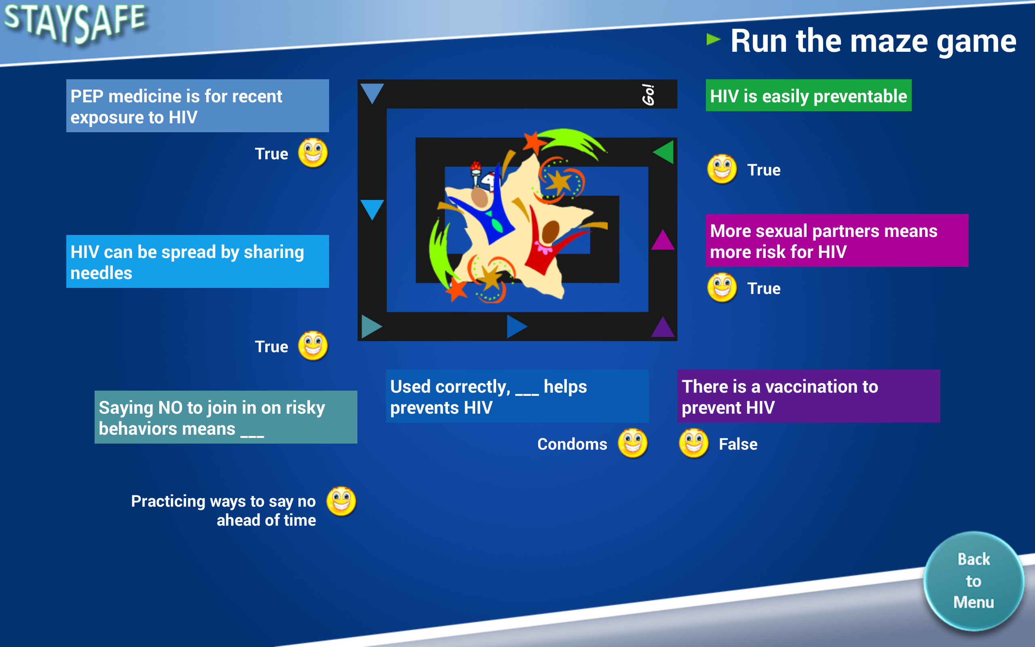
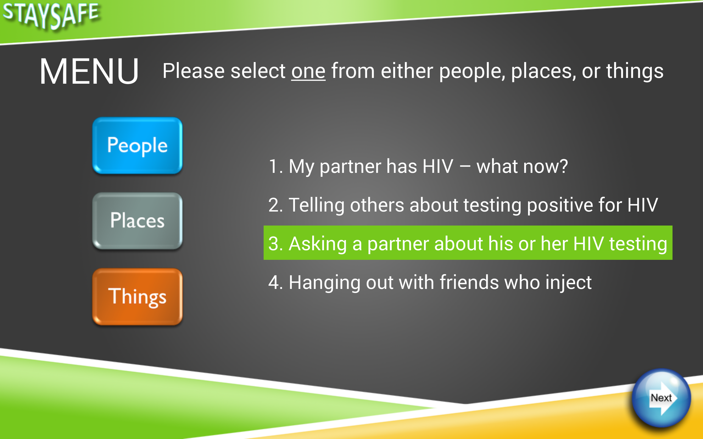
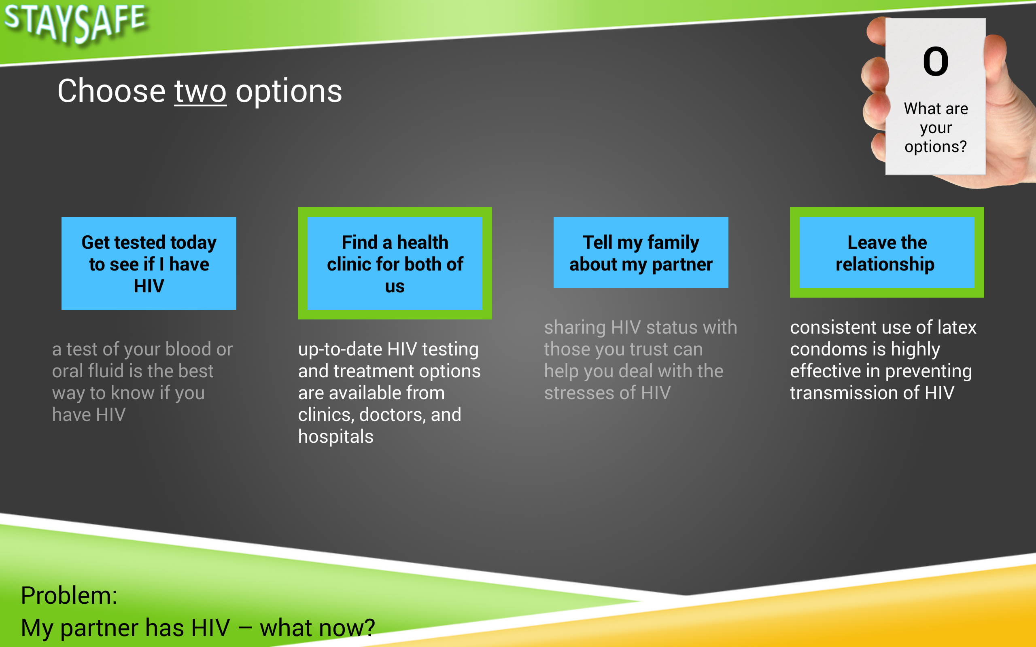
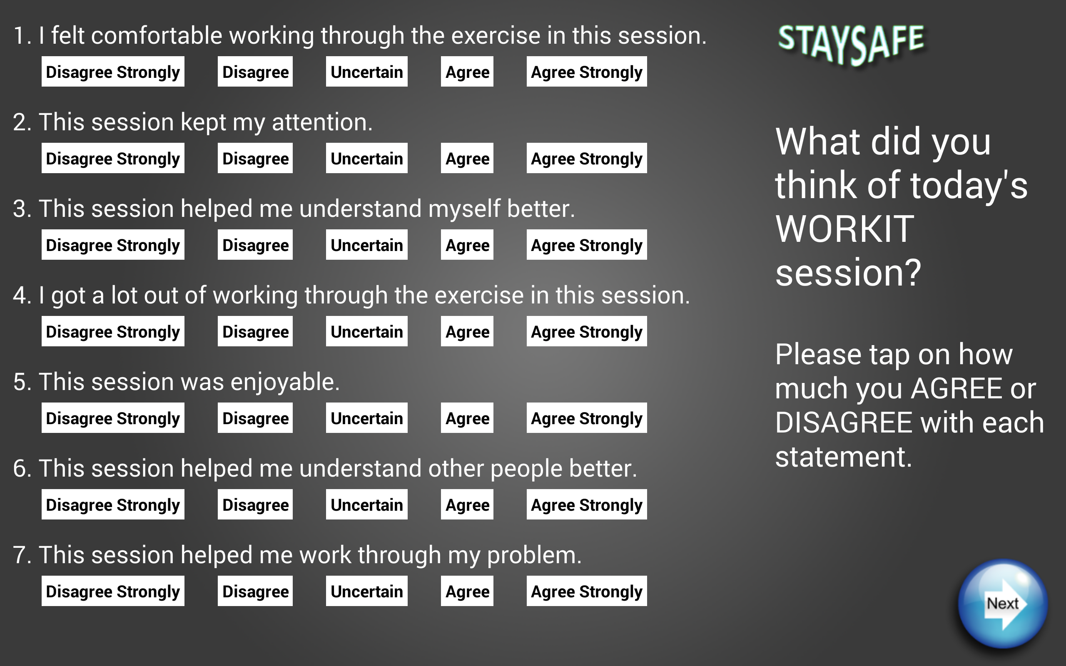
Notes:
Zack
Shown some of the 30+ unique screens designs in the app
Our task:
convert IBR design into android app
adding the desired functionality
Each screen had own challenges
animations
timing
displaying dynamic content
large number of layout elements
displaying appropriate feedback for the user

Slide 14
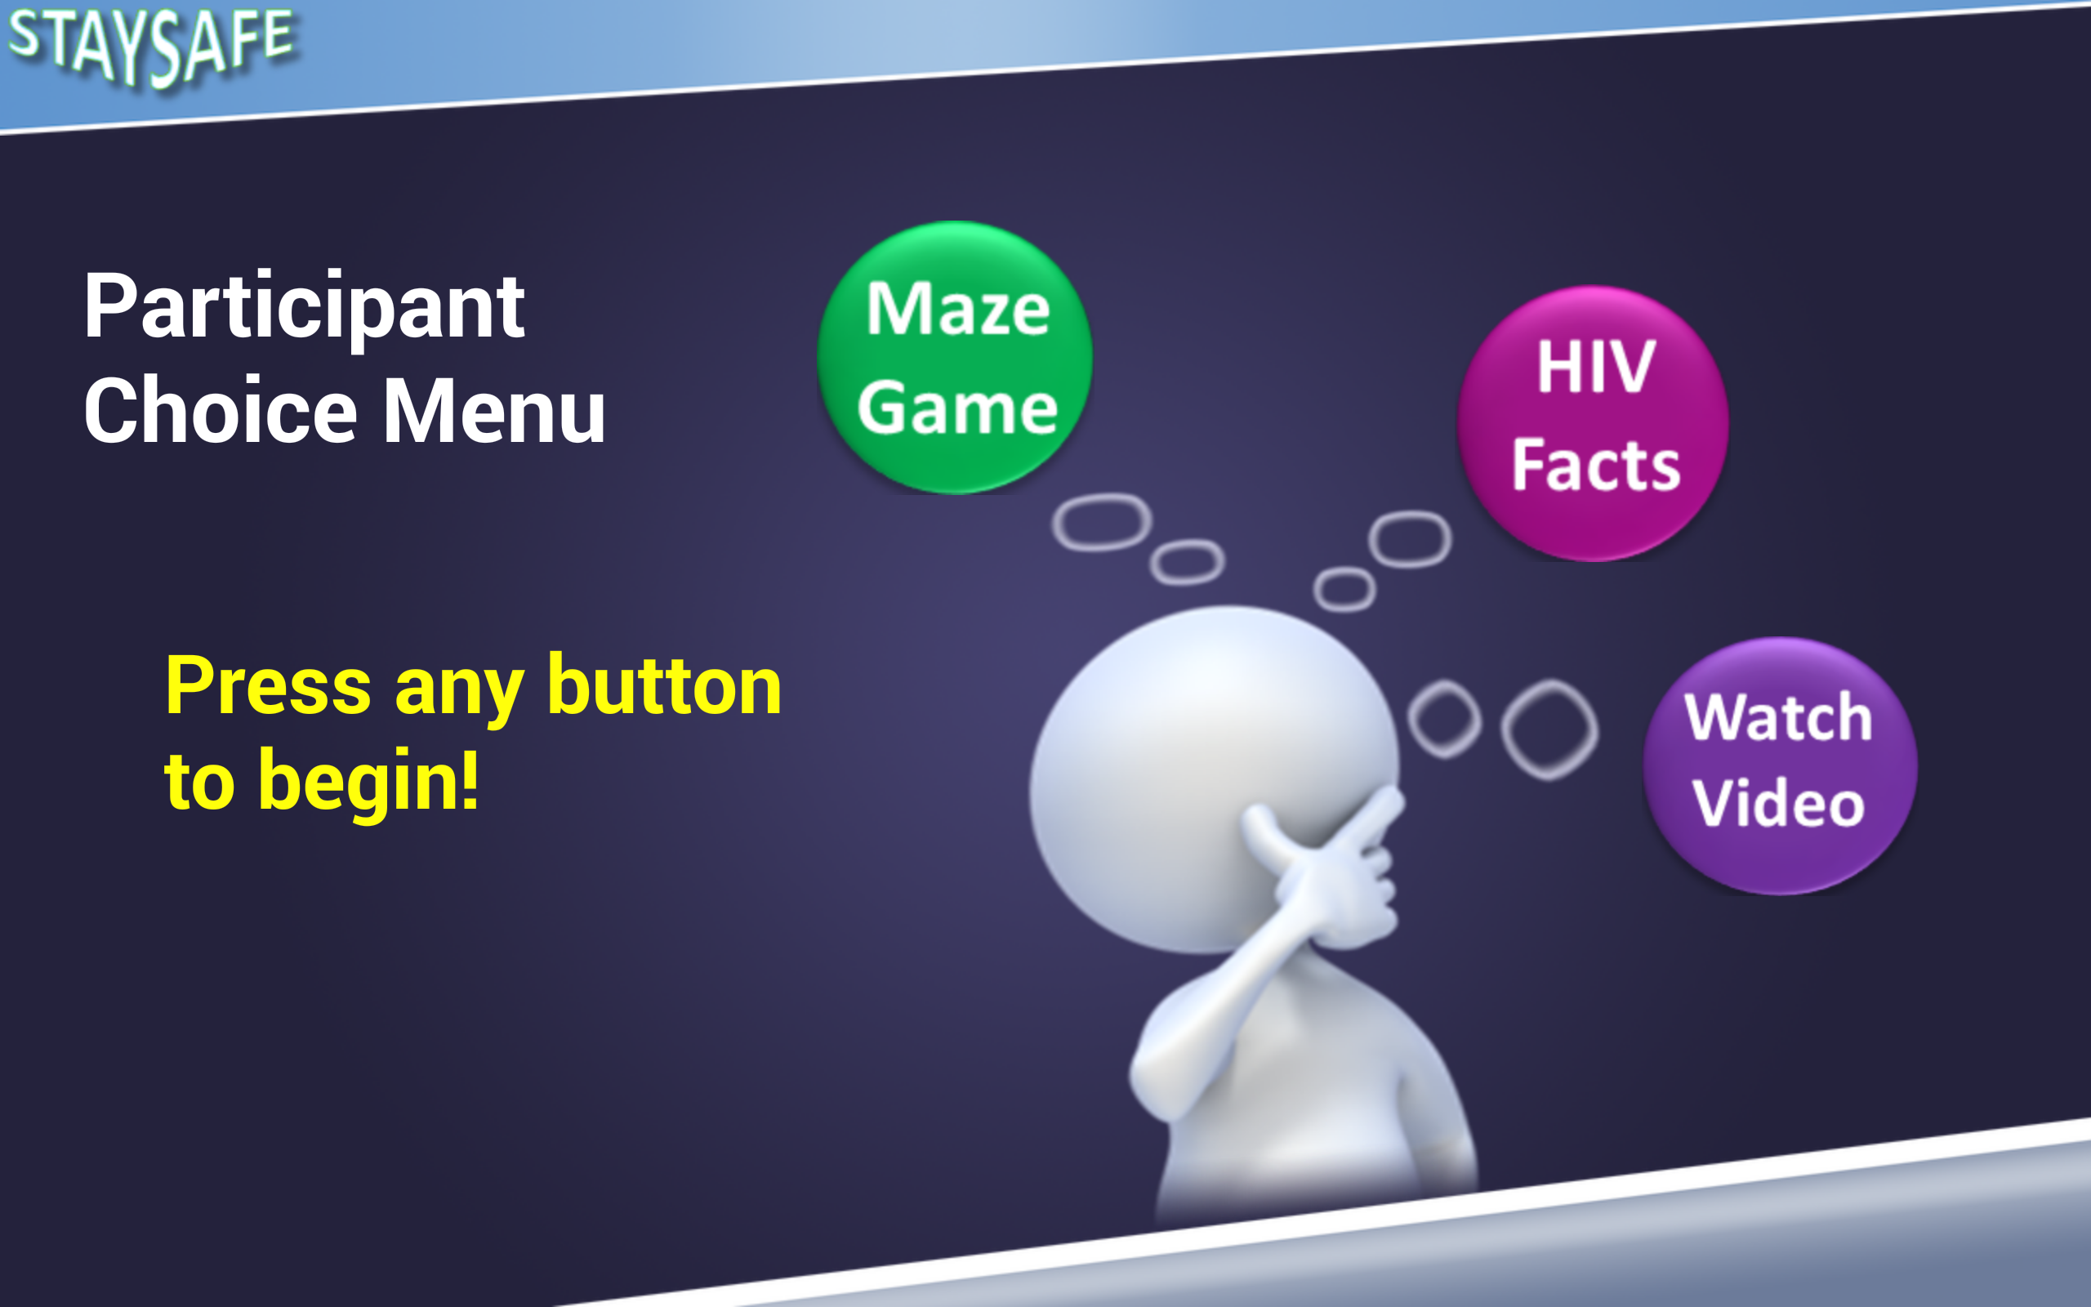
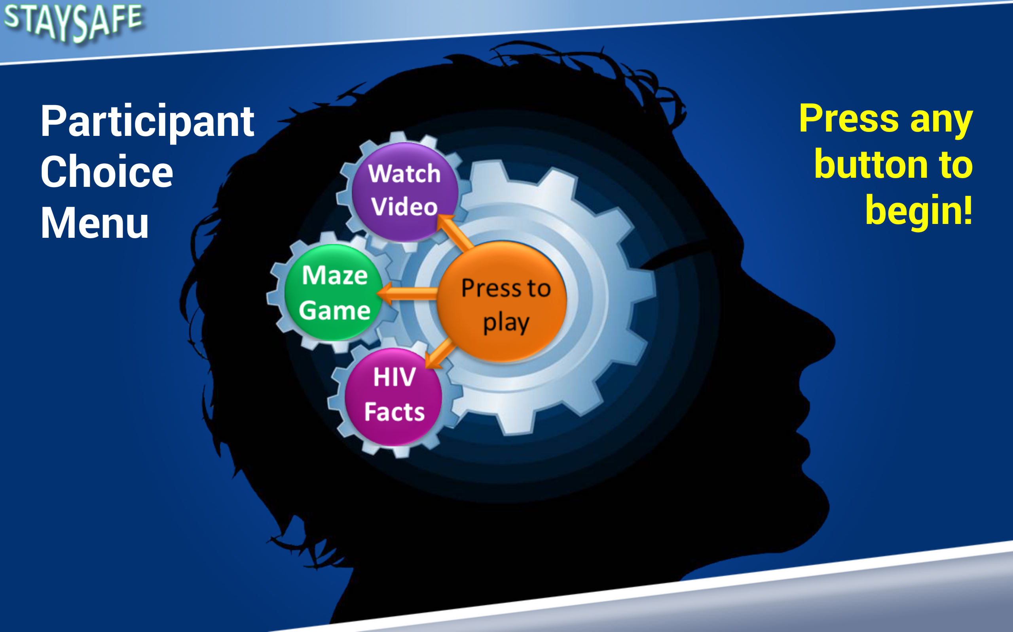

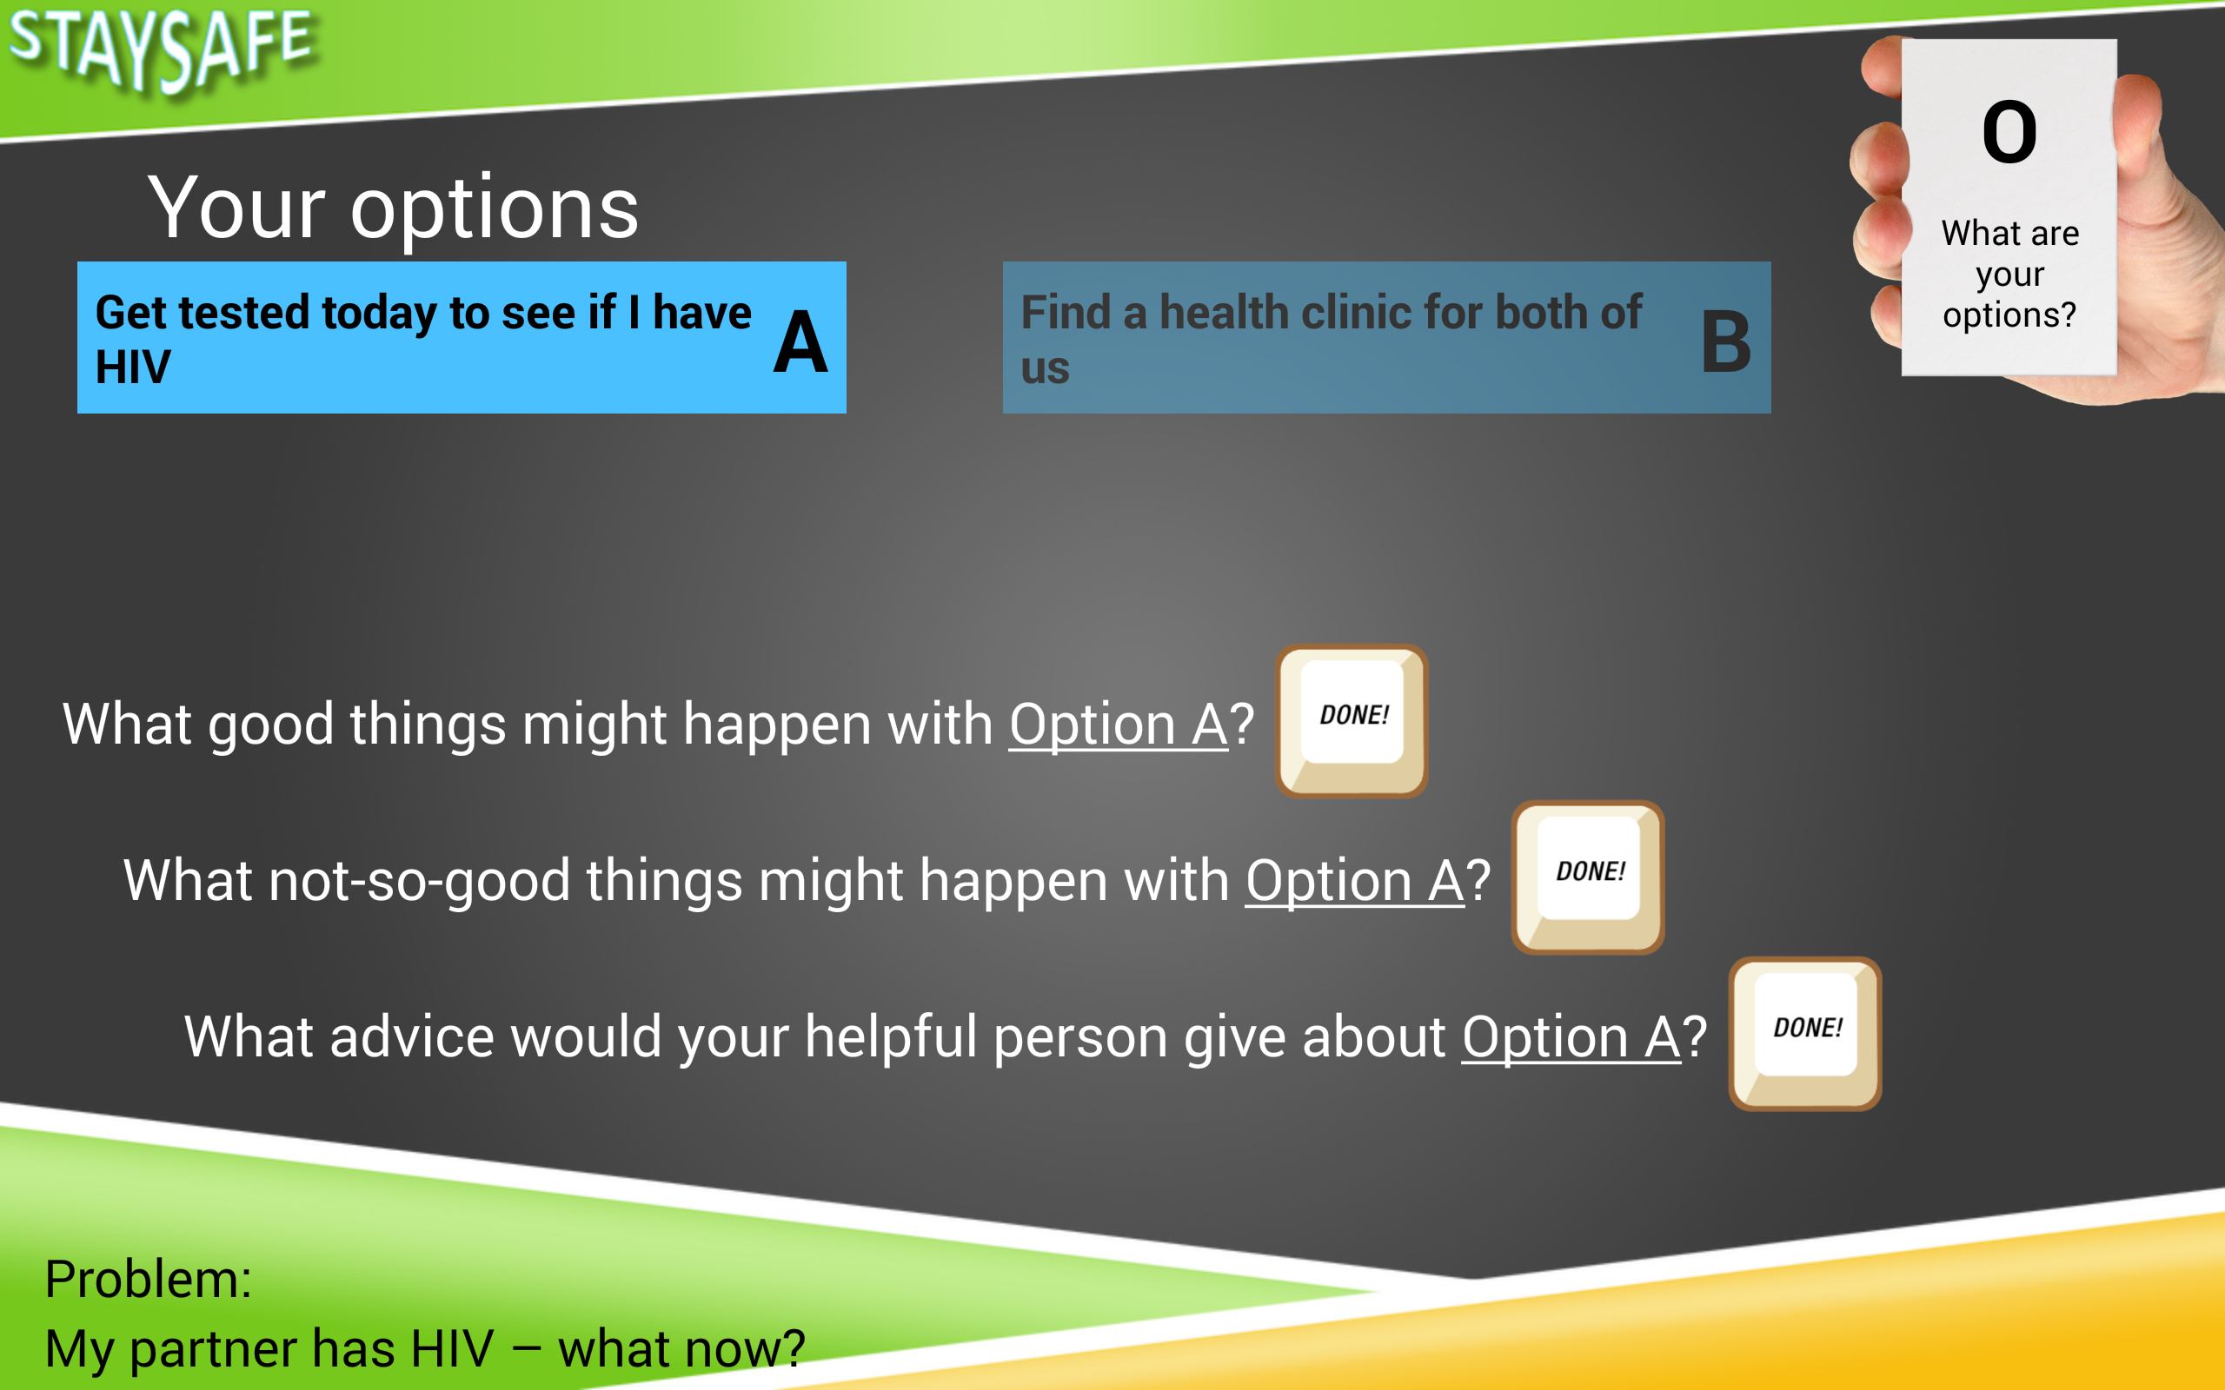
Notes:
Zack
Shown some of the 30+ unique screens designs in the app
Our task:
convert IBR design into android app
adding the desired functionality
Each screen had own challenges
Developed custom timing mechanism
Dealt with multiple large graphics on high density screen
Complex layout structures
Building screen with solely dynamic content

Slide 15
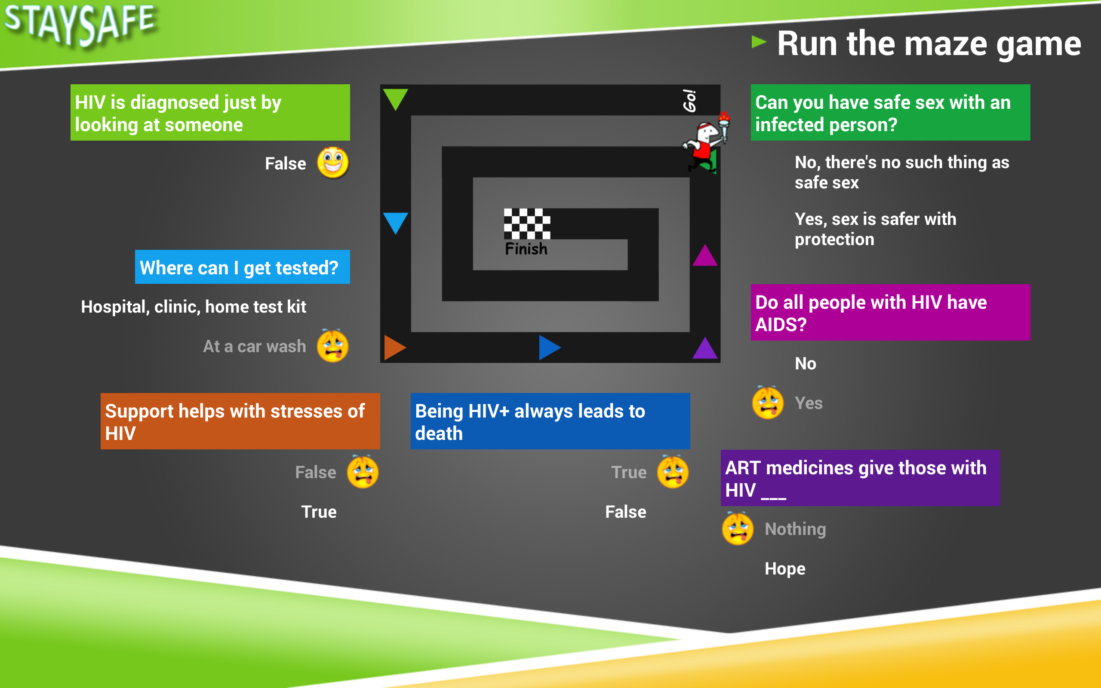
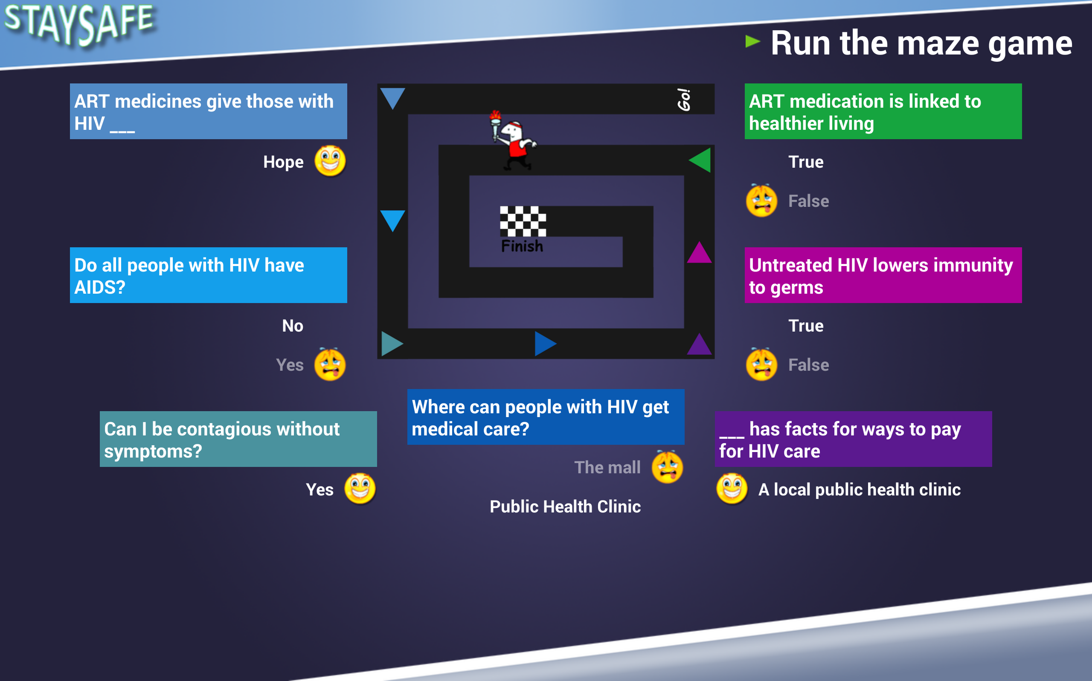
Notes:
Zack
Every screen was developed so that they can be altered quickly to have different look-and-feels throughout the application

Slide 16
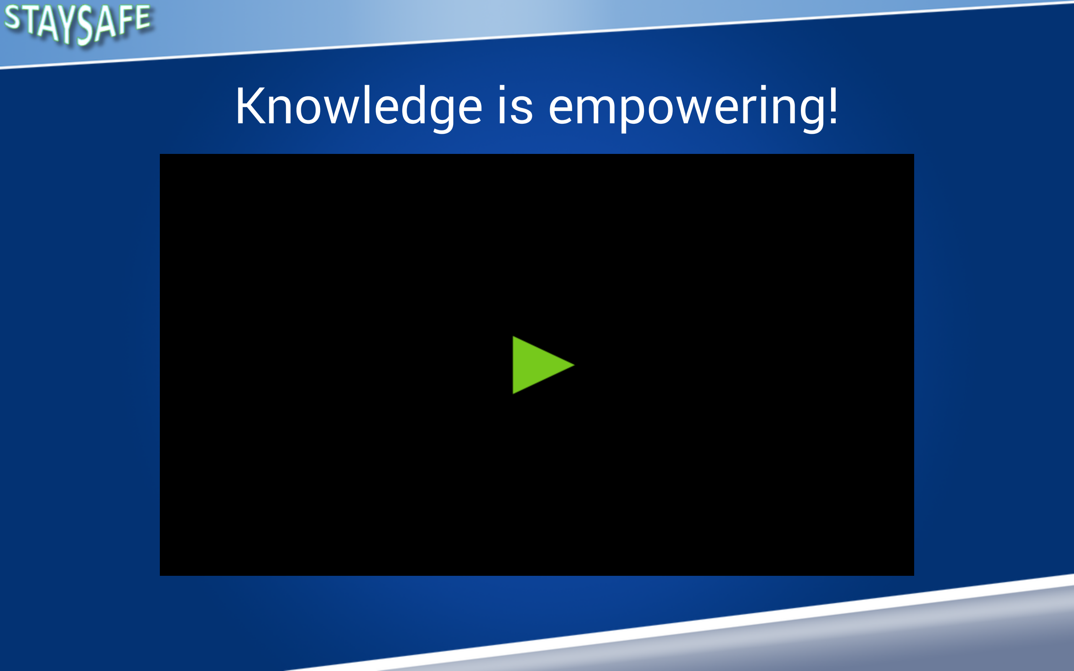
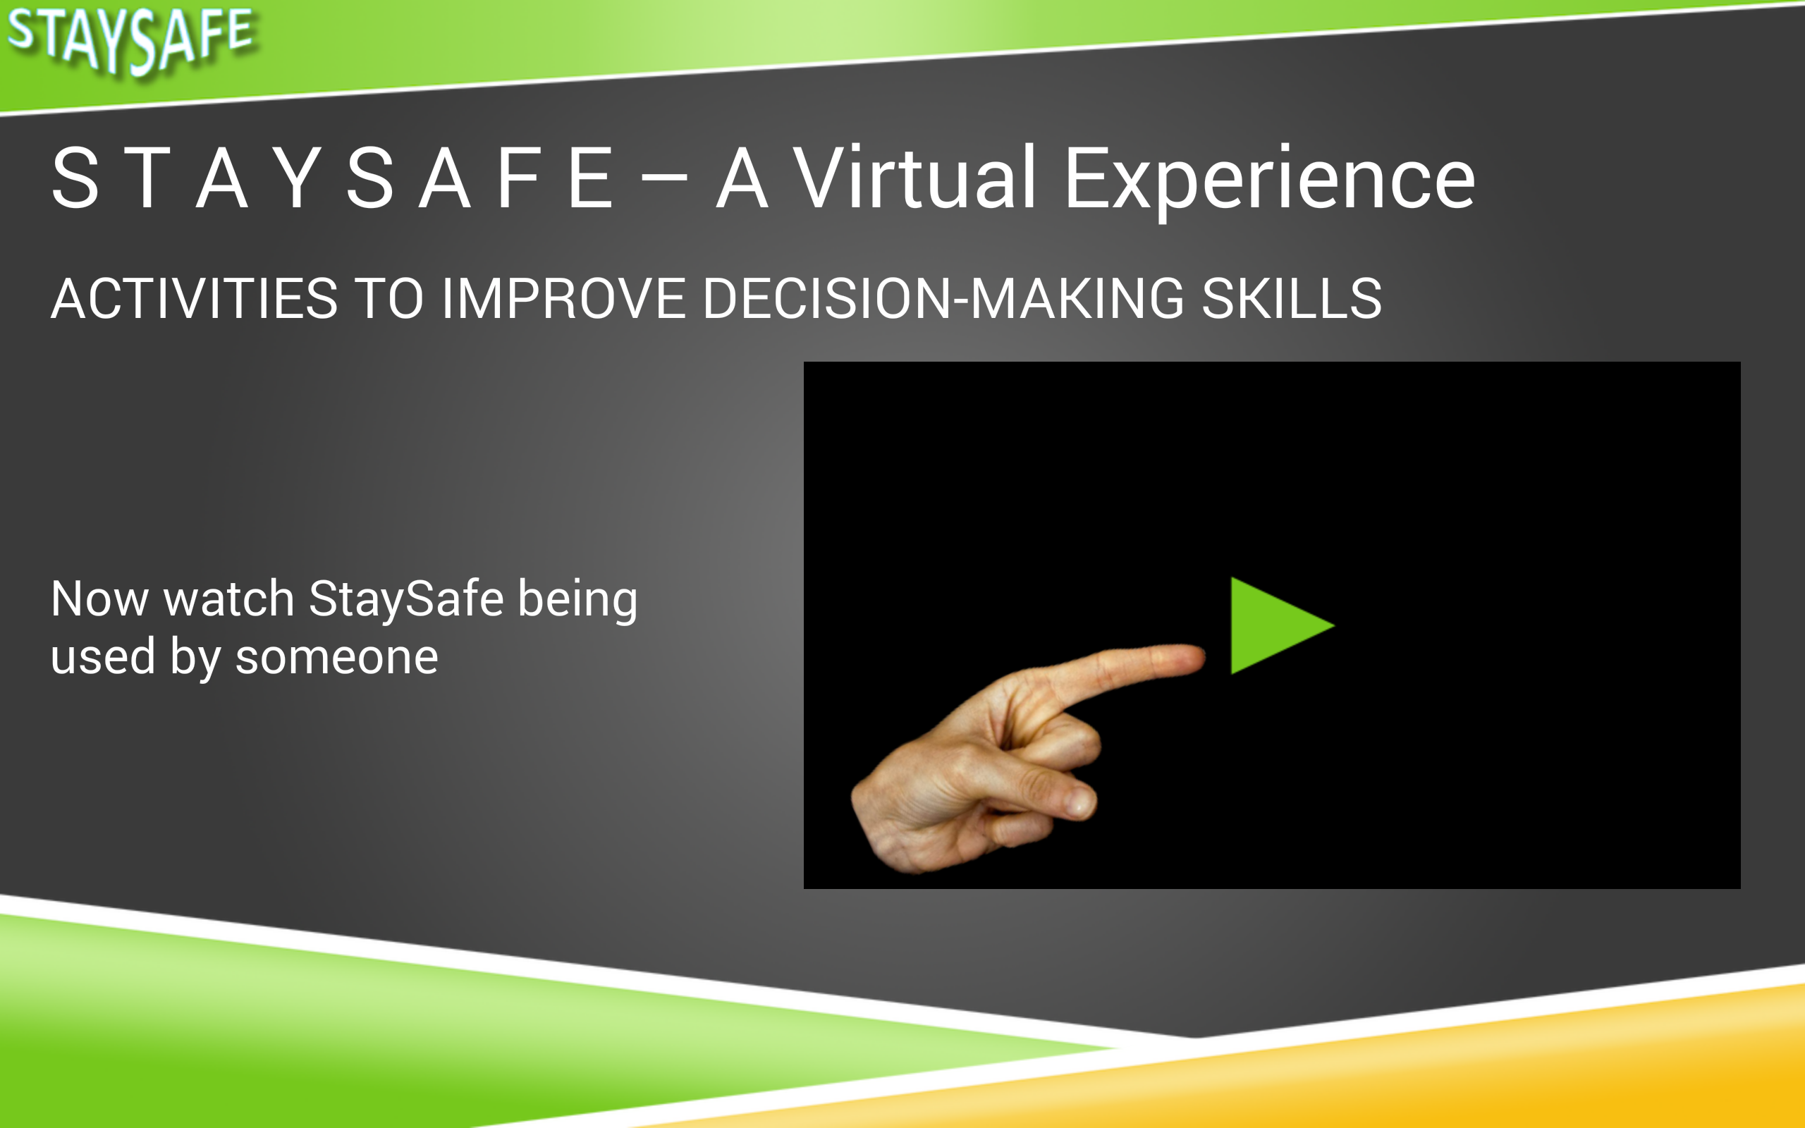

Notes:
Zack
Every screen was developed so that they can be altered quickly to have different look-and-feels throughout the application

Slide 17
Notes:
Marcus
2 parts of the MakeSafe solution
StaySafe
Android
User=Probationers
Dynamic content
Facilities research
KeepSafe
Versatility of any computer
Allows editing of StaySafe content; only IBR
Saves in JSON; read in efficiently by tablet
Simple utility for IBR
1600 variables and values

Slide 18

StaySafe in Action
Notes:
David

Slide 19
KeepSafe Application
Stand-alone curriculum management tool
Simple user interface
Utilizes JavaScript Object Notation
Imports/exports dynamic content
1600+ unique text values/variables exported
Drag and drop output to tablet for updates
Notes:
David

Slide 20
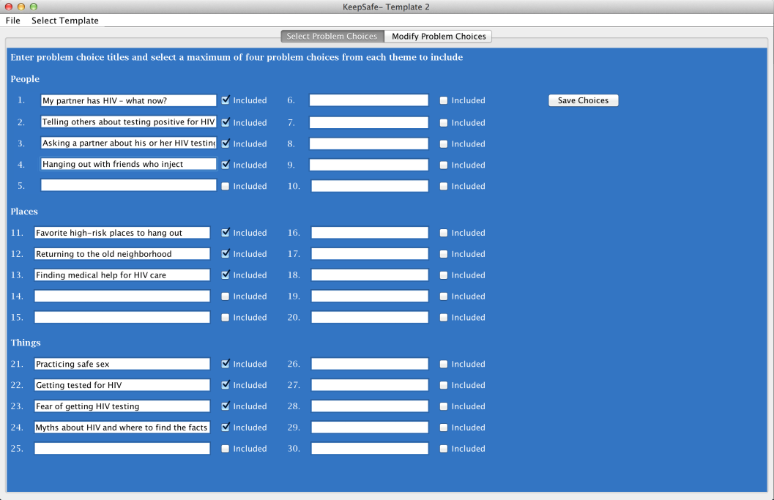
KeepSafe Application
Notes:
Matt
1600 values
User-friendly
Provides a file to be transferred to the tablet
Simplifies curriculum creating process
Utility; only for IBR

Slide 21
DRR1 – WaySafe
In-prison participants
Group-based
Help offenders when released
Largely positive results
  Improved knowledge, confidence, and motivation
Framework for StaySafe

Slide 22
DRR2 – StaySafe
Adaption of WaySafe
  Community-corrections participants
  Individual-based
  Self-paced
Newly released individuals
During probation appointments
Android application

Slide 23
Data Flow
Notes:
??

Slide 24










USB
Ready!
Done!
USB
ShareFile

Slide 25
Creating Curriculum
USB
Text
Audio
Images
Video
Ready!
Done!
USB
ShareFile

Slide 26
By the numbers
27 Java class files
15 layout files
200+ hours of coding
StaySafe – 12000+ lines of code
KeepSafe – 7000+ lines of code
150+ output variables/values
Notes:
Marcus Beal

Slide 27
Technology
Software
  Eclipse (Luna)
  Android SDK
Hardware
  Samsung Tablet running Android version 4.4.0+
  Auxiliary Computers

Slide 28
Issues Encountered
Android delivery limitations
File input/output
Time constraints and scheduling
Version update handling
JSON structure and implementation
Notes:
David

Slide 29
Takeaways
Well-defined requirements are key
Constant communication across teams
Active and timely feedback from customer
Testing assistance
  User acceptance testing
Document as you go
Notes:
Matt

Slide 30
Results and Future Work
StaySafe application completed
KeepSafe publishing software established for interaction with StaySafe
Data output for research
Production deployment in Summer 2015
Adaptable to different subject areas
Notes:
Marcus

Slide 31
Acknowledgements
Sponsors:
  Wayne E Lehman, Ph.D (Principle Investigator)
  Jennifer Pankow, Ph.D (Project Director)
  Grace Rowan, Ph.D (Data Manager)
  Julie Gray, Ph.D (Research Scientist)
Faculty Advisors:
  Donnell Payne, Ph.D
  Julie Gray, Ph.D
Notes:
Zach

