Slide 1
FrogFit
A Mobile Crossfit Companion
Geoffrey Adams, Bryan Kribbs, Matt Ratliff
Computer Science Department
Texas Christian University
NTASC ‘15

Slide 2
FrogFit Team
Geoff Adams
  Senior, CS Major
  Android Developer, DBA, Tech Lead
Bryan Kribbs
  Senior, CITE Major
  Admin Site Architect, Document Lead, Testing Lead
Matt Ratliff
  Senior, CS Major
  Android Developer, Internal Site Architect, Project Lead
NTASC ‘15

Slide 3
Overview
Background
What is Crossfit
What is FrogFit
What Makes FrogFit Unique
System Overview
Results and Conclusions
NTASC ‘15

Slide 4
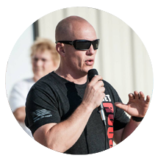
Background
Steve Johnston, a TCU Alumni
Crossfit athlete and founder of Chalkbucket Labs
Realized there is a need in the Crossfit world
Help athletes identify strengths and weaknesses
NTASC ‘15

Slide 5
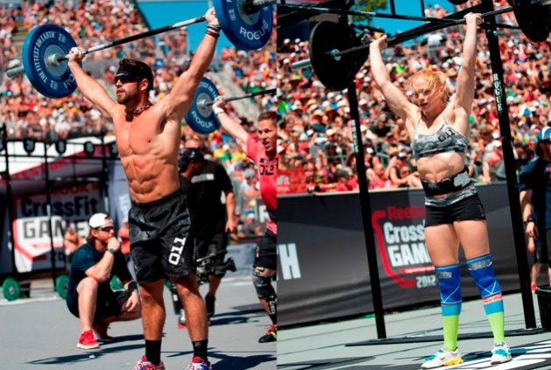
What is Crossfit
Crossfit is a strength and conditioning program
All encompassing and varied workouts
Developed for military and first responders
Exploded in popularity
Used by general population and elite athlete alike
NTASC ‘15

Slide 6
What is Crossfit
Terminology
WOD
Benchmarks/Named Workouts
NTASC ‘15

Slide 7
What is Crossfit
WOD
“Workout Of-the Day”
The workout for today, any workout, or any Crossfit activity
We mean Workout
What does a “WOD” entail
A combination of movements that is measured against time, repetitions, or weight.
NTASC ‘15

Slide 8
What is Crossfit
Benchmark\Named Workouts
The names are only used to remember the workout
Types of names
  Girls – Fran, Isabel, Cindy
  Heroes – Murph, Nate, JT
  Notables – Fight Gone Bad, 14.1, 15.2
Workouts chosen are popular and repeatable
Can be repeated to measure performance
NTASC ‘15

Slide 9

What is FrogFit
Designed for Crossfit athletes
Breakdown fitness into 8 categories
Scoring athletes on each category
Creating an overall score to show true fitness level
NTASC ‘15

Slide 10
FrogFit Categories
Body Weight
Endurance
Heavy Weight
Light Weight
Long
Olympic Lift
Power Lift
Speed
NTASC ‘15

Slide 11
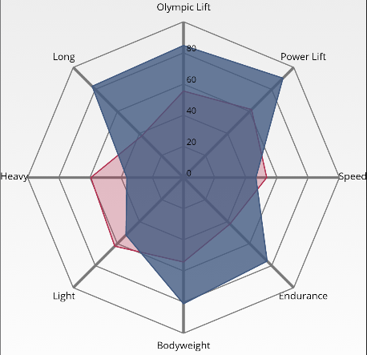
What Makes FrogFit Unique
Providing a FitScore
Creating a confidence level along side the FitScore
Being able to show a graphical representation of the FitScore
Visualizing strengths and weakness for athletes
NTASC ‘15

Slide 12
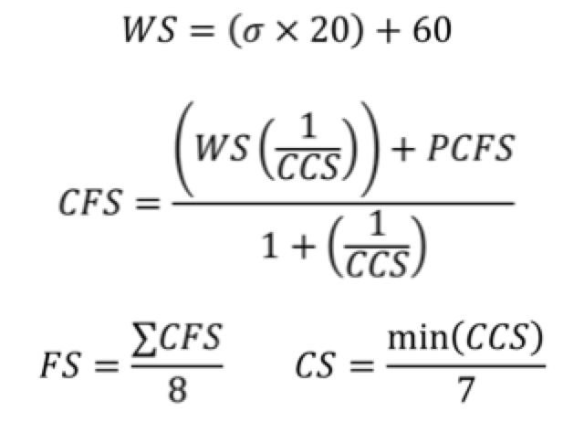
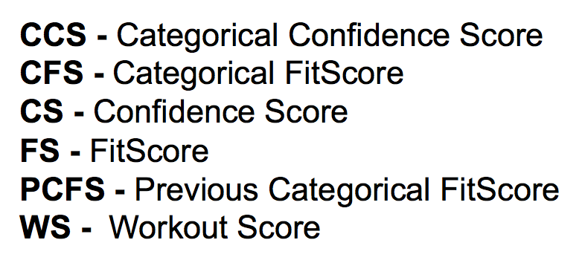

What Makes FrogFit Unique
Confidence Score to eliminate “Gaming the System”
Unique Algorithm
NTASC ‘15

Slide 13
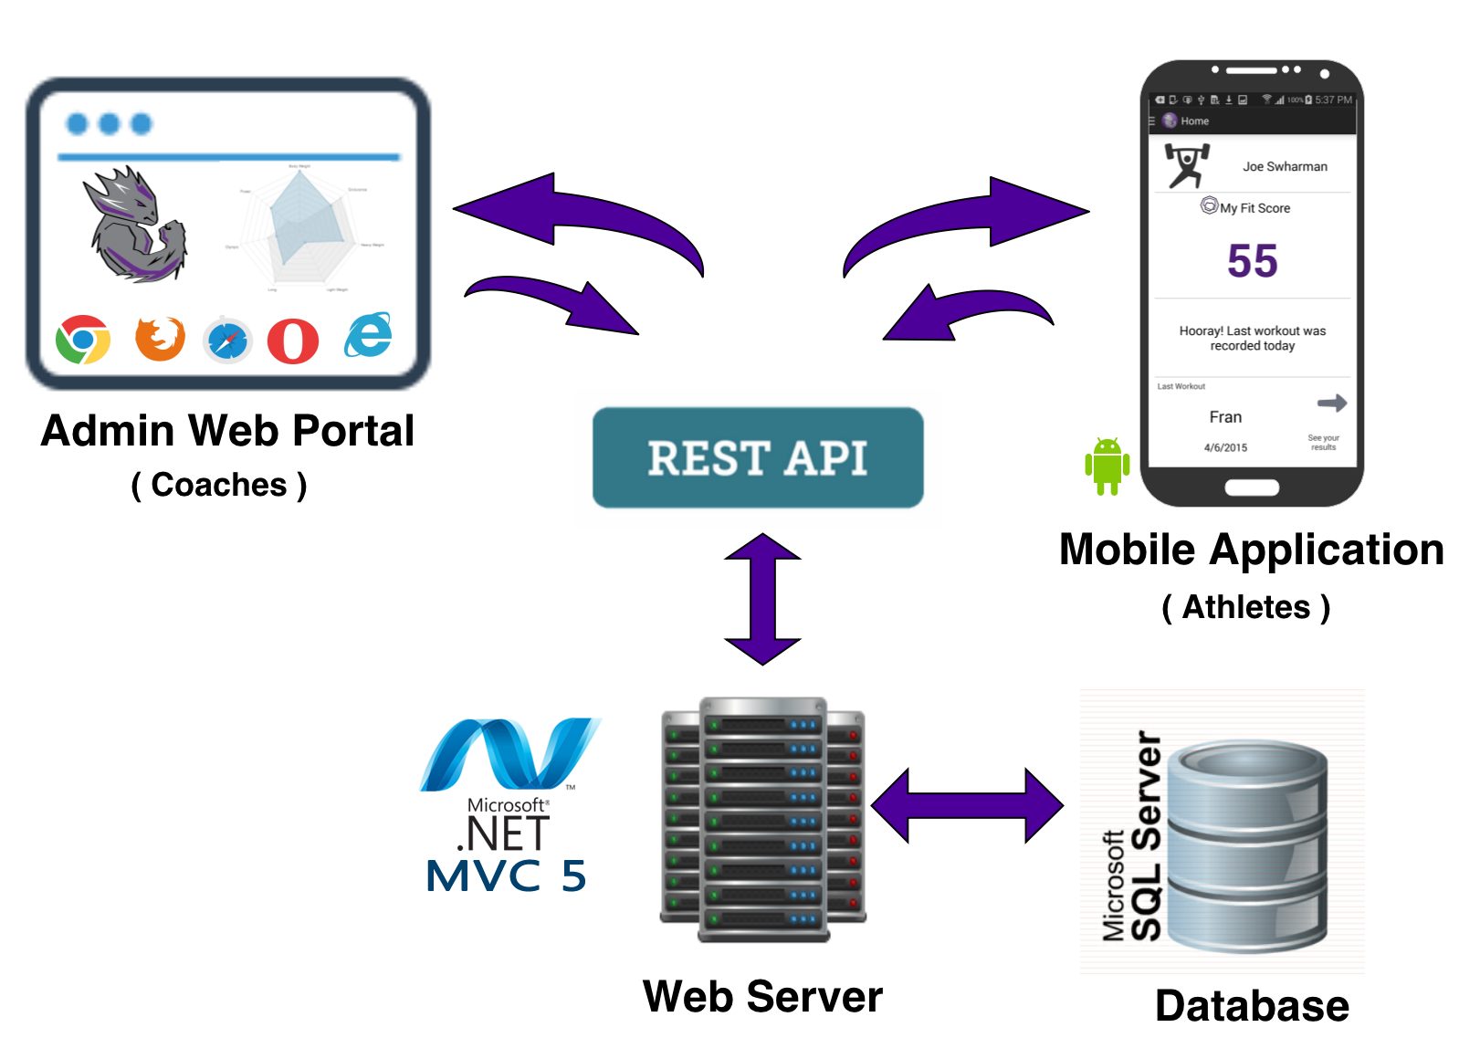
Platforms
NTASC ‘15

Slide 14
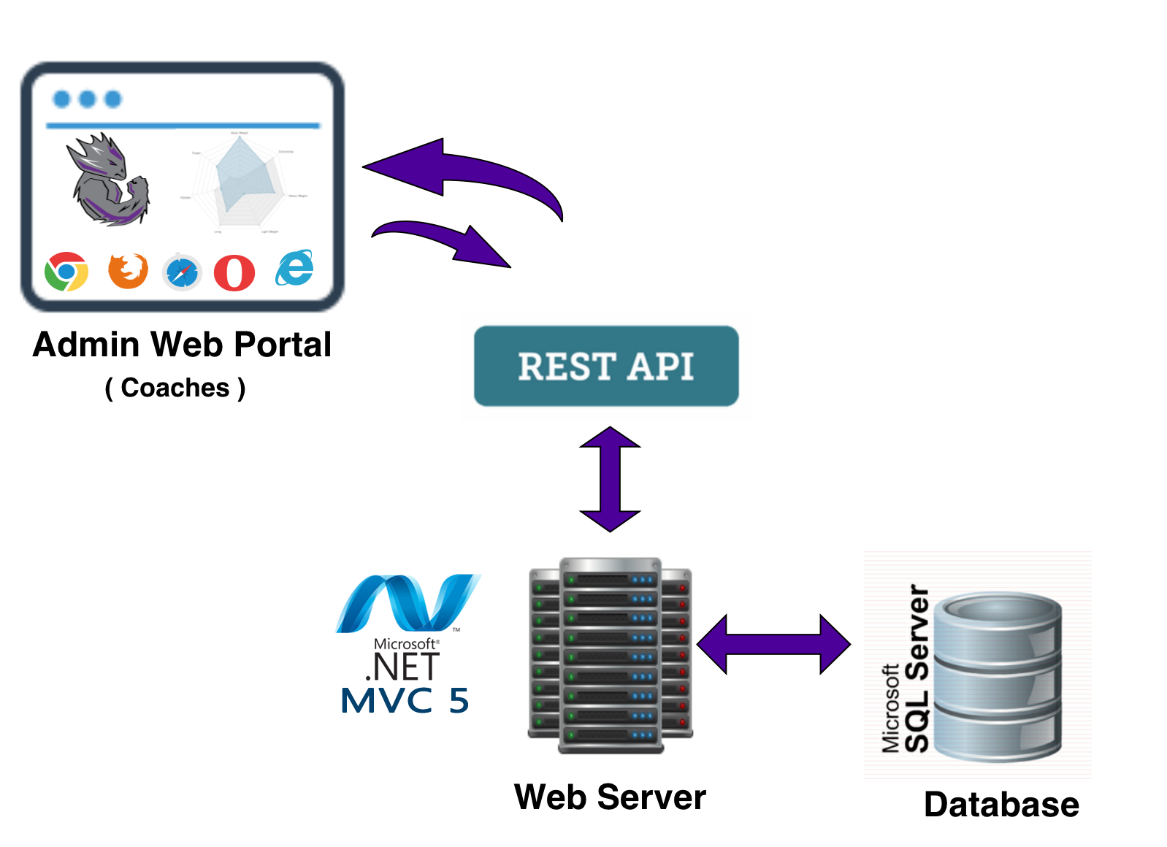
Admin Web Portal
Responsive Web Design
Bootstrap
REST API
ASP.NET MVC 5
Microsoft SQL Server 2012
NTASC ‘15

Slide 15
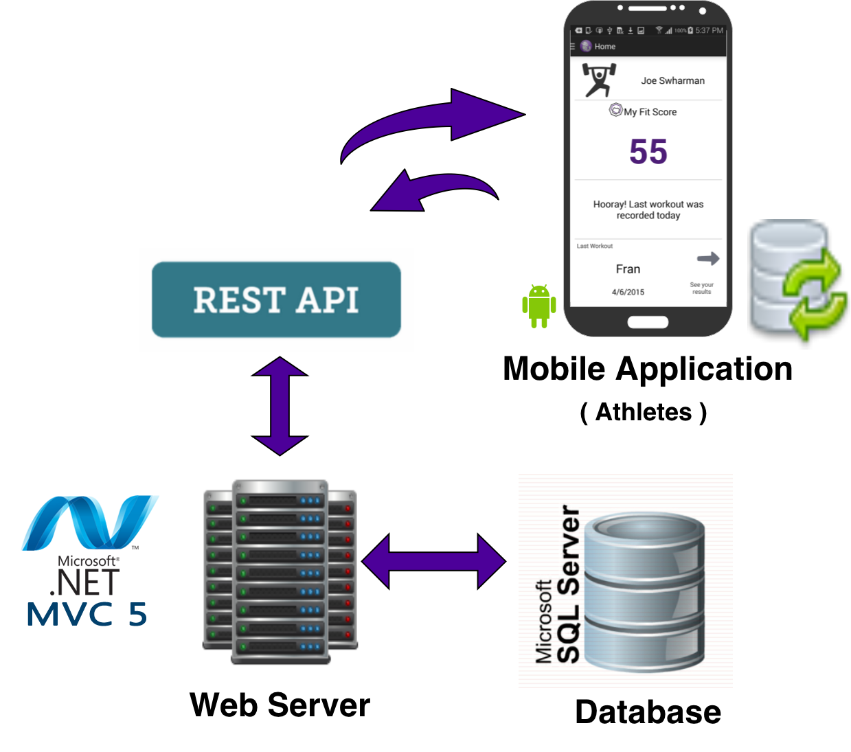
Athlete Mobile Application
Android Application
Relative layout
SQLite3 Database
NTASC ‘15

Slide 16
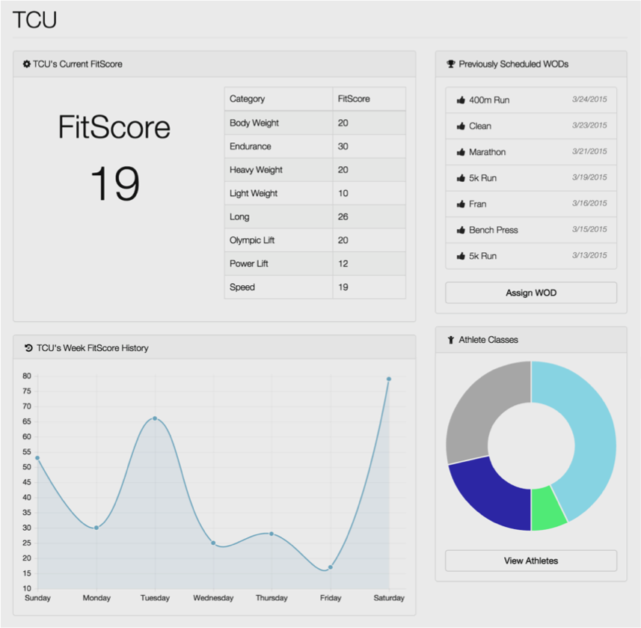
Administrative Portal
Home Screen
NTASC ‘15

Slide 17
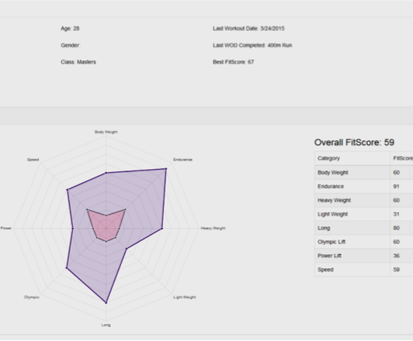
Administrative Portal
Athlete Page
NTASC ‘15

Slide 18
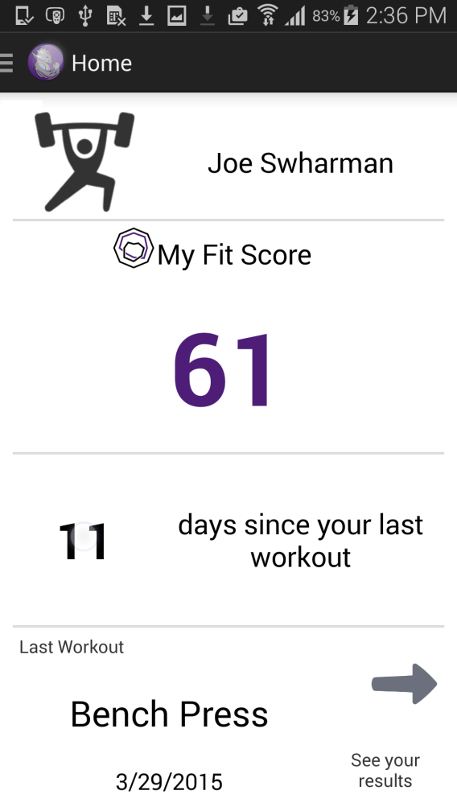
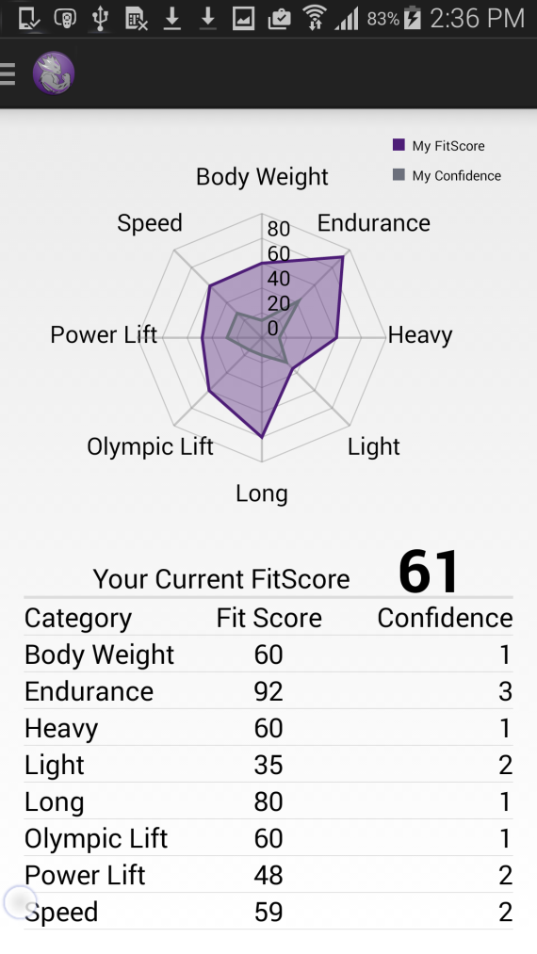
Athlete Mobile Application
Home Screen
FitScore Screen
NTASC ‘15

Slide 19
Demo
NTASC ‘15

Slide 20
Results and Conclusions
A system designed specifically to help Crossfit athletes
Communication and group dynamics was key
Client knowledge was extremely beneficial
New Technologies
Specific Requirements
NTASC ‘15

Slide 21
Questions
NTASC ‘15

