Slide 1
FrogFit
Spring 2015 Presentation
Iteration 2

Slide 2
FrogFit Team
Geoff Adams
  Senior, CS Major
  Android Developer, DBA, Tech Lead
Bryan Kribbs
  Senior, CITE Major
  Admin Site Architect, Document Lead, Testing Lead
Matt Ratliff
  Senior, CS Major
  Android Developer, Internal Site Architect, Project Lead

Slide 3
Overview
Background
What is Crossfit?
What is FrogFit?
What Makes FrogFit Unique?
Current State
Demo
Questions

Slide 4

Background
Steve Johnston
Crossfit athlete and founder of Chalkbucket Labs
Realized there is a need in the Crossfit world
Help athletes identify strengths and weaknesses

Slide 5

What is Crossfit
Crossfit is a strength and conditioning program
All encompassing and varied workouts
Developed for Military and first responders
Exploded in popularity
Now used by house wives and elite athlete alike

Slide 6

What is FrogFit?
Designed for Crossfit athletes
Breakdown fitness into 8 categories
Scoring athletes on each category
Creating an overall score to show true fitness level

Slide 7
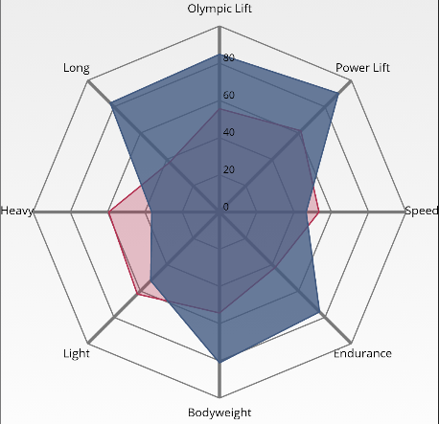
What Makes FrogFit Unique?
Providing a FitScore
Creating a confidence level along side the FitScore
Being able to show a graphical representation of the FitScore
Visualizing strengths and weakness for athletes

Slide 8
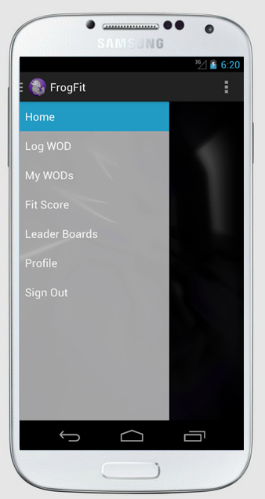




Platforms
Android API v4 (Jellybean) and above Web browsers

Slide 9
Current State
FitScore algorithm developed
Documentation created and being revised
Basic application functionality
Basic web functionality
Basic web API functionality
Basic mobile application functionality
Database created and being populated
Device interaction

Slide 10
What’s Been Easy
Communication and group dynamics.
Client knowledge.
What Hasn’t Been Easy
We quickly learned that documentation takes much longer than you’ll ever anticipate.
The steep learning curve for new technologies
The algorithm design and refinement time cost.

Slide 11
Iteration 3
Almost full functionality of mobile app
Almost full functionality website
Limited graphing capability
Full Web API created

Slide 12
Demo
FrogFit Admin Website
FrogFit Mobile Application

Slide 13
Questions

