Slide 1
FrogFit
Winter 2014 Presentation
Iteration 1

Slide 2
FrogFit Team
Geoff Adams
  Senior, CS Major
  Android Developer, DBA, Tech Lead
Bryan Kribbs
  Senior, CITE Major
  Admin Site Architect, Document Lead, Testing Lead
Matt Ratliff
  Senior, CS Major
  Android Developer, Internal Site Architect, Project Lead

Slide 3
Overview
What is Crossfit?
What is FrogFit?
What makes FrogFit unique?
Platforms
Current state
What’s been easy
What hasn’t been easy
Iteration 2
Miscellaneous

Slide 4

What is Crossfit
“Crossfit is the principal strength and conditioning program for many police academies and tactical operations teams, military special operations units, champion martial artists, and hundreds of other elite and professional athletes worldwide.” -The Main Site

Slide 5

What is FrogFit?
“FrogFit is designed for Crossfit athletes to track and monitor their individual progress over a given period of time in order to identify their own strengths and weaknesses. The FrogFit system will allow coaches to designate WODs in order to improve their gym’s overall fitness.”
-FrogFit

Slide 6
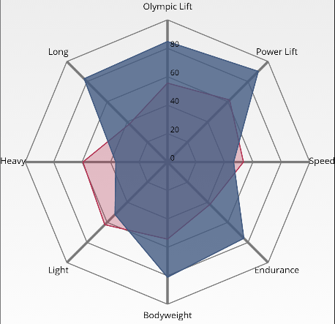
What Makes FrogFit Unique?
FrogFit utilizes an innovative scoring system that holds athletes accountable for their own fitness. By providing the athlete with a confidence score in addition to an overall FitScore, FrogFit users are presented with a gauge of their fitness far more reliable than any other solutions readily available. Where other systems may provide some gauge of fitness through rigid testing, FrogFit conforms to the users’ everyday activities in Crossfit.

Slide 7
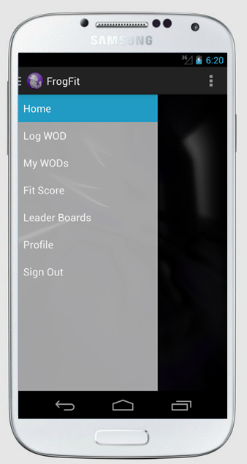




Platforms
Android API v4 (Jellybean) and above Web browsers

Slide 8
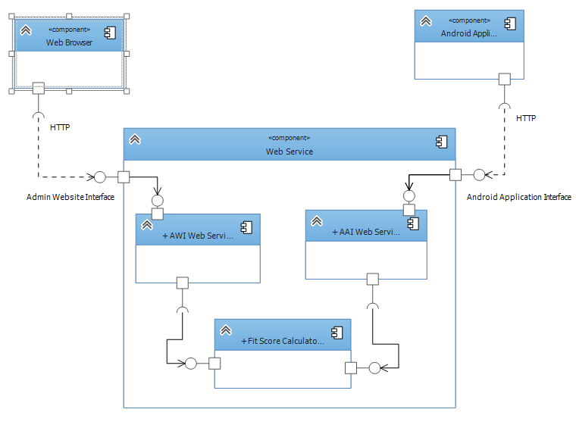
System Architecture

Slide 9
Current State
FitScore algorithm developed
First versions of documentation submitted and revised
Basic application functionality
Basic web functionality
Basic API functionality
Database created and sparsely populated
Basic device interaction

Slide 10
What’s Been Easy
Communication and group dynamics.
Client knowledge.

Slide 11
What Hasn’t Been Easy
We quickly learned that documentation takes much longer than you’ll ever anticipate.
The learning curve has been pretty steep for all of us since we’re working with languages and software we haven’t used before.
The refinement of the algorithm took longer than expected. Although the idea was simple to begin with it quickly turned into much more work than we initially thought.

Slide 12

Iteration 2
Iteration 2 will feature but is not limited to:
The “ability to navigate the mobile app and website with limited data passing. Database server completely populated and API more than half completed.”

Slide 13
Miscellaneous
Functional Requirements
Non-Functional Requirements
Future Schedule
Resources Used

Slide 14
Questions

