Slide 1
FrogFit A Mobile Crossfit Companion
Geoffrey Adams, Bryan Kribbs, Matt Ratliff Computer Science Department Texas Christian University

Slide 2
FrogFit Team
Geoff Adams
Senior, CS Major
Android Developer, DBA, Tech Lead
Bryan Kribbs
Senior, CITE Major
Admin Site Architect, Document Lead, Testing Lead
Matt Ratliff
Senior, CS Major
Android Developer, Internal Site Architect, Project Lead

Slide 3
Overview
Background
What is Crossfit
What is FrogFit
What Makes FrogFit Unique
System Overview
Demo
Technologies Learned
Future Expansions
Lessons Learned

Slide 4
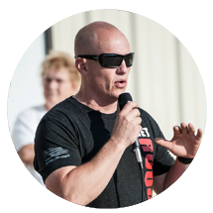
Background
Steve Johnston, a TCU Alumni
Crossfit athlete and founder of Chalkbucket Labs
Realized there is a need in the Crossfit world
Help athletes identify strengths and weaknesses

Slide 5
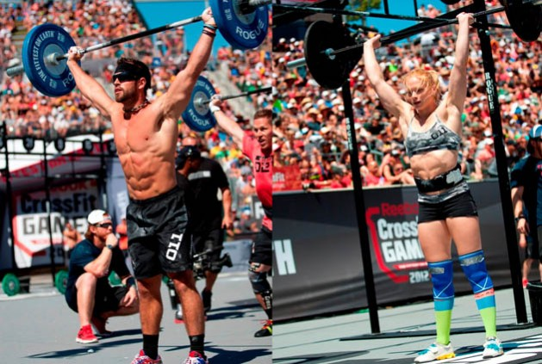
What is Crossfit
Crossfit is a strength and conditioning program
All encompassing and varied workouts
Exploded in popularity
Used by general population and elite athlete alike

Slide 6
What is Crossfit
WOD
“Workout Of-the Day”
The workout for today, any workout, or any Crossfit activity
We mean Workout
What does a “WOD” entail
A combination of movements that is measured against time, repetitions, or weight.
Rx – Completing a WOD “As Prescribed”

Slide 7
What is Crossfit
Benchmark/Named Workouts
The names are only used to remember the workout
Workouts chosen are popular and repeatable
Can be repeated to measure performance
Types of names
Girls – Fran, Isabel, Cindy
Heroes – Murph, Nate, JT
Notables – Fight Gone Bad, 14.1, 15.2

Slide 8
What is FrogFit
Designed for Crossfit athletes
Creating an overall score to show true fitness level
Breakdown fitness into 8 categories
Scoring athletes on each category

Slide 9
FrogFit Categories
Body Weight
Endurance
Heavy Weight
Light Weight
Long
Olympic Lift
Power Lift
Speed

Slide 10
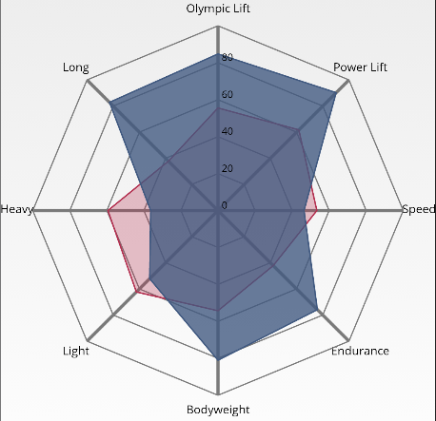
What Makes FrogFit Unique
Providing a FitScore
Creating a confidence level along with the FitScore
Being able to show a graphical representation of the FitScore
Visualizing strengths and weakness for athletes

Slide 11
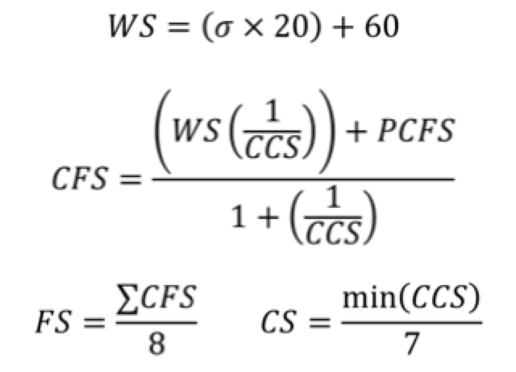
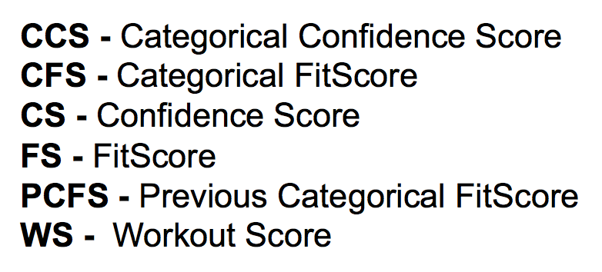
What Makes FrogFit Unique
Confidence Score to eliminate “Gaming the System”
Unique Algorithm

Slide 12
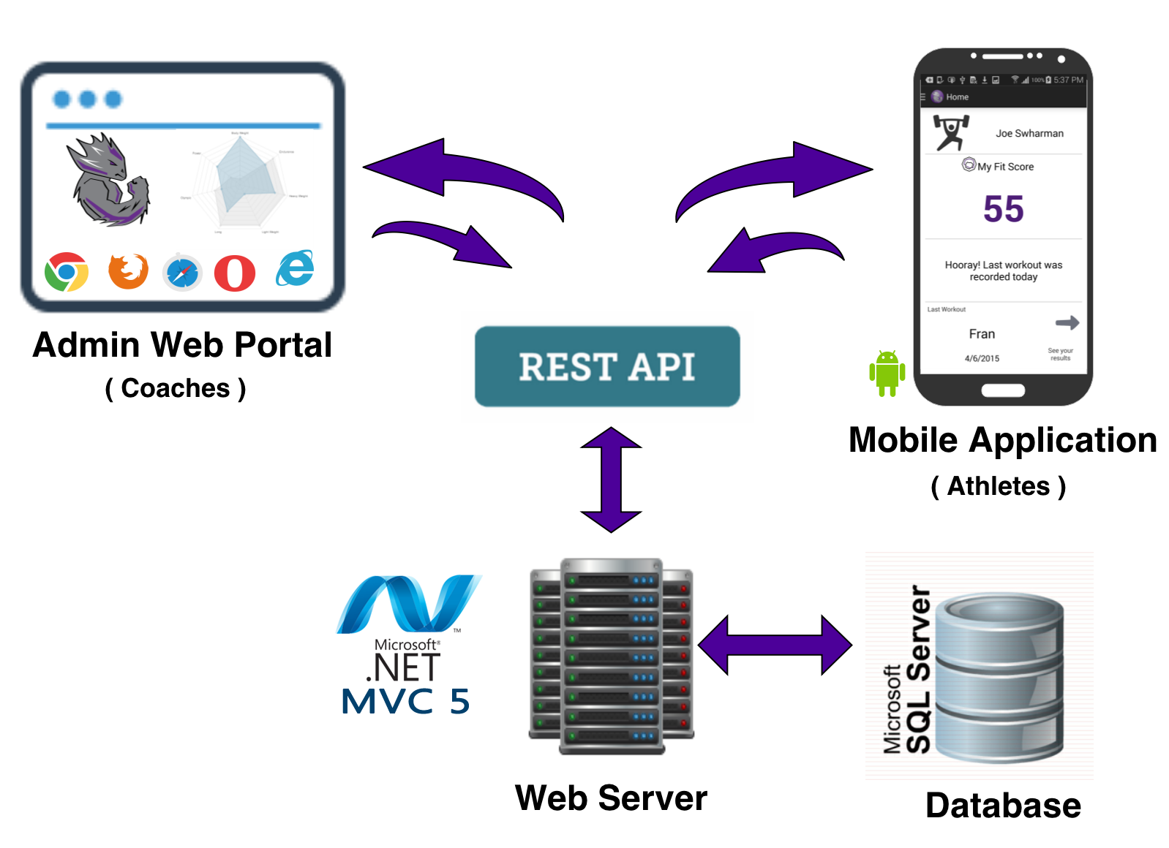
Platforms

Slide 13
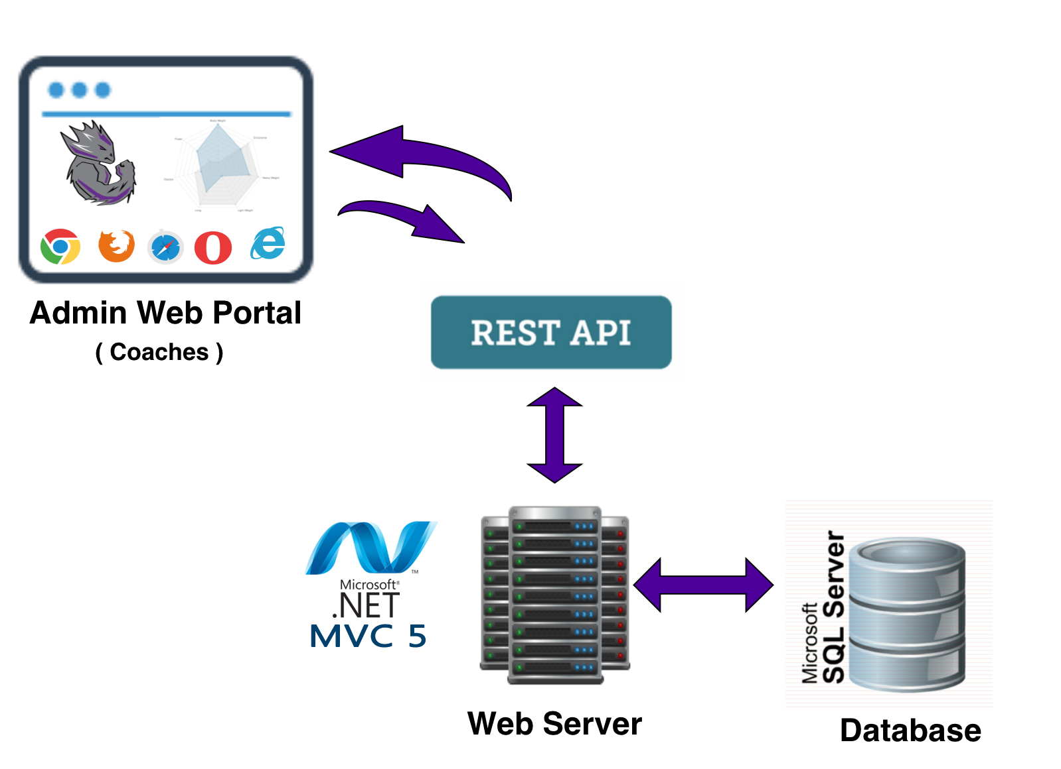
Admin Web Portal
Responsive Web Design
Bootstrap
REST API
ASP.NET MVC 5
Microsoft SQL Server 2012

Slide 14
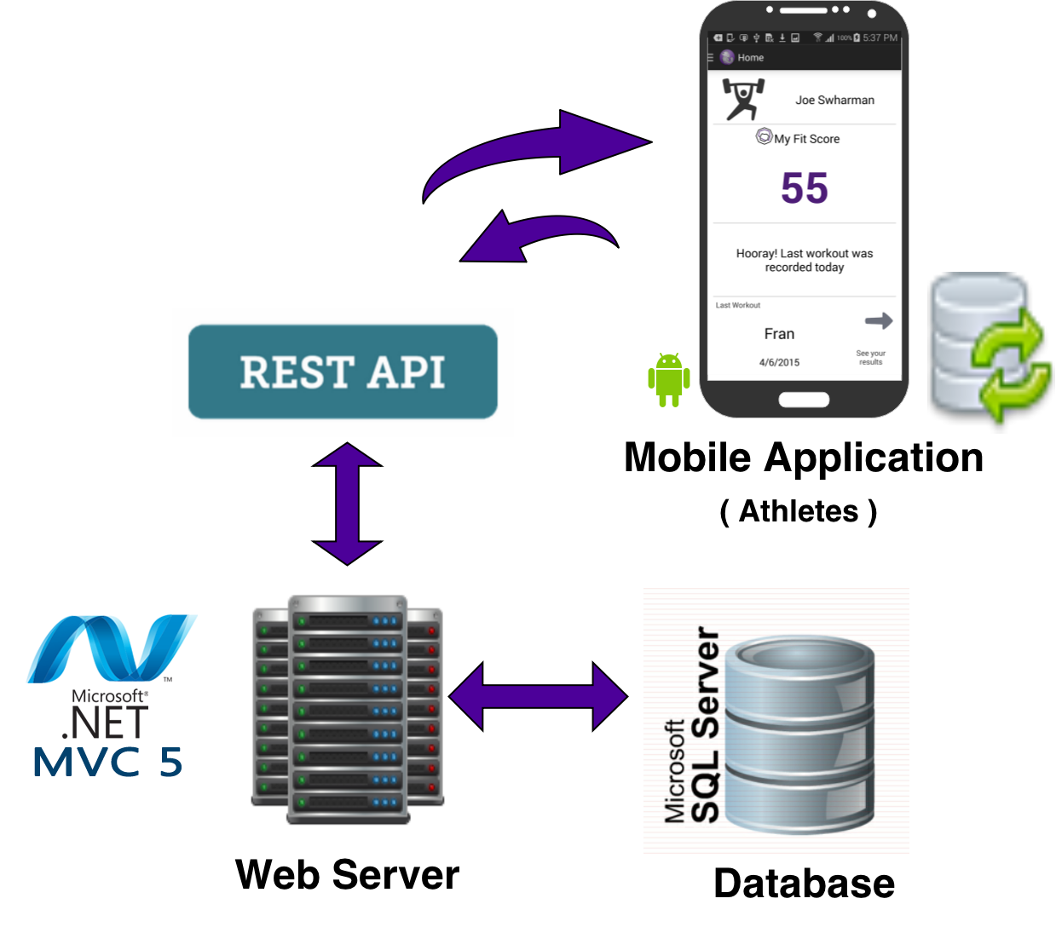
Athlete Mobile Application
Android Application
Relative Layout
SQLite3 Database

Slide 15
Administrative Portal
Home Screen

Slide 16
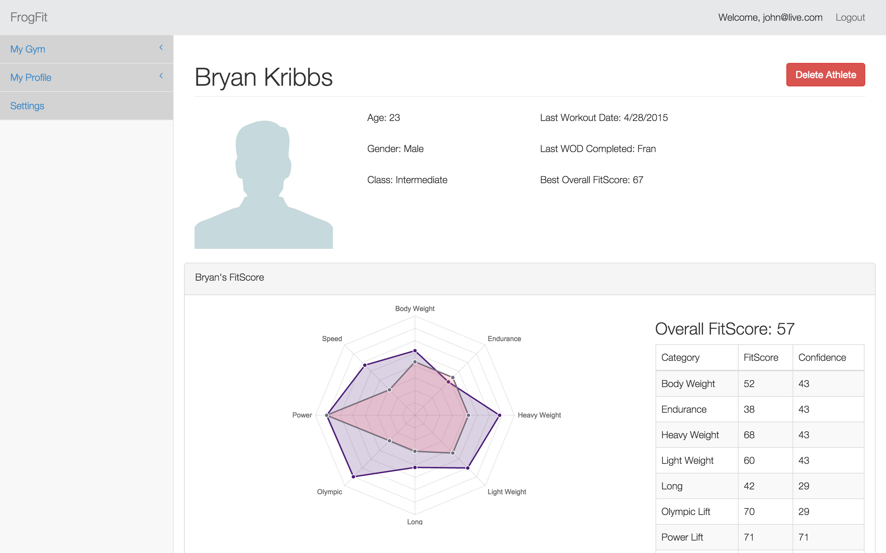
Administrative Portal
Athlete Page

Slide 17
Athlete Mobile Application
Home Screen
FitScore Screen

Slide 18
Demo

Slide 19
Technologies Learned
Android
Windows Web Services
MVC
C#
ASP.NET
SQL Server
SQL Management Studio

Slide 20
Future Expansions
Can be expanded to other sports
Just change the input data to use the needed fitness categories
Football - Speed, Endurance, Power Lifting, Agility
Gymnastics – Strength, Flexibility, Endurance

Slide 21
Lessons Learned
Gathering requirements
Learning our domain
Project size and scope
Teamwork, communication, and group dynamics
Client knowledge was extremely beneficial

Slide 22
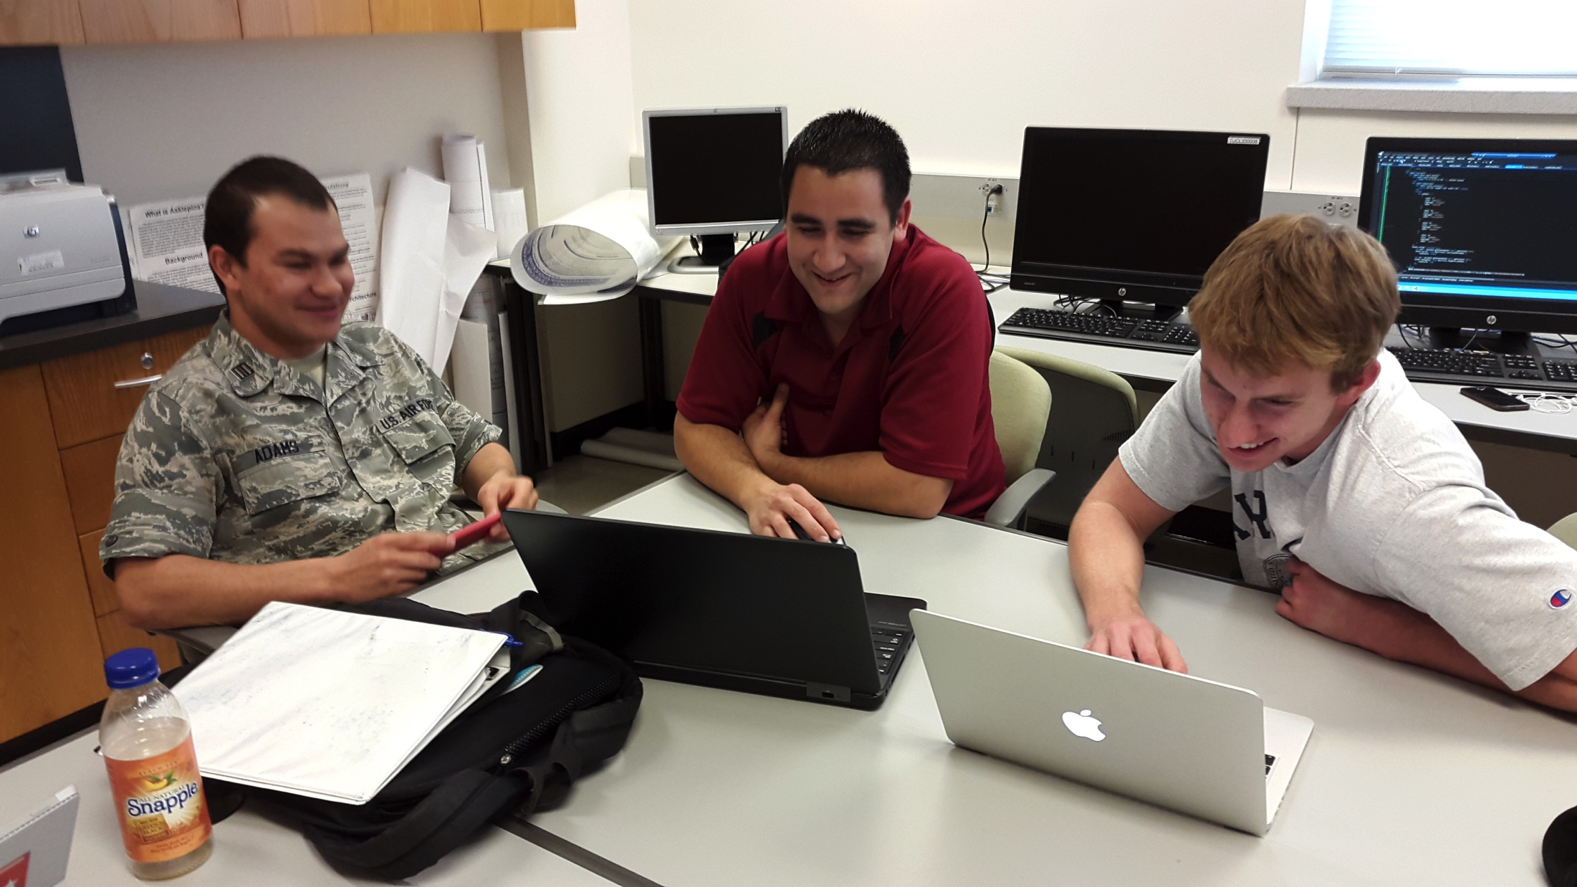
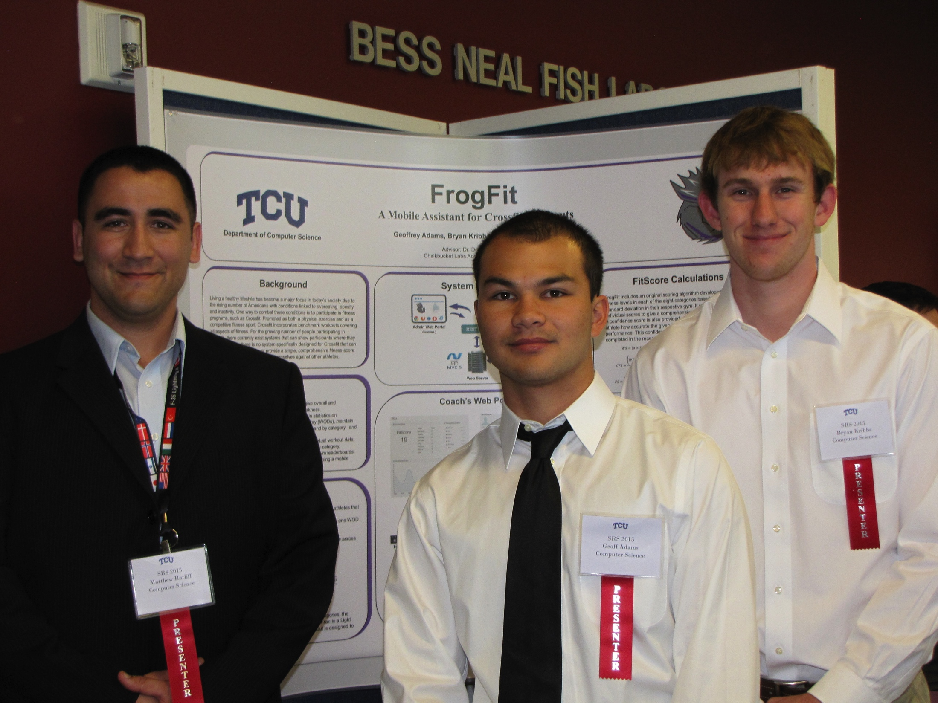
Thanks

