Slide 1

NTASC Presentation – Part i
04/05/14

Slide 2
Team
Stockton Ackermann
  Documentation Lead & Android Application Developer
Nicholas Capurso
  Project Lead & Network Engineer
Eric Elsken
  Technical Lead & General Programmer
Myrella Garcia
  Website Developer
Casey Stephens
  Android Application Developer
David Woodworth
  Testing Lead, Network Engineer & Website Developer

Slide 3
Overview
Project Background
Project Description
Hardware
Project Support Environment
System Components
System Architecture

Slide 4
Project Background
Pre-existing systems.
  OnStar and other proprietary systems.
    Accident detection.
    Roadside assistance.
    Contacts emergency services.
  Expensive and not widely available.
Project FrogStar

Slide 5
Project Description
Proof of concept.
Accident detection.
  Uses smart phone and TI SensorTag readings to detect accidents.
  Redundant computations between smart phone and on-board control unit (OBCU).
Use of Near Field Communication (NFC) and Bluetooth.
Ability to contact emergency services.

Slide 6
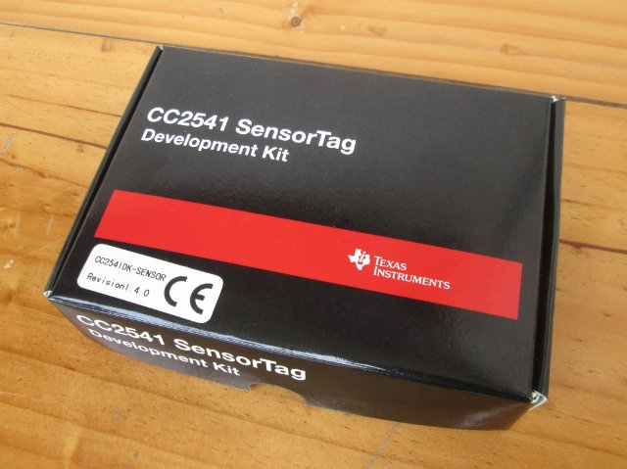
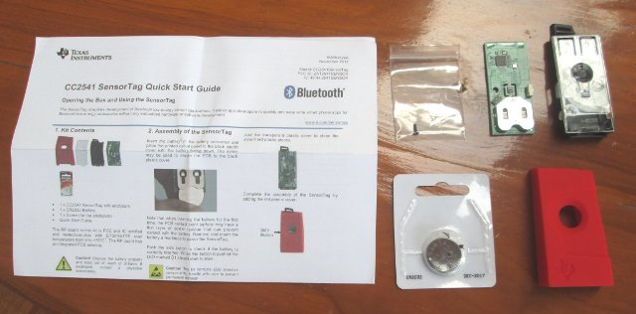
Texas Instruments SensorTags
Portable.
Inexpensive.
Bluetooth LE capability.
Open firmware.

Slide 7
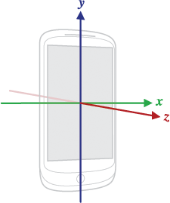
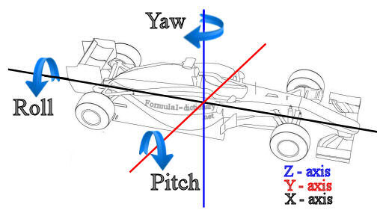
Texas Instruments SensorTags
Accelerometer - a device that measures acceleration, or the rate at which speed changes.
Gyroscope - a device that measures orientation in terms of yaw, roll, and pitch.

Slide 8
Types of Accidents
Accelerometer-based collisions
  Head-on
  Rear-end
  T-Bone
Gyroscope-based accidents
  Spin-out
  Rollover

Slide 9
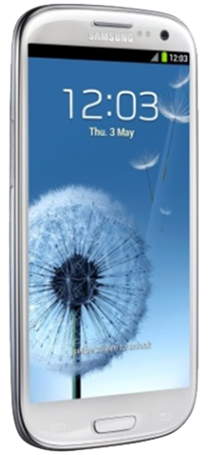
Why Android?
Variety of sensors.
Bluetooth capability.
NFC capability.
Open Source Platform.
Easy transition for our developers.

Slide 10
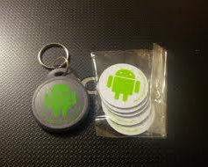
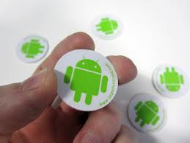
Use of NFC Tags
Android-compatible method for exchanging small pieces of data.
Convenient way to start and shutdown the system.
Re-programmable data storage.

Slide 11
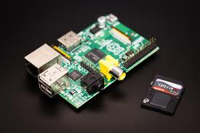
OBCU - Raspberry Pi
On-Board Control Unit (OBCU)
Advantages:
  Inexpensive
  Storage via SD Card
  Expandable via USB
    Bluetooth
Offloads SensorTag querying from phone.
Runs Linux.
Powered by vehicle.

Slide 12
System Environment
Programming Environment
Hardware
  Android Development Toolkit (2.2) Plugin for Eclipse.
  BlueZ 5.2
  Eclipse: Kepler (4.3.1)
  Raspbian Linux
  Windows 7 64-bit SP 1
  Samsung Galaxy S4 (Android 4.2.2)
  Raspberry Pi
  TI CC2541 Sensor Tags (4)
  USB Bluetooth Adapters (5)
  NFC Tag

Slide 13
Smart Phone Components
FrogStar App
  User information
  Vehicle database
  NFC capability
  Technician mode
Networking Service
  Bluetooth
Sensor Service
  Computation engine
  Sensor querying

Slide 14
OBCU (Raspberry Pi) Components
Master program.
Bluetooth server.
  Smart phone communication
Bluetooth LE server
  General attributes (GATT)
  SensorTag querying
Computation engine

Slide 15
System Architecture

Slide 16
Key Requirements
  NFC tag.
    Network information.
    Toggle the system on and off.
  Smart phone & OBCU.
    Query sensors.
    Accident detection.
    Confirm accidents.
  OBCU
    Provides system status info.
  On accident confirmation, alert user.
    If user confirms or cannot respond, alert proper authorities.

Slide 17
Next Part II
FrogStar Application.
Networking.
NFC Operation Demo.
Prototype Vehicle Demo.

Slide 18
Questions?

