Slide 1

Senior Design Iteration 1
2013 - 2014

Slide 2
Team
Stockton Ackermann
  Documentation Lead & Android Application Developer
Nicholas Capurso
  Project Lead & Network Engineer
Eric Elsken
  Technical Lead & General Programmer
Myrella Garcia
  Website Developer & Android Application Developer
Casey Stephens
  Android Application Developer
David Woodworth
  Testing Lead, Network Engineer & Website Developer

Slide 3
Overview
Project Background
Hardware System Components
Project Description
System Environment
Iteration 1 Description
Key Requirements
UML Diagrams
Demos
Winter Break & Iteration 2

Slide 4
Project Background
Pre-existing systems.
  OnStar and other proprietary systems.
    Accident detection.
    Roadside assistance.
    Contacts emergency services.
  Expensive and not widely available.
TI Sensor Tags
Project FrogStar

Slide 5
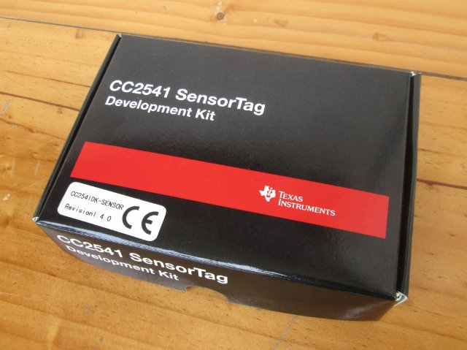
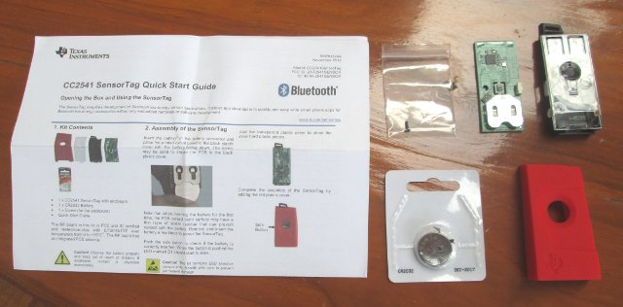
Texas Instruments Sensor Tags
Inexpensive.
Bluetooth LE capability.

Slide 6
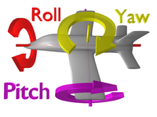
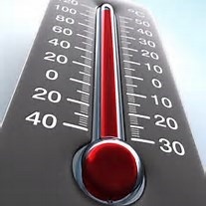
Texas Instruments Sensor Tags
Accelerometer - a device that measures acceleration, or the rate at which speed changes.
Gyroscope - A device that measures orientation in terms of yaw, roll, and pitch.
Thermometer.

Slide 7
Project Description
Proof of concept.
Accident detection.
  Uses smart phone and TI Sensor Tag readings to detect accidents.
  Redundant computations between smart phone and on board microprocessor.
Ability to contact emergency services.
Expandable to detect unattended children in hot vehicle.

Slide 8
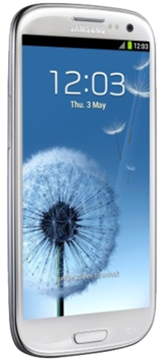
Why Android?
Wi-Fi Direct & Bluetooth capability.
NFC capability.
Open Source Platform.
Easy transition for our developers.

Slide 9
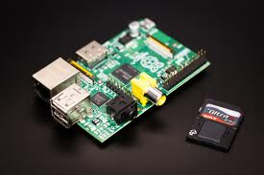
Why Raspberry Pi?
OBCU- On-Board Control Unit
Saves smart phone battery by offloading sensor querying from phone.
Expandable via USB capabilities.
Runs Linux distributions.
Powered by vehicle.

Slide 10
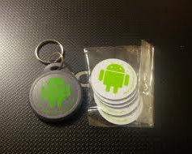
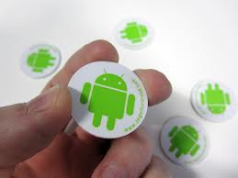
Use of NFC Tags
Android compatible method for exchanging small pieces of data.
Used to start and shutdown our system.
Re-programmable data storage.

Slide 11
System Environment
Software
Hardware
  Programming Environment
    Android Development Toolkit Plugin for Eclipse 2.2.
    BlueZ 5.1
    Eclipse: Kepler (4.3.1) Service Release 1
    GCC 4.8.2
    Linux: Fedora Remix
    Windows 7 64-bit SP 1
  File Transfer and Version Control
    CoreFTP Lite 2.2
    Tortoise SVN 1.7.10
    Windows 2008 Server running Subversion & IIS
  Productivity Software
    Adobe Photoshop CS6
    Camtasia Studio
    GroupMe
    Microsoft Visio 2010
    Microsoft Word 2010
    Microsoft PowerPoint 2010
    Microsoft Project 2010
    Notepad++ 6.5.1
    ASUS N13 rev. B1 USB Wi-Fi Adapter (2)
    Plugable USB Bluetooth 4.0 LE Adapters (2)
    Raspberry Pi (2)
    Samsung Galaxy S4 (Android 4.2.2)
    NFC Tags (12)
    TI CC2541 Sensor Tags (10)

Slide 12
Iteration 1
Inter-device communication.
NFC tag functionality.
Android platform training.
-December 12, 2013

Slide 13
Inter-Device Communication
  Smart phone – RaspberryPi Communication
    Options:
      Wi-Fi Direct
      Bluetooth
  Raspberry Pi – SensorTag Communication
    Bluetooth LE
      GATT

Slide 14
NFC Tag Functionality
  Near Field Communication
  Launching the Application
  Storing & Reading Data from NFC tag

Slide 15
Android Platform Training
  Getting to Know the API
    Activities
    Menus
    Intents
    XML
  Database

Slide 16
Database
  Entity-Relationship Model
  Schema

Slide 17
Key Requirements
  An NFC tag shall be used to hold network information – this tag may be scanned by a user to toggle the system on and off.
  The smart phone application shall collect its own acceleration and gyroscope sensor readings to determine if there has been an accident.
  The OBCU shall query and collect the TI sensor tags’ readings to determine if there has been an accident.

Slide 18
Key Requirements (cont.)
  The smart phone shall respond to OBCU requests for accident detection. The OBCU shall respond to smart phone requests pertaining to system health and accident detection.
  Upon accident detection, the smart phone application shall give the user an option to confirm whether an accident has occurred.
  A smart phone shall alert the proper authorities in the event of an accident if the user of the smart phone does not prevent this action from taking place.

Slide 19
System Architecture

Slide 20
State Diagram

Slide 21
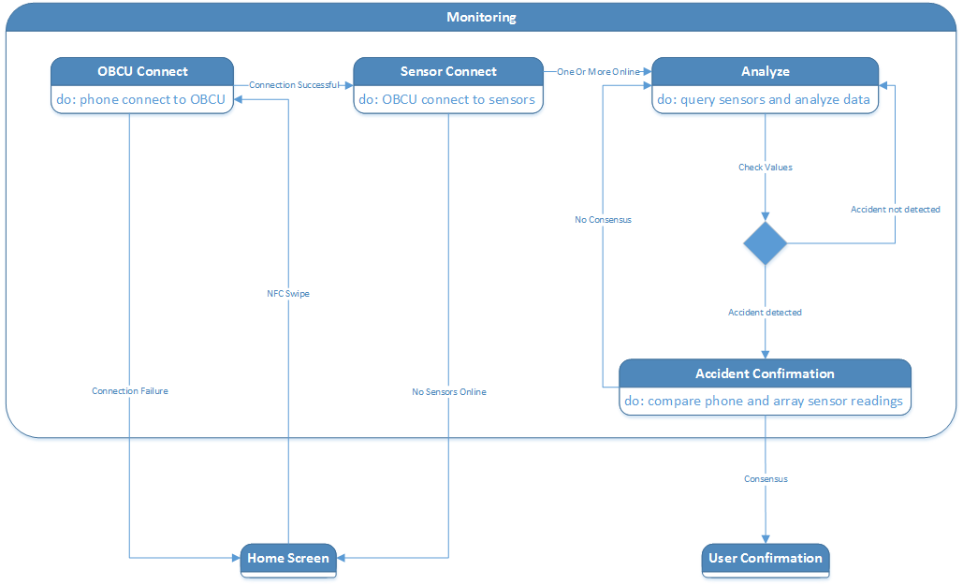
Monitoring State

Slide 22
Class Diagram

Slide 23
Accident Detection Sequence Diagram

Slide 24
Ask if Unharmed Sequence Diagram

Slide 25
NFC & Bluetooth Communication Demo

Slide 26
SensorTag Demo

Slide 27
Android App Prototype Demo

Slide 28
Significant Problems
Initial SensorTag Communication
Android Emulator
Wi-Fi Direct

Slide 29
Upcoming Schedule
Winter Break Jobs
Spring Semester
Stockton – Android app & training
Nick – Bluetooth communication
Eric – SensorTag communication
Myrella – Android app & training
Casey – Android app & training
David – Bluetooth communication
January 31, 2014 - Iteration 2
February 4, 2014 - Faculty Presentation
March 4, 2014 - Iteration 3
March 24, 2014 - NTASC Abstract
April 1, 2014 - Iteration 4
April 1, 2014 - User Manual
April 1, 2014 - Developer Manual
April 5, 2014 - NTASC
April 11, 2014 - SRS Poster Due
April 18, 2014 - SRS
May 1, 2014 - Final Presentation
May 2, 2014 - Complete All Documents
May 5, 2014 - Final Product DVD

Slide 30
Iteration 2
Android app completion
  GUI
  Database
  Smart phone sensor querying
Begin Accident Detection
  RaspberryPi SensorTag querying
  Detection algorithms
-January 31, 2014

Slide 31
Questions?

