Slide 1

Senior Design Project Overview
2013 - 2014

Slide 2
Team
Stockton Ackermann
  Documentation Lead & Android Application Developer
Nicholas Capurso
  Project Lead & Network Engineer
Eric Elsken
  Technical Lead & General Programmer
Myrella Garcia
  Website Developer & Android Application Developer
Casey Stephens
  Android Application Developer
David Woodworth
  Testing Lead, Network Engineer & Website Developer

Slide 3
Overview
Project Background
Hardware System Components
Project Description
System Environment
System Requirements
  Functional Requirements
  Nonfunctional Requirements
Use-Case Diagrams & Descriptions

Slide 4
Project Background
Pre-existing systems.
  OnStar and other proprietary systems.
    Collision detection.
    Roadside assistance.
    Contacts emergency services.
  Expensive and not widely available.
TI Sensor Tags
Project FrogStar

Slide 5
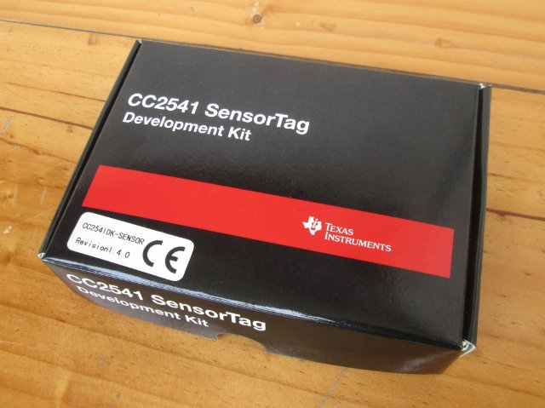
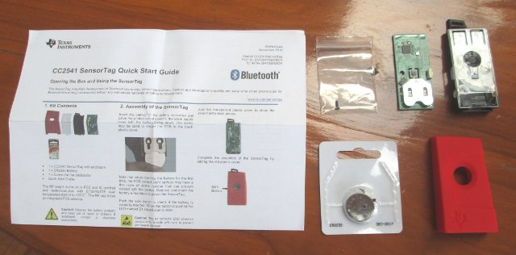
Texas Instruments Sensor Tags
Inexpensive.
Bluetooth LE capability.
Accelerometer.
Gyroscope.
Thermometer.

Slide 6
Project Description
Proof of concept.
Collision detection.
  Uses smart phone and TI Sensor Tag readings to detect collisions.
  Redundant computations between smart phone and on board microprocessor.
Ability to contact emergency services.
Expandable to detect unattended children in hot vehicle.

Slide 7
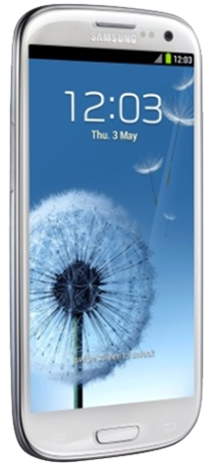
Why Android?
Bluetooth LE capability.
NFC capability.
Open Source Platform.
Wi-Fi Direct.
Easy transition for our developers.

Slide 8
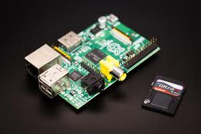
Why Raspberry Pi?
Saves smart phone battery by offloading sensor querying from phone.
Expandable via USB capabilities.
Runs Linux distributions.
Powered by vehicle.

Slide 9
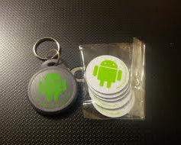
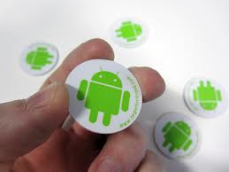
Use of NFC Tags
Android compatible method for exchanging small pieces of data.
Used to start and shutdown our system.
Re-programmable data storage.

Slide 10
Deliverables and Milestones
Fall Semester
Spring Semester
October 17, 2013 - Project Proposal
October 17, 2013 - Project Plan Document
October 17, 2013 - Skeleton Website
October 22, 2013 - PSE
October 31, 2013 - Requirements Document
Nov. 21, 2013 - Design Document
December 2, 2013 - Iteration 1
January 31, 2014 - Iteration 2
February 4, 2014 - Faculty Presentation
March 4, 2014 - Iteration 3
March 24, 2014 - NTASC Abstract
April 1, 2014 - Iteration 4
April 1, 2014 - User Manual
April 1, 2014 - Developer Manual
April 5, 2014 - NTASC
April 11, 2014 - SRS Poster Due
April 18, 2014 - SRS
May 1, 2014 - Final Presentation
May 2, 2014 - Complete All Documents
May 5, 2014 - Final Product DVD

Slide 11
Iteration 1
Inter-device communication.
NFC tag functionality.
Android training.
Collision detection method research.
-December 2, 2013

Slide 12
Iteration 2
Completed UI.
Implementation of collision detection algorithms.
-January 31, 2014

Slide 13
Iteration 3
Completion of collision detection system.
Begin system testing.
Begin unattended child detection.
-March 4, 2014

Slide 14
Iteration 4
Completion of testing.
Requirements verification.
UI enhancements.
-April 1, 2014

Slide 15
System Environment
Software
Hardware
  Programming Environment
    Android Development Toolkit Plugin for Eclipse 2.2.
    BlueZ 5.1
    Eclipse: Kepler (4.3.1) Service Release 1
    GCC 4.8.2
    Linux Distribution
    Windows 7 64-bit SP 1
  File Transfer and Version Control
    CoreFTP Lite 2.2
    Tortoise SVN 1.7.10
    Windows 2008 Server running Subversion & IIS
  Productivity Software
    Adobe Photoshop CS6
    Camtasia Studio
    GroupMe
    Microsoft Visio 2010
    Microsoft Word 2010
    Microsoft PowerPoint 2010
    Microsoft Project 2010
    Notepad++ 6.5.1
    ASUS N13 rev. B1 USB Wi-Fi Adapter (2)
    Pluggable USB Bluetooth 4.0 LE Adapters (2)
    Raspberry Pi (2)
    Samsung Galaxy S4 (Android 4.2.2)
    NFC Tags (12)
    TI CC2541 Sensor Tags (10)

Slide 16
Functional Requirements
  An NFC tag shall be used to hold network information – this tag may be scanned by a user to toggle the system on and off.
  A user shall be able to manage user and car profiles through a smart phone application.
  A user shall be able to view the system information and health diagnostics through a smart phone application.

Slide 17
Functional Requirements
  The smart phone application shall be able to display system data and alert the user of system health problems.
  The smart phone application shall collect its own acceleration and gyroscope sensor readings to determine if there has been a collision.
  The OBCU shall query and collect the TI sensor tags’ readings to determine if there has been a collision.

Slide 18
Functional Requirements
  The smart phone shall respond to OBCU requests for collision detection. The OBCU shall respond to smart phone requests pertaining to system health and collision detection.
  Upon collision detection, the smart phone application shall give the user an option to confirm whether a collision has occurred.
  A smart phone shall alert the proper authorities in the event of a collision if the user of the smart phone does not prevent this action from taking place.

Slide 19
Functional Requirements
  An intermediary OBCU and a smart phone shall temporarily store sensor readings within the past 1 minute.
  The system shall back up data in the event of a collision.

Slide 20
Non-Functional Requirements
Performance Requirements
  The querying of TI CC2541 Sensor Tags shall be done in a fashion such that an accurate decision can be made concerning a collision.
  A minimal amount of storage space shall be used to accommodate data storage.
  The CC2541 Sensor Tags shall be queried at or above the minimum possible sampling interval.
External Requirements
  911 emergency respondents shall only be called in the case of an actual emergency.

Slide 21
System Architecture

Slide 22
Use-Cases: User Interaction

Slide 23
User Profile
Manage User Profile
Actors | User
Description | The user can input and edit their general information such as name, gender, birthday, telephone number, etc.
Data | The data the user inputs will be stored.
Pre-Conditions | The user must have the application installed on their smart phone.
Triggers | First app start or an edit button click.
Events | The application starts or the user clicks the edit button. Edit screen for user data appears. If data has already been entered the data fields will be populated. User interacts to edit the fields. User clicks the save button, user profile is saved, and screen closes.

Slide 24
Vehicle Profile
Manage Vehicle Profile
Actors | User
Description | The user can input and edit their general information about their vehicle such as VIN number, license plate number, etc.
Data | The data the user inputs will be stored.
Pre-Conditions | The user must have the application installed on their smart phone.
Triggers | First app start after user profile management or an edit button click.
Events | The application starts or the user clicks the edit button. Edit screen for user data appears. If data has already been entered the data fields will be populated. User interacts to edit the fields. User clicks the save button, vehicle profile is saved, and screen closes.

Slide 25
NFC Start
Swipe NFC Start
Actors | User
Description | Once user enters the vehicle and turns the car on, they shall hold their phone within the appropriate distance of the NFC tag. Once this occurs the smart phone application will trigger a startup.
Data | Bluetooth and OBCU MAC addresses.
Pre-Conditions | The NFC tag shall be preprogrammed with the appropriate data.
Triggers | When the user swipes the phone over the NFC tag.
Events | User swipes smart phone over NFC tag. Application processes data and connects to the OBCU. Application triggers system startup.

Slide 26
System Information
View System Information
Actors | User
Description | The user will be able to view the sensor tag health, networking statistics, and the user and vehicle profiles.
Data | User profile, vehicle profile, networking statistics, and sensor tag health.
Pre-Conditions | The application must be running and Swipe NFC Start events have been completed.
Triggers | The user clicks the system health button.
Events | The user clicks the system health button. System health information is displayed.

Slide 27
NFC Shutdown
Swipe NFC Shutdown
Actors | User
Description | Before user exits the vehicle and turns the car off, they shall hold their phone within the appropriate distance of the NFC tag. Once this occurs the smart phone application will trigger a shutdown.
Data | There is no data.
Pre-Conditions | The application and system are currently running.
Triggers | When the user swipes the phone over the NFC tag.
Events | User swipes smart phone over NFC tag. Application triggers system shutdown.

Slide 28
Use-Cases: On Board Control Unit

Slide 29
Startup
Startup
Actors | OBCU
Description | OBCU boots, initializes networking, turns on sensor tags, and receives startup command from smart phone.
Data | MAC addresses of the sensor tags.
Pre-Conditions | None.
Triggers | OBCU receives power from car.
Events | OBCU receives power from car. OBCU boots OS. Initializes networking. Turns on sensor tags. Receives startup command. Begins Collect TI Sensor Data use-case.

Slide 30
Collect TI Sensor Data
Collect TI Sensor Data
Actors | OBCU
Description | The OBCU shall query the sensor tags’ accelerometer and gyroscope information. Data is stored.
Data | Accelerometer and gyroscope readings.
Pre-Conditions | The system is currently running.
Triggers | OBCU Startup events have completed.
Events | Startup events have completed. OBCU queries sensor tags Stores data readings gathered in the last minute.

Slide 31
Collision Detection
Collision Detection
Actors | OBCU
Description | When the OBCU detects an accelerometer or gyroscope reading above the threshold for a collision, then it will communicate with the smart phone to confirm similar readings.
Data | Accelerometer and gyroscope readings.
Pre-Conditions | The system is currently running.
Triggers | OBCU detects a collision.
Events | OBCU detects a collision. Communicates with smart phone to confirm similar readings.

Slide 32
Shutdown
Shutdown
Actors | OBCU
Description | After receiving shutdown command from the smart phone, OBCU halts data collection, puts the sensor tags to sleep, and powers down.
Data | None.
Pre-Conditions | The system is currently running.
Triggers | The OBCU receives a shutdown command from the smart phone.
Events | The OBCU receives a shutdown command from the smart phone. OBCU halts data collection. OBCU sends sleep commands to sensor tags. OBCU powers down.

Slide 33
Respond to Phone Requests
Respond to Phone Requests
Actors | OBCU
Description | When receiving a query from the smart phone, the OBCU will process the query and respond with the appropriate results.
Data | Query data from the smart phone and result.
Pre-Conditions | The system is currently running.
Triggers | OBCU receives a query from the smart phone.
Events | OBCU receives a query from the smart phone. OBCU responds with appropriate data.

Slide 34
Use-Cases: Smart Phone

Slide 35
Startup System
Startup System
Actors | Smart Phone
Description | After the NFC tag has been swiped, phone will connect to OBCU. Sends necessary data to OBCU along with a startup command.
Data | Sends Bluetooth information to OBCU.
Pre-Conditions | The smart phone application has been started.
Triggers | NFC tag is swiped.
Events | NFC tag is swiped. Phone connects to OBCU. Phone sends data and startup command to OBCU.

Slide 36
Display System Data
Notify/Display System Data
Actors | Smart Phone
Description | If there is an inconsistency between smart phone and OBCU acceleration and gyroscope readings a notification will prompt the user to interact with the application. Additionally, if the system is deemed unhealthy then a notification will appear with a diagnosis.
Data | Sensor readings from both smart phone and OBCU.
Pre-Conditions | The application is running and the system is functioning.
Triggers | Unhealthy system and inconsistent data.
Events | Inconsistent data or a malfunction is determined. A message is displayed with pertinent data.

Slide 37
Collect Phone Sensor Data
Collect Phone Sensor Data
Actors | Smart Phone
Description | The smart phone shall query its accelerometer and gyroscope information. Data is stored.
Data | Accelerometer and gyroscope readings.
Pre-Conditions | The application and system are running.
Triggers | System startup.
Events | Smart phone queries accelerometer and gyroscope information.

Slide 38
Collision Detection
Collision Detection
Actors | Smart Phone
Description | When the smart phone detects an accelerometer or gyroscope reading above the threshold for a collision, then it will communicate with the OBCU to confirm similar readings. If the OBCU confirms similar readings, then a collision has occurred. Finally the user is prompted to confirm a collision has occurred.
Data | Accelerometer and gyroscope readings.
Pre-Conditions | Application is running.
Triggers | Through processing data, the smart phone has determined a collision has occurred.
Events | Through data collection and processing the smart phone will determine a collision has occurred. Phone communicates with OBCU to confirm a collision has occurred. A prompt will the sent to the user if a collision has occurred. If a collision has not occurred, data collection will resume.

Slide 39
Ask if User is Okay
Ask if User is Okay
Actors | Smart Phone
Description | Prompts the user to check if they need emergency assistance in the event of a collision. If the user does not respond or confirms that they need assistance, emergency personnel will be notified.
Data | There is no data.
Pre-Conditions | A collision has been confirmed.
Triggers | A collision has been confirmed.
Events | A collision has been confirmed. User is prompted for emergency assistance. If there is no response or the user needs assistance, emergency personnel will be notified. If the user declines assistance system will shut down.

Slide 40
Respond to OBCU Requests
Respond to OBCU Requests
Actors | Smart Phone
Description | Smart phone will be queried if the OBCU detects a collision. Smart phone will either confirm or deny that a collision has occurred.
Data | There is no data.
Pre-Conditions | The system is running.
Triggers | When the OBCU detects a collision.
Events | Smart phone receives a query from the OBCU. If the phone also detects a collision, either 3 or 4 from Collision Detection will take place.

Slide 41
Shutdown System
Shutdown System
Actors | Smart Phone
Description | OBCU is sent shutdown signal from smart phone. Smart phone stops data collection.
Data | There is no data.
Pre-Conditions | The system is running.
Triggers | NFC Swipe before exiting vehicle.
Events | NFC tag is swiped before exiting vehicle. OBCU is sent a shutdown signal. Phone halts data collection.

Slide 42
Questions?

