Slide 1

Faculty Presentation
02/04/14

Slide 2
Team
Stockton Ackermann
  Documentation Lead & Android Application Developer
Nicholas Capurso
  Project Lead & Network Engineer
Eric Elsken
  Technical Lead & General Programmer
Myrella Garcia
  Website Developer & Android Application Developer
Casey Stephens
  Android Application Developer
David Woodworth
  Testing Lead, Network Engineer & Website Developer

Slide 3
Overview
Project Background
Project Description
Hardware
System Components
System Architecture
Significant Issues & Solutions
Current Progress
Iteration 3
Demo

Slide 4
Project Background
Pre-existing systems.
  OnStar and other proprietary systems.
    Accident detection.
    Roadside assistance.
    Contacts emergency services.
  Expensive and not widely available.
TI SensorTags
Project FrogStar

Slide 5
Project Description
Proof of concept.
Accident detection.
  Uses smart phone and TI SensorTag readings to detect accidents.
  Redundant computations between smart phone and on-board control unit (OBCU).
Use of Near Field Communication (NFC) and Bluetooth
Ability to contact emergency services.

Slide 6
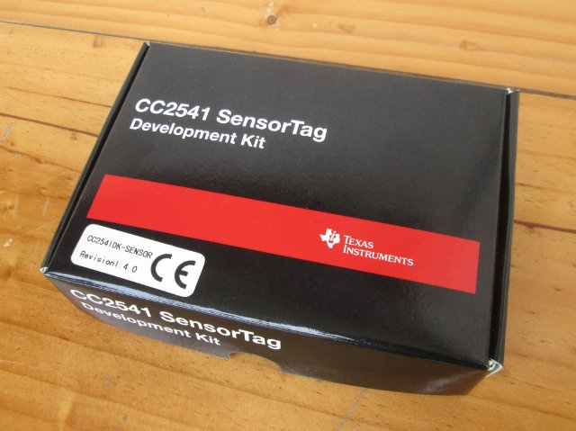
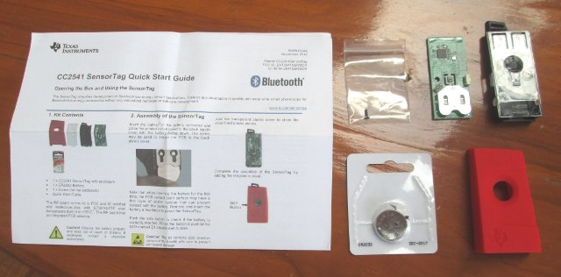
Texas Instruments SensorTags
Inexpensive.
Bluetooth LE capability.

Slide 7
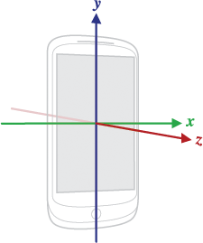
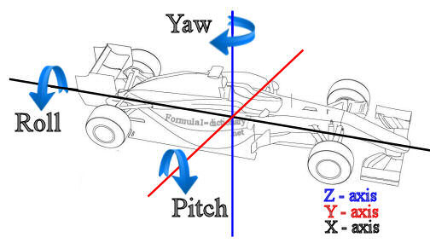
Texas Instruments Sensor Tags
Accelerometer - a device that measures acceleration, or the rate at which speed changes.
Gyroscope - a device that measures orientation in terms of yaw, roll, and pitch.

Slide 8
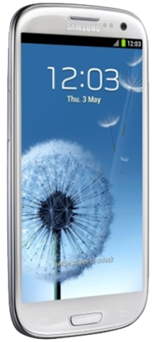
Why Android?
Bluetooth capability.
NFC capability.
Open Source Platform.
Easy transition for our developers.

Slide 9
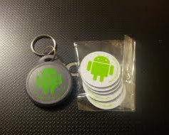
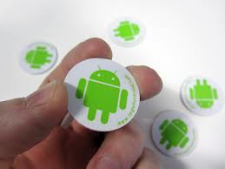
Use of NFC Tags
Android-compatible method for exchanging small pieces of data.
Convenient way to start and shutdown the system.
Re-programmable data storage.

Slide 10
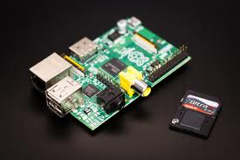
OBCU - Raspberry Pi
Advantages:
  Inexpensive
  Storage via SD Card
  Expandable via USB
    Bluetooth
On-Board Control Unit (OBCU)
Offloads sensor querying from phone.
Runs Linux distributions.
Powered by vehicle.

Slide 11
Smart Phone Components
FrogStar App
  User information
  Vehicle database
  NFC capability
  Technician mode
Networking Service
  Bluetooth
Sensor Service
  Computation engine
  Sensor querying

Slide 12
Database
  Entity-Relationship Model
  Schema

Slide 13
OBCU (Raspberry Pi) Components
Master program
Bluetooth server
  Smart phone communication
Bluetooth LE server
  General attributes (GATT)
  SensorTag querying
Computation engine

Slide 14
System Architecture

Slide 15
Key Requirements
  An NFC tag shall be used to hold network information – this tag may be scanned by a user to toggle the system on and off.
  The smart phone application shall collect its own accelerometer, gyroscope, and GPS readings to determine if there has been an accident.
  The OBCU shall query and collect the TI SensorTags’ readings to determine if there has been an accident.

Slide 16
Key Requirements (cont.)
  The smart phone shall respond to OBCU requests for accident detection.
  The OBCU shall respond to smart phone requests pertaining to system health and accident detection.
  Upon accident detection, the smart phone application shall give the user an option to confirm whether an accident has occurred.
  The smart phone shall alert the proper authorities in the event of an accident if the user confirms the accident or does not respond.

Slide 17
Accident Detection Sequence Diagram

Slide 18
Ask if Unharmed Sequence Diagram

Slide 19
State Diagram

Slide 20
Significant Issues & Solutions
Website browser compatibility
Android emulator
SensorTag documentation
Inter-device communication
  Wi-Fi Direct vs. Bluetooth
  Bluetooth Server – Python vs. C
Android database programming
Interprocess communication

Slide 21
Current Progress
Website
Project Support & Development Environment
Android training
Application UI
Vehicle database
NFC capability
Networking
Sensor querying

Slide 22
Iteration 3
Complete accident detection algorithms
Complete Android application
Begin of system testing

Slide 23
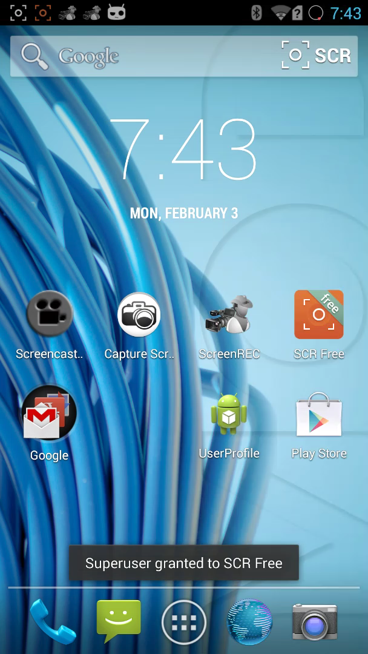
Demo

Slide 24
Questions?

